Slide 1
: Energy-Autonomous Always-On Cognitive & Attentive Cameras for Distributed Real-Time Vision with milliWatt Power Consumption
C gniVisi n
Quarterly meeting: 24/06/2021
Dr. Bharatha Kumar Thangarasu (speaker)
Prof. Yeo Kiat Seng (Co-PI)

Slide 2
Research Progress
Technical Contents – RFIC design
RFIC Sub-systems Design for Tapeout
Super regenerative Receiver
Transmitter frontend
Frequency locked loop
Power Management
Future work

Slide 3
Super regenerative receiver (SRR) - Progress
Current Progress:
Design and simulation of SRR receiver
Layout of individual circuit blocks and integration
Current issues:
The SRO is becoming unstable for longer simulation time.
Timing of Quench waveform is to be optimized.
On-going and Future works:
Post-layout simulations of building blocks and integration
Design for probe station and PCB testability

Slide 4
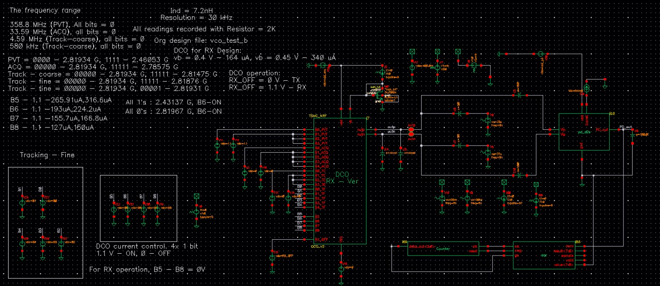
SRR test bench

Slide 5
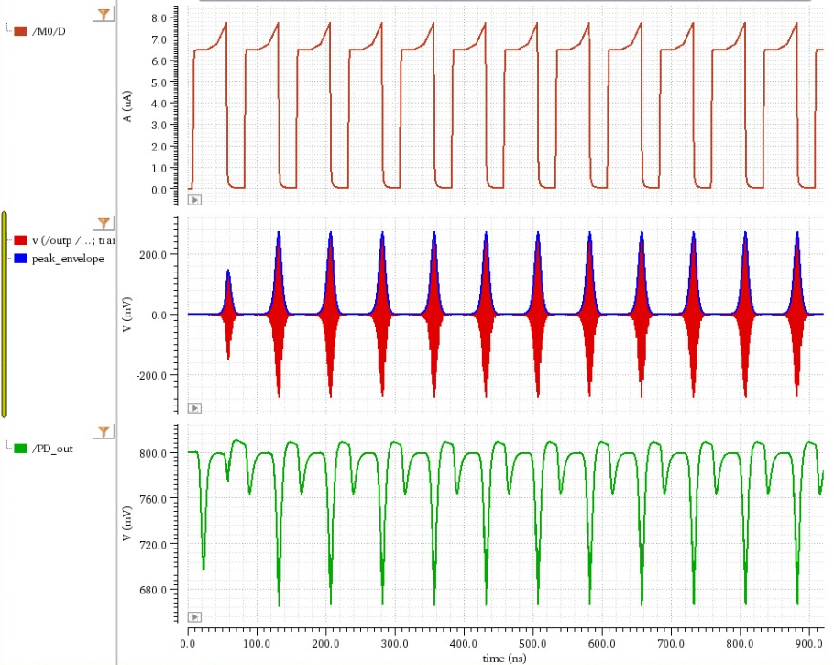
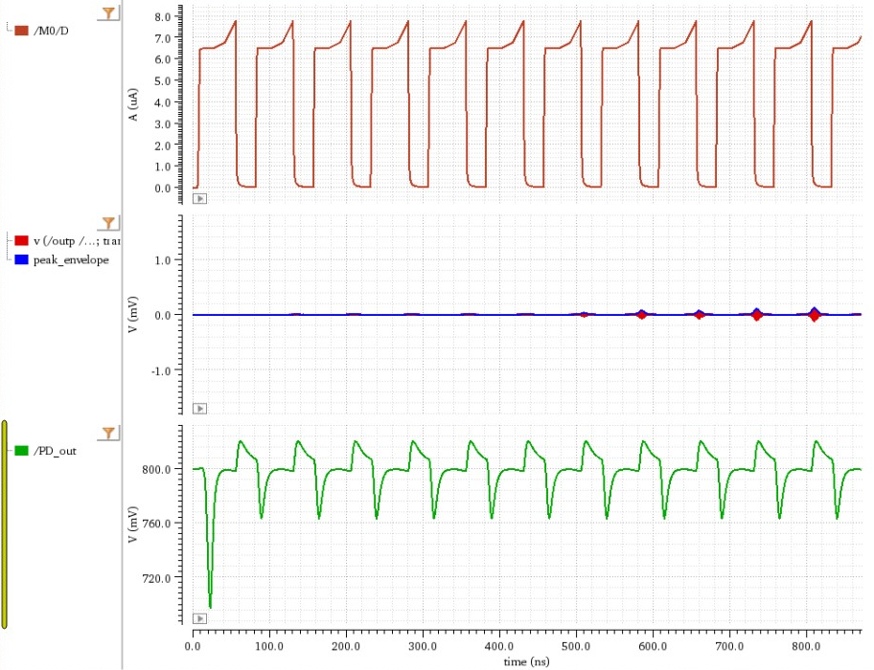
SRR simulation - result
Simulation with RF input data ‘1’ Simulation plot without RF input data ‘0’

Slide 6
SRR simulation test bench
Simulation is performed with all the design blocks in spectre view as well as SAR block in Verilog
The testbench includes,
Low noise amplifier
Super regenerative oscillator
Envelope Detector
SAR logic (Verilog)
Quench waveform generator
Simulations are set for the standard data rate condition
Parameter | Simulation
Frequency range | 2.4 to 2.5 GHz
Sensitivity | -82.6 dBm
Selectivity bandwidth | 15-MHz
Data rate** | 50kHz
Power consumption | 140µW
I/O return loss | < -15 dB
Unconditional stability | Yes
**Design supports till 6.4 Mbps in simulation

Slide 7
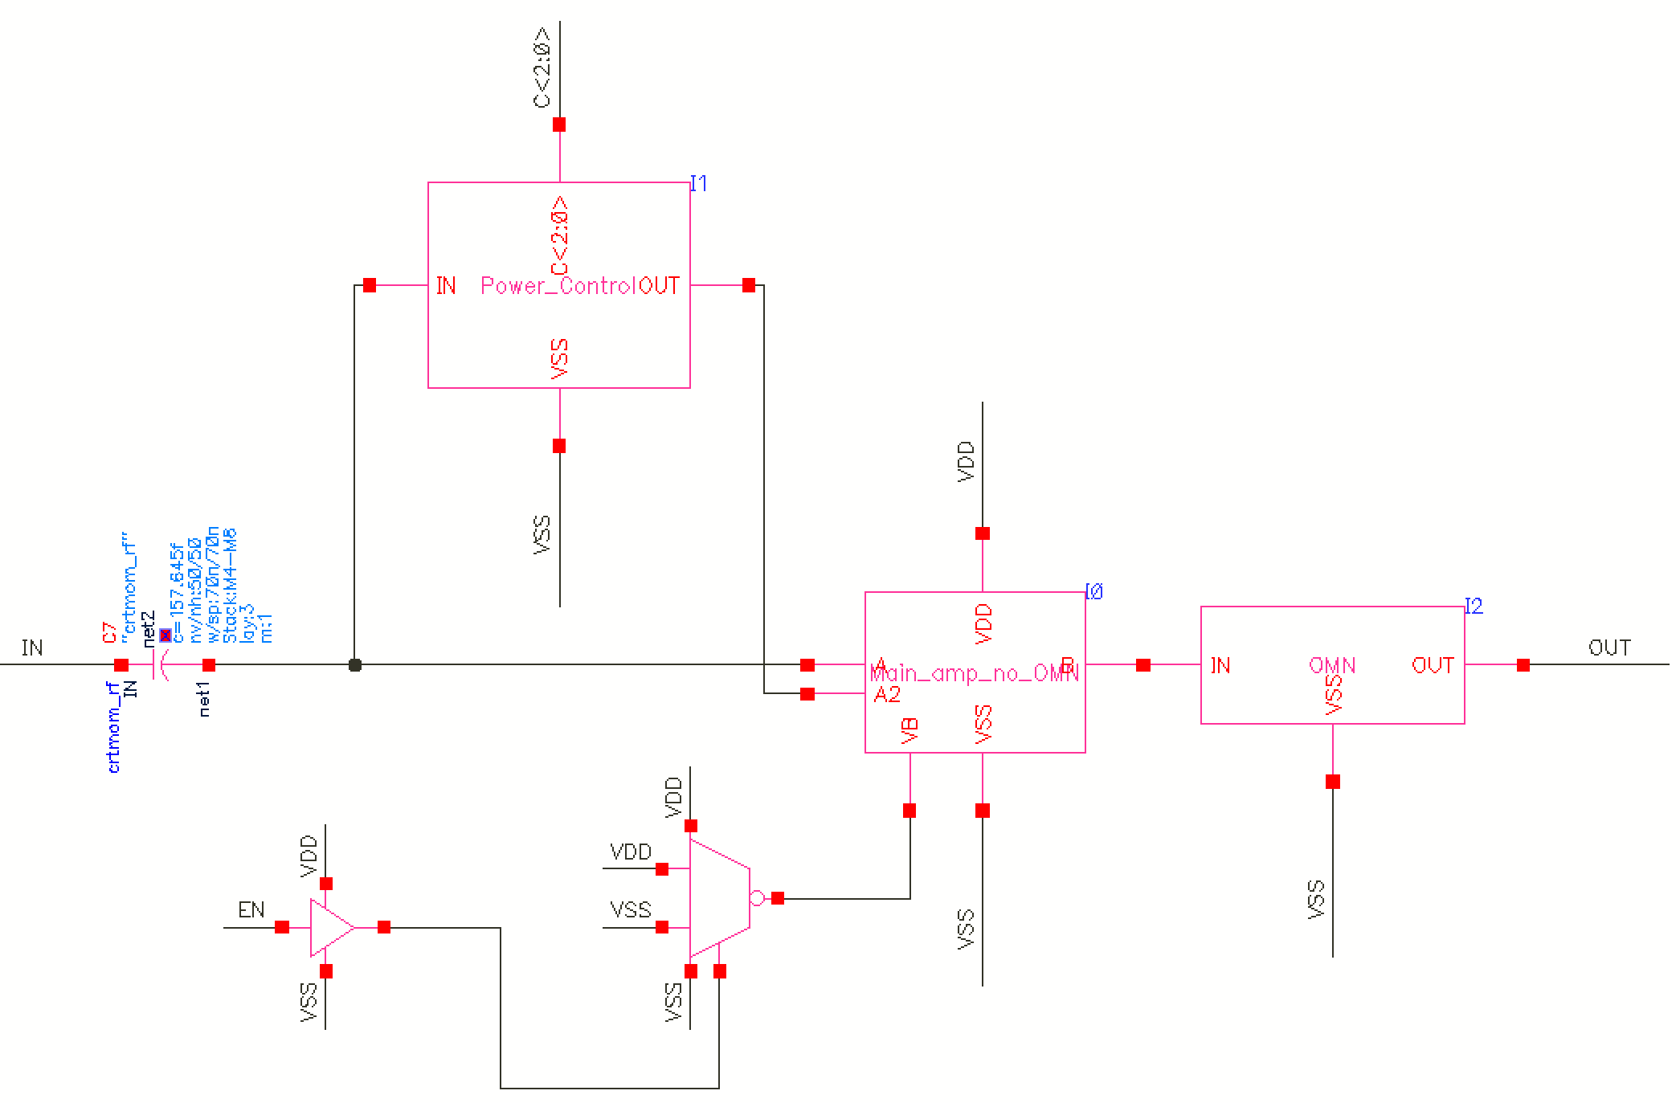
Transmitter - Schematic and Simulation Results
Overall Schematic
Block in blue boxes: Post layout
Max. Pout | Schematic | Postlayout
Pout (dBm) | -7.3 | -7.66
Power (uW) | 501.6 | 488.6
Efficiency (%) | 37.11 | 35.09
Min. Pout | Schematic | Postlayout
Pout (dBm) | -15.13 | -15.39
Power (uW) | 313.3 | 310
Efficiency (%) | 9.79 | 9.33
Standard cells

Slide 8
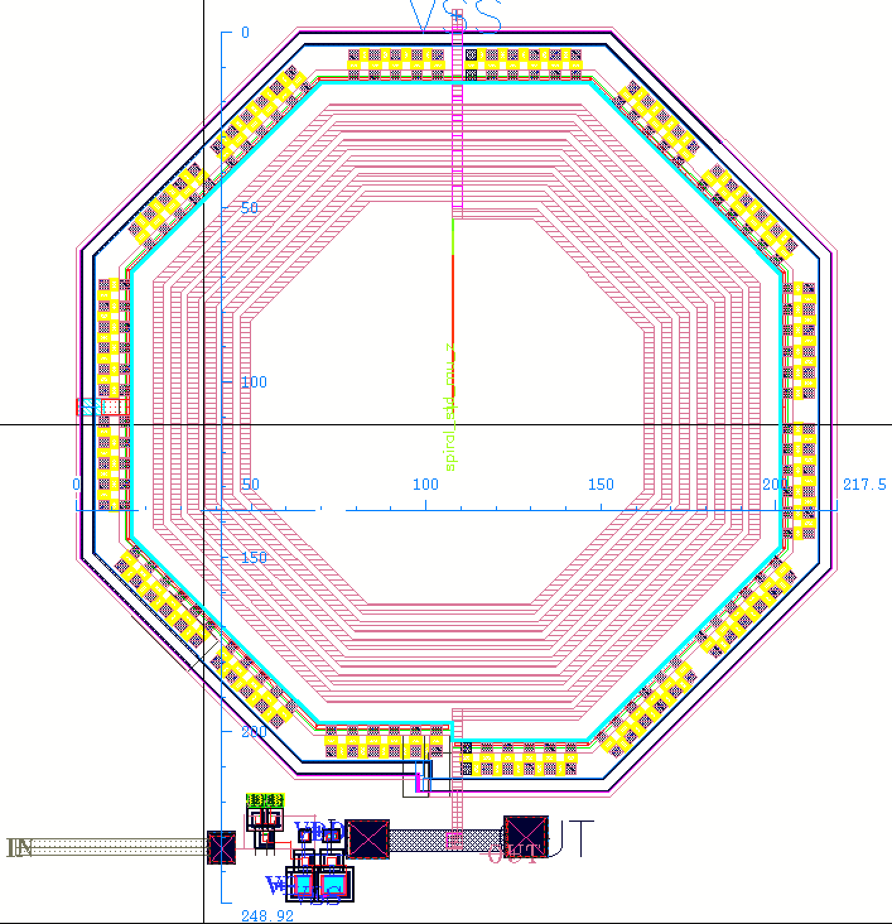
Transmitter - Layout and Future Works
Total size 220 X 250
To obtain the overall postlayout simulation results
Pads to be attached.
Tunability for OMN.

Slide 9
Frequency locked loop (FLL) - Progress
Current Progress:
Design and simulation of FLL loop
Layout of individual circuit blocks
Current issues:
The FLL loop simulation take a long time to converge. So, the simulations are split. Also, there are convergence issues in some cases. In such cases, the SAR clock speed in increased.
On-going and Future works:
Post-layout simulations
Integration of FLL loop
Design for testability

Slide 10
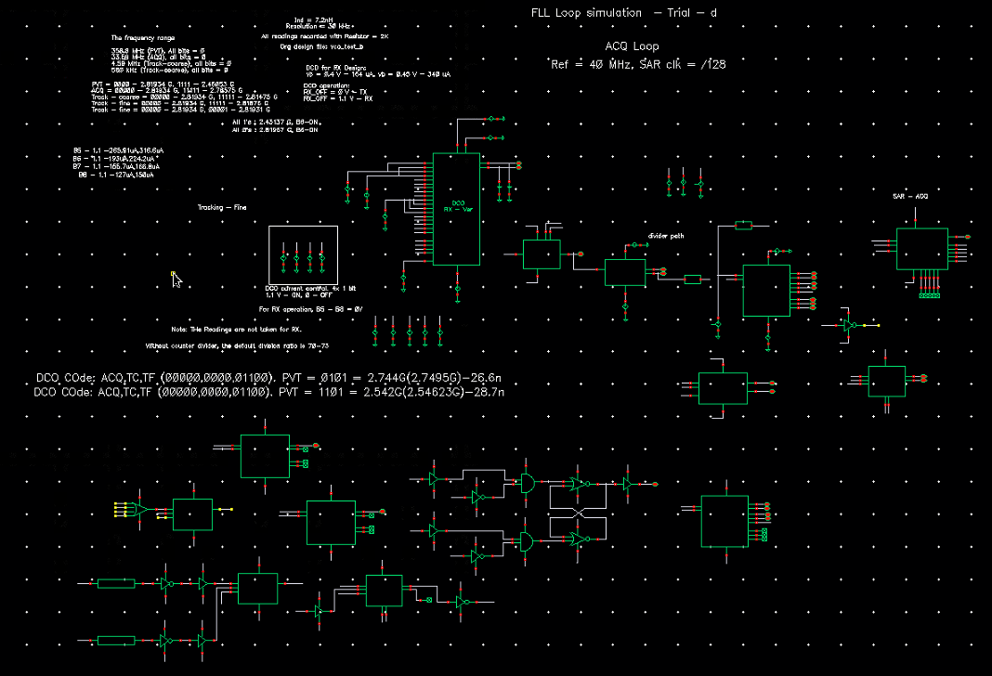
FLL test bench
Simulation is performed with all the design blocks
In some cases, to speed up the simulations, Verilog blocks are used
Shown is a typical test bench for one of the FLL loop locking
The TB consists of
DCO (circuit block)
Divider chain (Verilog)
SAR logic (circuit)
SAR control logic (circuit & Verilog)
Simulation is performed for a fixed DCO frequency with varied reference (note: DCO frequency is high in simulation)

Slide 11
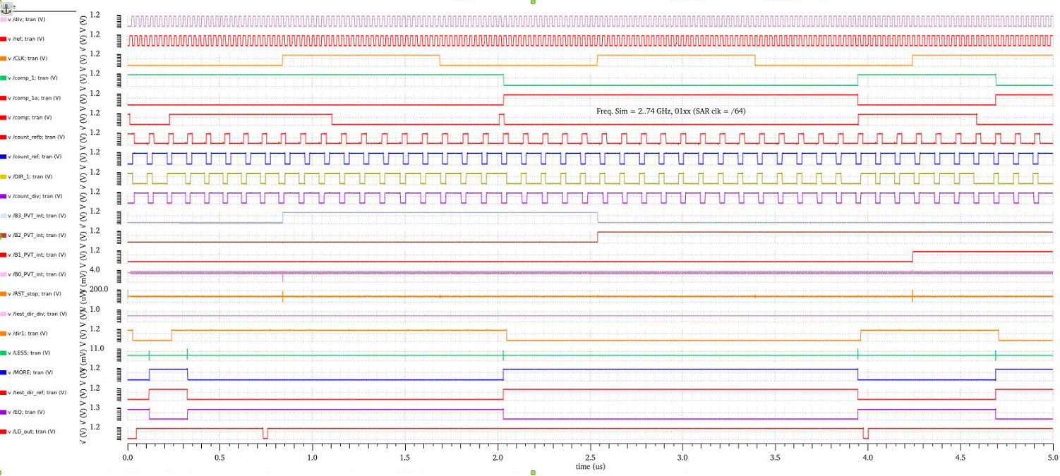
PVT Simulation – Freq = 2.74 GHz
Simulation is performed to check on the state change (B3 -0 to B2 -1)

Slide 12
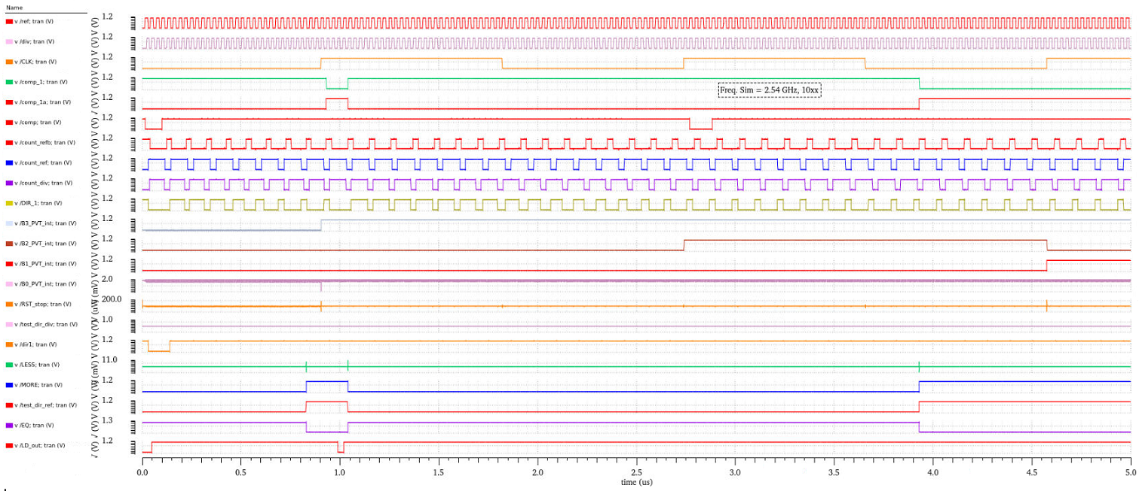
PVT Simulation – Freq = 2.54 GHz
Simulation is performed to check on the state change (B3 -1 to B2 -0)

Slide 13
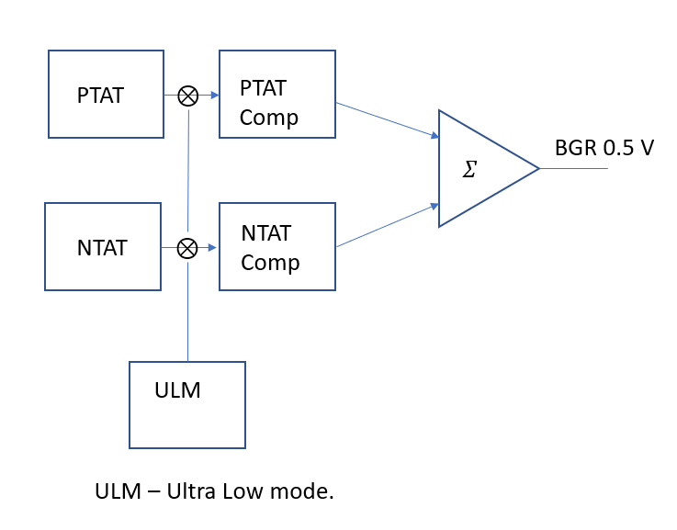
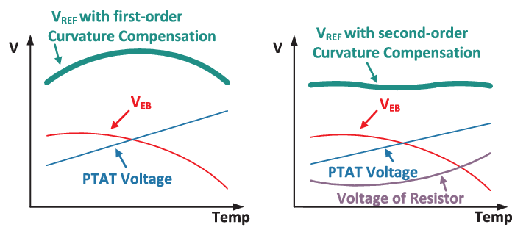
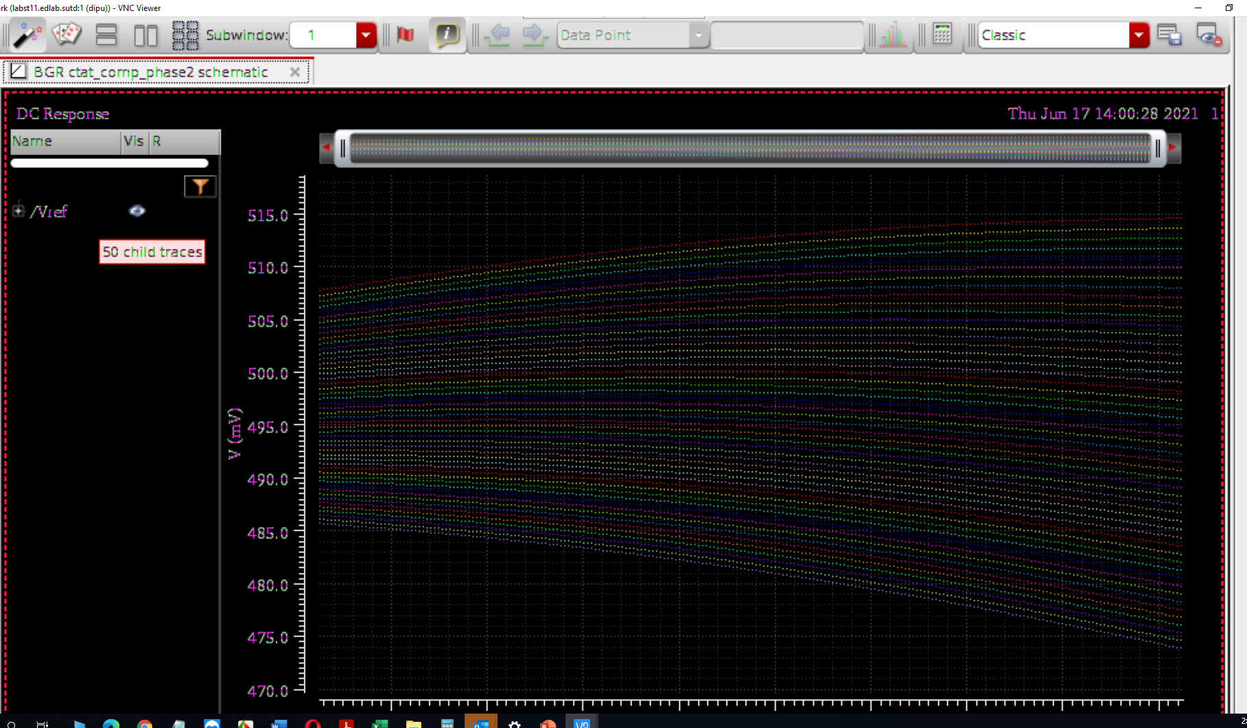
Power Management - Progress
Higher Order Compensated BGR
Dual Mode High Precession Bandgap Reference with Second-Order Curvature compensation topology for Energy Harvest Applications
Specification Curvature Compensation Topology
CMOS(um) | 40 nm (Normal Mode) | 40nm (Ultra Low Power Mode)
Vbg | 0.565 | 0.565
VCC | 0.9v-1.8V | 0.9-1.2
TC(ppm/C) | 19 ppm | 58 ppm
T min | -55 ̊ C | -55 ̊ C
T max | 125 ̊ C | 125 ̊ C
I (VDD) | 974nA | 124nA
PSRR (in db) | 67 | 61
Simulation results
Notes:
13

Slide 14
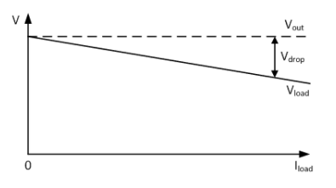
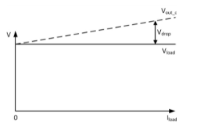
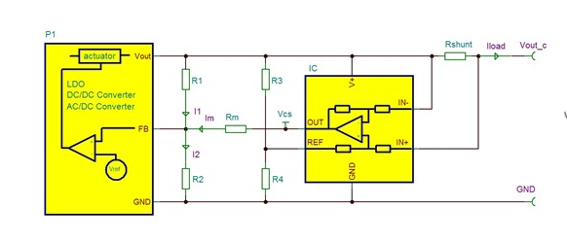
Research Progress-LDO
High power Programmable Dynamic Voltage Scaling Low Drop out Regulator with Droop compensation for RF Applications
Technical Specification
This LDO application is used for powering RF/Digital that have a wide operating voltage range: it is advantageous, to lower the operating voltage of the RF/Digital in order to achieve lower power consumption
CMOS(um) | 40 nm
VLDO | 0.7v-1.2v
VCC | 0.9v-1.8V
System Frequency | 6Mhz – 24Mhz
T min | -25 ̊ C
T max | 75 ̊ C
I Quiescent | Target < 35uA
Output Current | 500mA
After droop compensation
Before droop compensation
Status - Design optimization is On-going
Notes:
14

Slide 15
Future work
Post layout simulation and optimization – On-going
Tapeout submission (TSMC MPW Shuttle – 1st September 2021 deadline)

Slide 16
Tasks – RFIC design – Next Quarter
Testing and measurement arrangement
Design and fabrication of evaluation PCB

Slide 17
Clarifications needed
Slide is already sent to the team for discussion.

Slide 18
Thank you

Slide 19
< This slide is intentionally left blank>

Slide 20
Visibility
Summary of Project-Tracking_Template.xlsx
list of items in “Public materials” sheet
list of items in “Talks” sheet
list of items in “Videos” sheet
list of items in “News” sheet
list of items in “Press releases” sheet

Slide 21
Research Staff
Current research staff (PhD, PostDoc, Research Engineers, etc.)
list of Current Headcount in “Expenditures” sheet in “Project-Tracking_Template.xlsx”
… (PhD)
… (PostDoc/Research Fellow)
Past research staff (PhD, PostDoc, Research Engineers, etc.)
list of Past Headcount in “Expenditures” sheet in “Project-Tracking_Template.xlsx”

Slide 22
Publications – Journal papers
22
YEAR 2019
Nagarajan Mahalingam, Kaixue Ma and Kiat Seng Yeo, “A Multi-Mode Multi-Coil Coupled Tuned Inductive Peaking ILFD for Low Injected Power With Compact Size,” IEEE Access, vol.7, no.1, pp.59059-59068, Dec 2019.
Hang Liu, Xi Zhu, Muting Lu, Yichuang Sun, and Kiat Seng Yeo, “Design of Reconfigurable dB-Linear Variable-Gain Amplifier and Switchable-Order Gm-C Filter in 65-nm CMOS Technology,” IEEE Transactions on Microwave Theory and Techniques, vol.67, no.12, pp.5148-5158, Dec 2019. (IF = 3.756, Flagship journal in IEEE Microwave Theory and Techniques Society).
YEAR 2020
L. Kong, H. Liu, X. Zhu, C. C. Boon, C. Li, Z. Liu, K. S. Yeo, “Design of a wideband variable-gain amplifier with self-compensated transistor for accurate dB-linear characteristic in 65 nm CMOS technology,” IEEE Transactions on Circuits and Systems I - Regular Papers, vol.67, no.12, pp.4187-4198, Dec 2020.
Samuel B.S. Lee, Hang Liu, Kiat Seng Yeo, Jer-Ming Chen, Xiaopeng Yu, “Design of Differential Variable-Gain Transimpedance Amplifier in 0.18-µm SiGe BiCMOS,” MDPI/Electronics, Special Issue on Millimeter-Wave Integrated Circuits and Systems for 5G Applications, vol.9, no.7, pp.1058-1073, 27 June 2020. (Open Access Journal).
Jinna Yan, Hang Liu, Xi Zhu, Kai Men and Kiat Seng Yeo, “Ka-Band Marchand Balun with Edge and Broadside Coupled Configuration,” MDPI/Electronics, Special Issue on Millimeter-Wave Integrated Circuits and Systems for 5G Applications, vol.9, no.7, pp.1116-1124, 9 July 2020. (Open Access Journal) (Selected as the front cover page of MDPI/Electronics in July 2020).

Slide 23
Publications – Journal papers
23
Hang Liu, Xi Zhu, Yisheng Wang, Kai Men and Kiat Seng Yeo, “A 60 GHz 8-Way Combined Power Amplifier in 0.18 μm SiGe BiCMOS,” IEEE Transactions on Circuits and Systems – II: Express Briefs (TCAS II), 22 Dec 2020. DOI: 10.1109/TCSII.2020.3046512
Kai Men, Hang Liu and Kiat Seng Yeo, “Design of a Ka-Band U-Shaped Bandpass Filter with 20-GHz Bandwidth in 0.13-μm BiCMOS Technology,” MDPI/Electronics, Special Issue on Millimeter-Wave Integrated Circuits and Systems for 5G Applications, vol.9, no.10, pp.1608-1618, 1 Oct 2020. (Open Access Journal).
Zhichao Li, Shiheng Yang, Samuel B.S. Lee, Kiat Seng Yeo, “A Two-Stage X-Band 20.7-dBm Power Amplifier in 40-nm CMOS Technology,” MDPI/Electronics, Special Issue on Millimeter-Wave Integrated Circuits and Systems for 5G Applications, vol.9, no.12, pp.2198-2207, 20 Dec 2020. (Open Access Journal). (Selected as the front cover page of MDPI/Electronics in July 2021)
YEAR 2021
Chen Lang, Liu Hang, Jefferson Hora, Andrew Zhang, Yeo Kiat Seng and Xi Zhu, “Monolithically Integrated Single-Input Load-Modulated Balanced Amplifier with Enhanced Efficiency at Power Back-Off,” IEEE Journal of Solid-State Circuits, 14 Jan 2021. DOI: 10.1109/JSSC.2020.3048715

Slide 24
Publications - Conference papers
24
YEAR 2019
Hang Liu, Xi Zhu, Muting Lu and Kiat Seng Yeo, “Design of a Voltage-Controlled Programmable-Gain Amplifier in 65-nm CMOS Technology,” 2019 IEEE MTT-S International Microwave Symposium (IMS), 2-7 June 2019, Boston, Massachusetts, USA.
Samuel Bai Song Lee, Hang Liu, Xiaopeng Yu, Jer-Ming Chen, Kiat Seng Yeo, “An Inductorless 5-GHz Differential Dual Regulated Cross-Cascode Transimpedance Amplifier using 40 nm CMOS,” 2019 IEEE 13th International Conference on ASIC (ASICON), 29 Oct.-1 Nov. 2019, Chongqing, China.
B. S. Lee, H. Liu and K. S Yeo, "An inductorless 6-GHz variable gain differential transimpedance amplifier in 0.18-um SiGe BiCMOS," IEEE International Symposium on Circuits and Systems (ISCAS), Sapporo, Japan, May 2019.
YEAR 2020
Kiat Seng Yeo, Jinna Yan, Bharatha Kumar Thangarasu and Hang Liu, “Ku-Band Bidirectional Mixer with Directional Control,” 9th IEEE International Symposium on Next-Generation Electronics (IEEE ISNE 2020), 7-9 Nov 2020, Changsha, China (Invited Paper).
Boora Aasish, Bharatha Kumar and Yeo Kiat Seng, “An Ultra-Low Power 900 MHz Intermediate Frequency Low Noise Amplifier for Low-Power RF Receivers,” 33rd IEEE International System-On-Chip Conference (IEEE SOCC), Virtual Event, 8-11 Sep 2020 (acceptance rate: 34%).

Slide 25
Publications - Conference papers
25
Zhichao Li, Shiheng Yang, Hang Liu and Kiat Seng Yeo, “CMOS Transformer Design for X-band Power Amplifier Applications,” 2020 15th IEEE International Conference on Solid-State and Integrated Circuit Technology (ICSICT 2020), Nov 3-6, 2020, Kunming, China (Invited Paper).
Boora Aasish, Bharatha Kumar and Yeo Kiat Seng, “Ultra-Low Power Receiver Architecture with Enhanced Input Signal Swing for Improved Sensitivity,” 2020 13th UK-Europe-China Workshop on Millimetre-Waves and Terahertz Technologies (UCMMT), 29 Aug.-1 Sept. 2020 Tianjin, China.
YEAR 2021
Hang Liu, Xi Zhu, Yisheng Wang, Kai Men, Kiat Seng Yeo, “A 60 GHz Edge-Coupled 4-Way Balun Power Amplifier with 22.7dBm Output Power and 27.7% Peak Efficiency,” 2021 IEEE MTT-S International Microwave Symposium, 6-11 June 2021, Georgia World Congress Center, Atlanta, Georgia, USA.
Nagarajan Mahalingam, Yisheng Wang, Bharatha Kumar Thangarasu, Kiat Seng Yeo and Kaixue Ma, “A 24.6-32.5 GHz Millimeter-wave Frequency Synthesizer for 5G Wireless and 60 GHz Applications,” 2021 IEEE MTT-S International Microwave Symposium, 6-11 June 2021, Georgia World Congress Center, Atlanta, Georgia, USA.
Thurein Aung, Nagarajan Mahalingam and Kiat Seng Yeo, “A New Degeneration Technique for Low-voltage, Low-power, Triple-cascode Low Noise Amplifier in Millimeter Wave Applications,” IEEE 14th International Conference on ASIC (ASICON 2021), October 26-29, 2021, Wyndham Grand Plaza Royale Hotel, Kunming, China (Invited Paper).

Slide 26
Publications - Conference papers
26
Invited Talks
25-26 Oct 2019, Yeo KS, 2019 International Workshop on Advanced Chip Microsystems, “Device optimization and its application to design fully-integrated low-noise amplifiers for multi-standard communications”, Tianjin, China.
29 Oct-1 Nov 2019, Yeo KS, 13th IEEE International Conference on ASIC (ASICON 2019), “An inductorless 5-GHz differential dual regulated cross-cascode transimpedance amplifier using 40-nm CMOS for visible light communication”, Chongqing, China.
7 Nov 2020, Yeo KS, 2020 International Workshop on Microwave and Microsystems, “Design of voltage-controlled oscillators for 60-GHz wireless communication applications,” Tianjin, China.
Book
Kiat Seng Yeo, Chirn Chye Boon, Xiang Yi and Fanyi Meng, “CMOS Millimeter-Wave Integrated Circuits for Next Generation Wireless Communication Systems”, World Scientific Publishing (Singapore), International Edition, ISBN 978-981-120-260-5 (hardcover), 978-981-120-262-9 (ebook), July 2019.

Slide 27
Awards
27
List of External Awards for Research at International Level in “Evidence” sheet in “Project-Tracking_Template.xlsx”
… (accumulate over the years, highlight new in red)

Slide 28
Patents
List of Patents Disclosures/Filed/Granted/Commercialized in “Evidence” sheet in “Project-Tracking_Template.xlsx”
Invention disclosures: … (accumulate over the years, highlight new in red)
Patents filed: … (accumulate over the years, highlight new in red)
Patents granted: … (accumulate over the years, highlight new in red)
Patents commercialized: … (accumulate over the years, highlight new in red)

Slide 29
Demos/Public Materials
List of No. of TRL 4/6 Prototypes in “Evidence” sheet in “Project-Tracking_Template.xlsx”
Links to demos: … (accumulate over the years, highlight new in red)
Links to public materials (e.g., GitHub): … (accumulate over the years, highlight new in red)

Slide 30
Talks, Videos, News, Press
List of items in “Project-Tracking_Template.xlsx”
Public materials sheet: … (accumulate over the years, highlight new in red)
Talks sheet: … (accumulate over the years, highlight new in red)
Videos sheet: … (accumulate over the years, highlight new in red)
News sheet: … (accumulate over the years, highlight new in red)
Press releases sheet: … (accumulate over the years, highlight new in red)

Slide 31
Notes and Suggestions
… (anything that can help progress or do things better)
…

