Slide 1








: Energy-Autonomous
Always-On Cognitive & Attentive Cameras for Distributed Real-Time Vision with milliWatt Power Consumption
C gniVisi n
Quarterly meeting: 26/02/2021
Dr. Bharatha Kumar Thangarasu (speaker)
Prof. Yeo Kiat Seng (Co-PI)

Slide 2
Research Progress
Technical Contents – RFIC design
  Proposed single chip Transceiver system RFIC
  RFIC Sub-systems Design
  Clarifications needed
  List of Publications

Slide 3
Proposed Single-Chip Transceiver RFIC
Single-chip SoC integrated with digital baseband
*SRO: Super-Regenerative Oscillator
*MN: Matching Network
*ED: Envelope Detector
*DPA: Digital Power Amplifier
*WuRX: Wake-up Receiver

Slide 4
Proposed Single-Chip Transceiver RFIC
 | Transmitter | Receiver
Power Consumption | < 500 μW Including oscillator and baseband | < 150 μW Including oscillator and baseband
Feature | DPA (No standby power consumption) | Aux. WuRX ➔ low standby power
Antenna Gain | 0 dBi | 0 dBi
RF signal level | ≥ -15 dBm | ≤ -82 dBm
Modulation | On-Off Keying (OOK)
Distance | ≥ 20 m
Data rate | 50 kbps till 5 Mbps
Structure | DPA controlled by digital codes | SRO and ED with WuRX

Slide 5
Super-regenerative oscillator receiver design
Proposed SRO receiver includes,
  Input low noise amplifier (LNA) for improving SNR
  SRO will be implemented using the digital control oscillator in the all-digital FLL based frequency synthesizer for ultra-low power consumption and compact design
  The quench waveform controller also will include the options for wake-up receiver control, and the adjustable data-rate control sampling of the received data to ensure optimum power consumption.
  Envelope detector (ED), low pass filter (LPF), variable gain amplifier (VGA), comparator, etc.

Slide 6
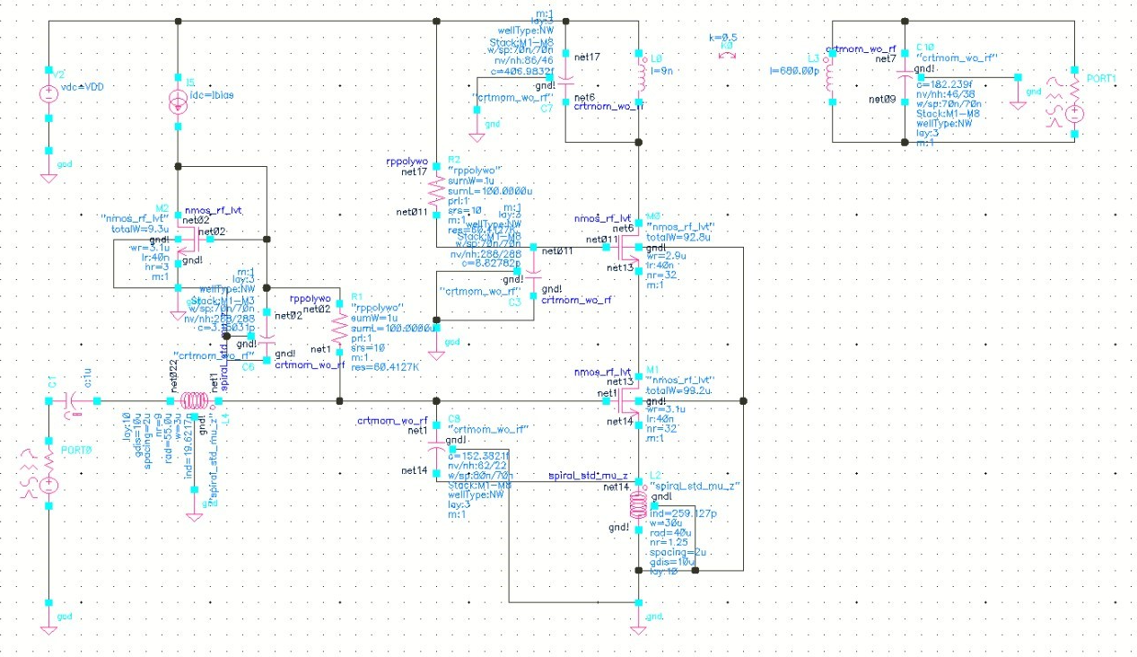
SRO receiver - LNA design
LNA operating at 2.4 GHz
Based on inductive degeneration and transformer coupled load
Performance limitation is from the input inductor size and Q-factor

Slide 7
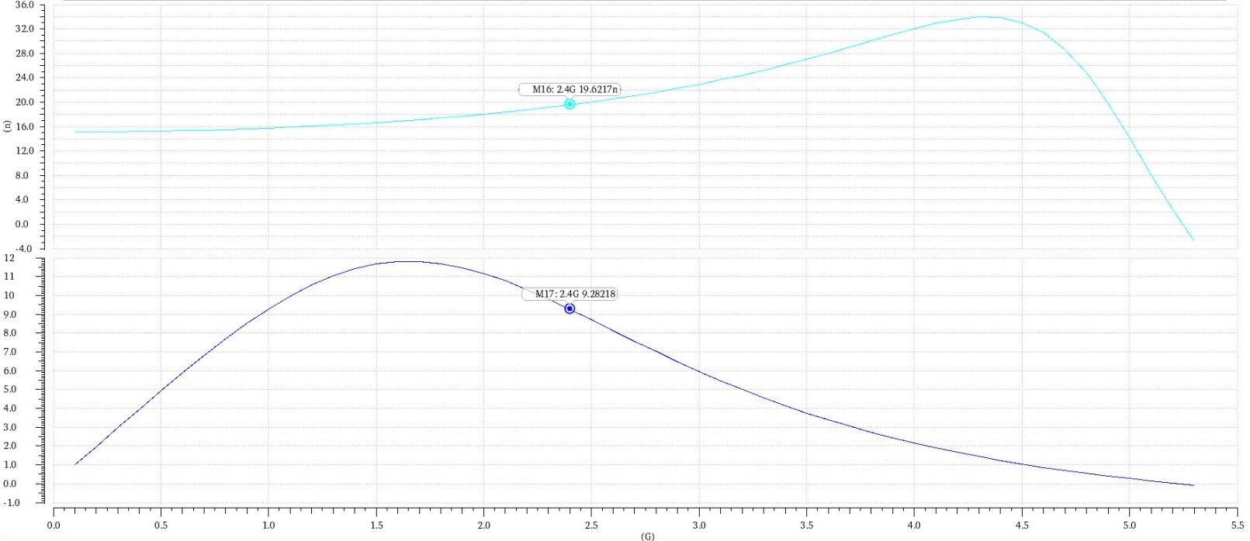
LNA design – PDK components
Limitation is on the input inductor value ~19nH
And Q-factor of 9.2 at 2.4 GHz frequency
Inductance (nH)
Q-factor
Frequency (GHz)

Slide 8
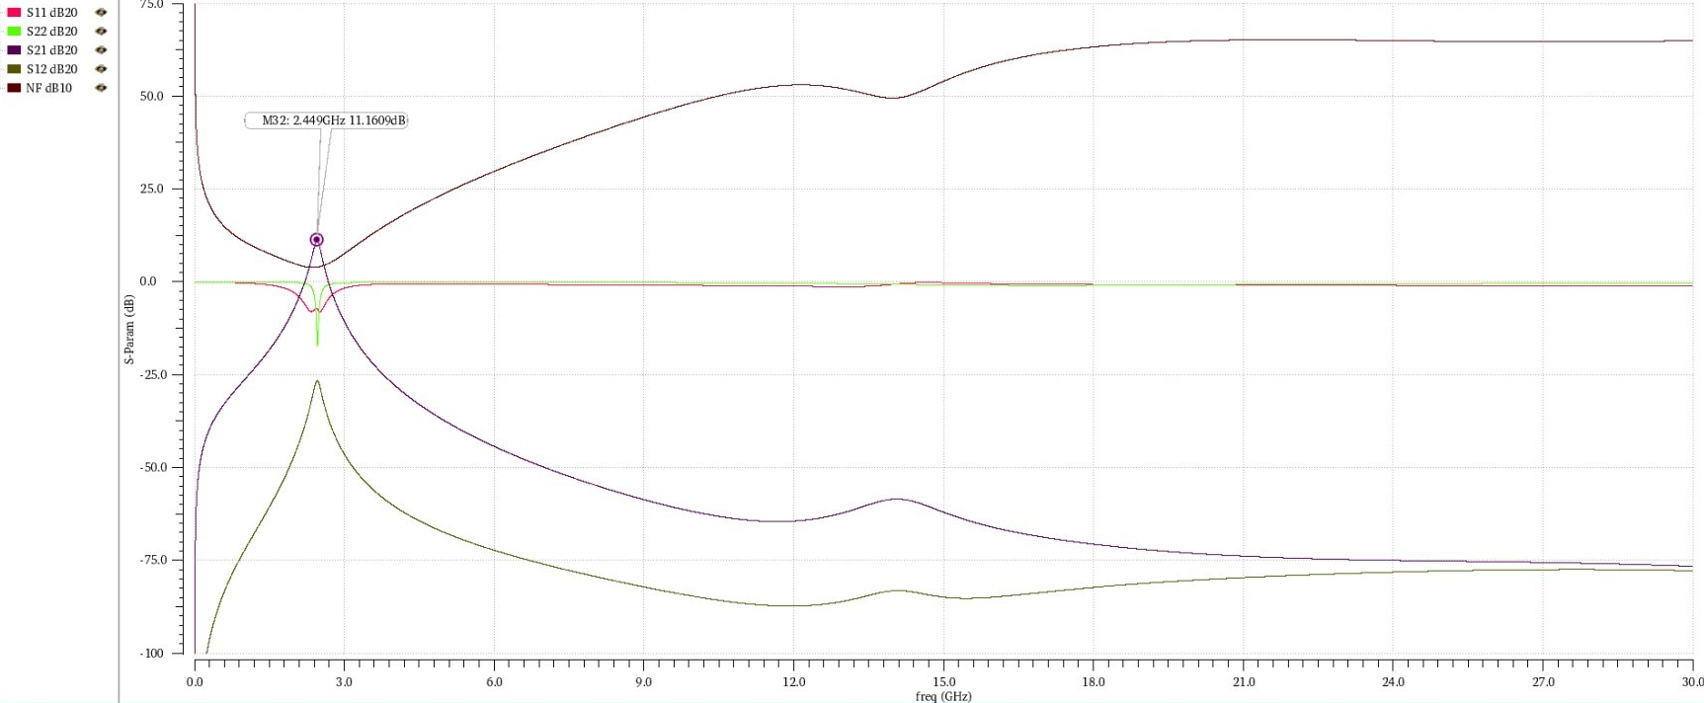
LNA design – PDK components
S-parameters and Noise Figure (NF) simulated till 30-GHz to check for any undesired spurs/oscillations

Slide 9
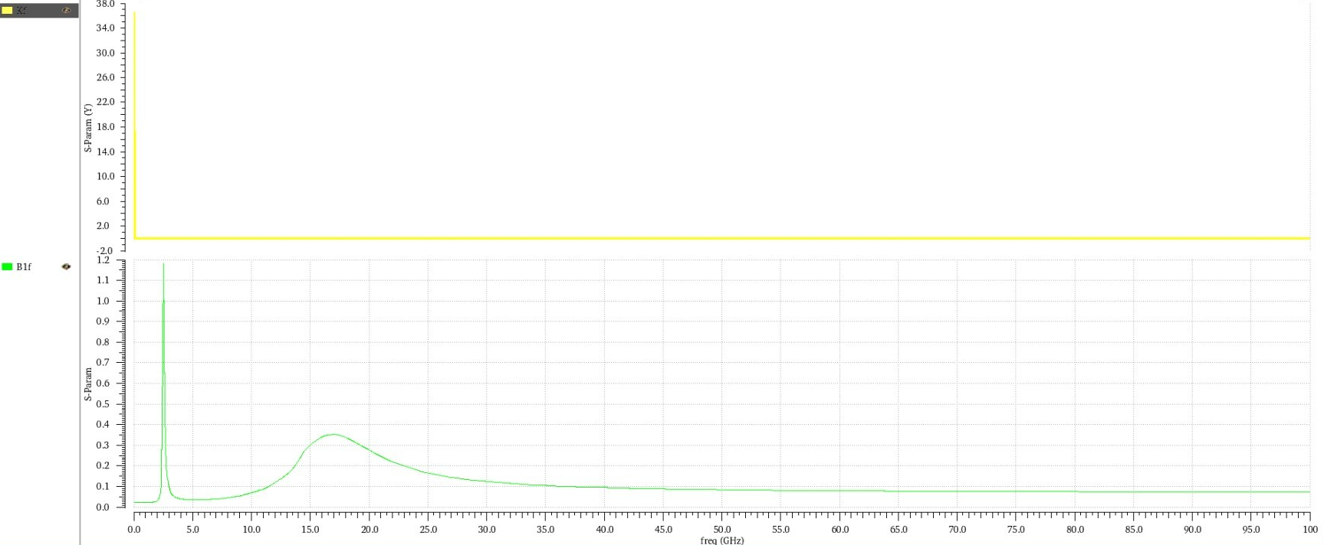
LNA design – PDK components
B1f > 0, K1f > 2.3 – Unconditionally stable till 100GHz

Slide 10
LNA design – 2.4-GHz - Specification
Parameter | Specification | Simulation
Frequency range | 2.4 to 2.5 GHz | 2.4 to 2.5 GHz
Gain | > 10 dB | 11.1
Bandwidth | > 5-MHz | 100 MHz
Power consumption | < 100 µW (= for Rx) | 142 µW
NF | < 5 dB | 4.2 dB
I/O return loss | < -15 dB | < -15 dB
Unconditional stability | Yes | Yes
- Working on techniques to reduce power consumption < 100µW without significantly affecting the performance

Slide 11
Features of DCO Design
Negative gm topology for reduced current
Resistor Tunable current source for VCO switching and phase noise performance
Small Frequency resolution = 30 kHz / LSB
Binary capacitor bank implementation
PVT Bank = 4 bits ; Frequency coverage = 358.81 MHz (Required is 80 MHz)
Acquisition bank = 5 bits; Frequency coverage = 33.59 MHz
Tracking Bank : coarse and Fine.
  Coarse = 4 bits; Frequency coverage = 4.59 MHz
  Fine = 5 bits; Frequency coverage = 580 kHz
Overlap bands to cover process variations

Slide 12
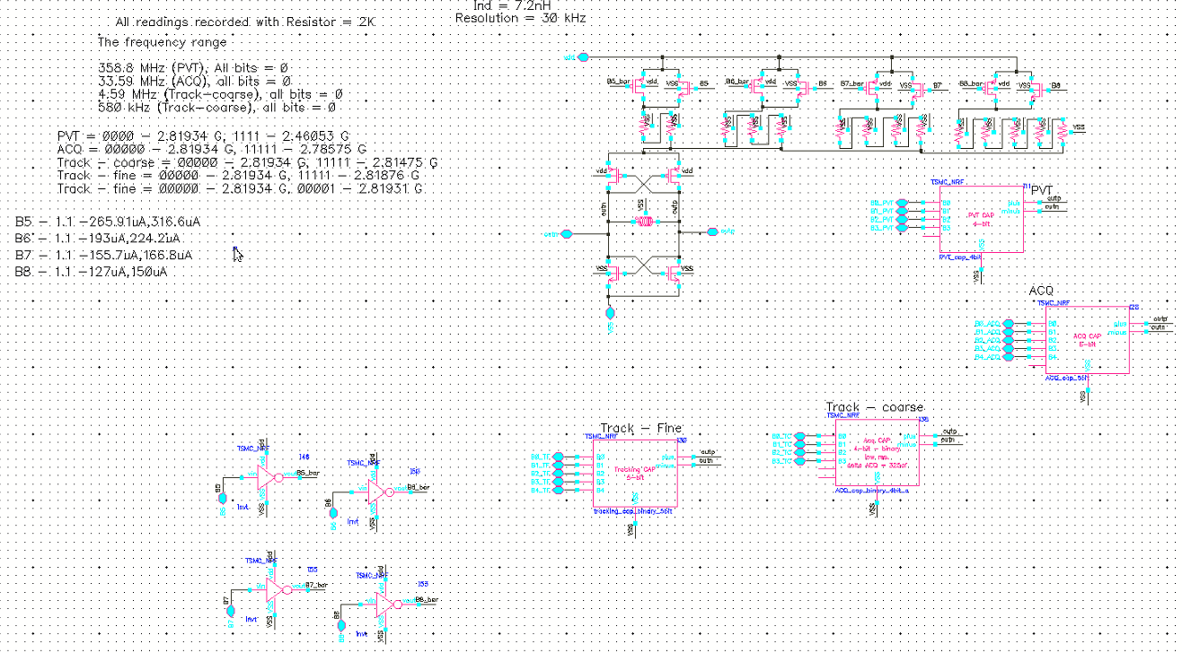
Proposed DCO Design

Slide 13
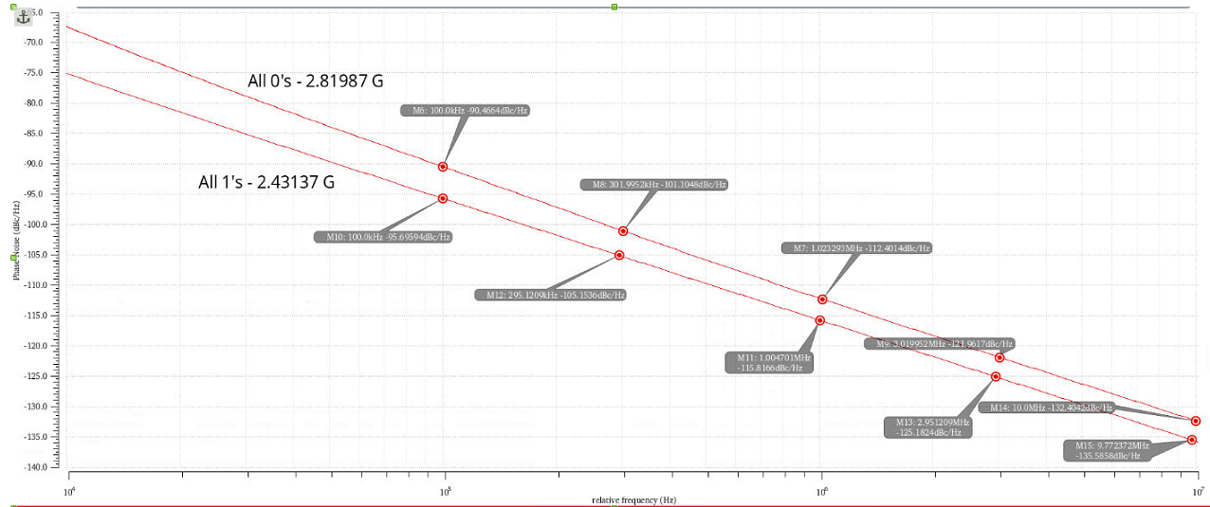
DCO Phase noise simulation
Average phase noise < -110 dBc/Hz @ 1 MHz offset

Slide 14
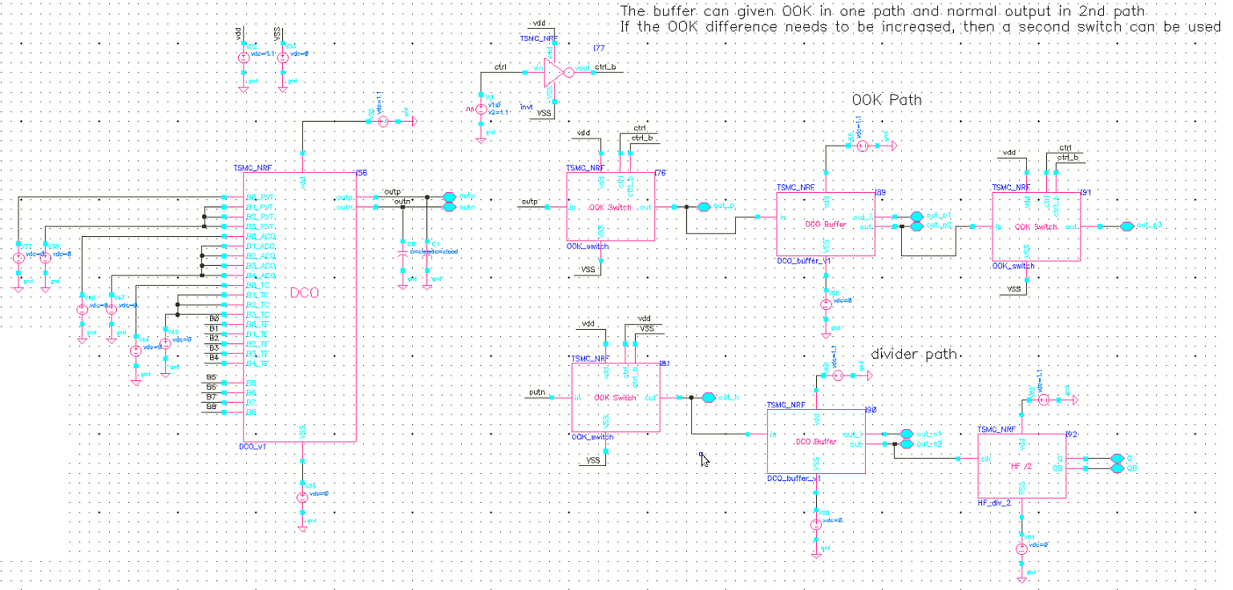
Proposed FLL – HF Loop

Slide 15
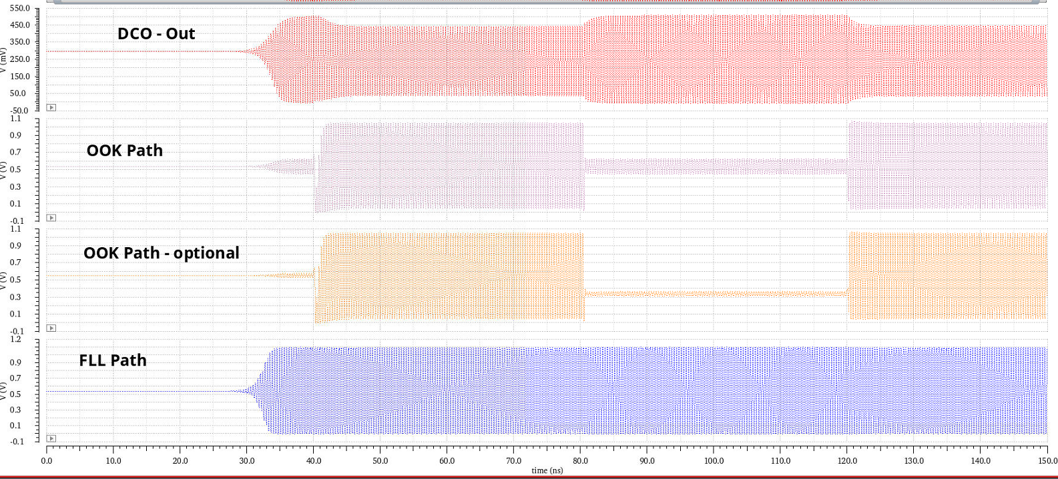
Proposed FLL – HF Loop simulation

Slide 16
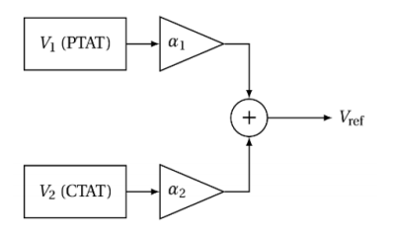


Research Progress - BGR
High precision Bandgap Reference with second-order curvature compensation topology for Energy Harvest Applications
Technical Specification
Technology | 40nm CMOS
Vbg | 0.7 V
VCC | 0.9 - 1.2 V
TC(ppm/C) | Target < 1
Tmin | -25 ̊ C
Tmax | 85 ̊ C
I (VDD) | Target < 50nA
PSRR | -90 dB
V_{BE} equation
Vref Equation after PTAT + CTAT
16
Notes:
16

Slide 17
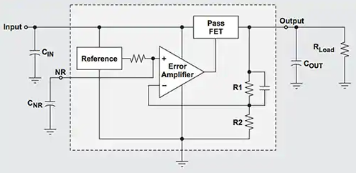
Research Progress-LDO
High power Programmable Dynamic Voltage Scaling Low Drop out Regulator with Droop compensation for RF Applications
Technical Specification
This LDO application is used for powering RF/Digital that have a wide operating voltage range: it is advantageous, to lower the operating voltage of the RF/Digital in order to achieve lower power consumption
Technology | 40nm CMOS
VLDO | 0.7 - 1.2 V
VCC | 0.9 - 1.8 V
System Frequency | 6 – 24 MHz
Tmin | -25 ̊ C
Tmax | 85 ̊ C
I_{Quiescent} | Target < 35µA
Output Current | 500 mA
17
Notes:
17

Slide 18
Future work
Continue design of LNA optimization and then to interface with DCO as SRO
To start design of other blocks – VGA, Comparator/ADC, etc.
FLL loop design and simulation
Design of DCO with reduced frequency resolution (optional after post layout simulation)
Transmitter chain will be optimized by co-simulation with DCO output
To design the power management building blocks
Reduction of overall power consumption

Slide 19
Tasks – RFIC design – Next Quarter
RFIC building blocks design, optimization, simulation, layout and Post-layout simulations
Sub-systems (RX, TX, PLL and PM) integration - design and layout, Post-layout simulations

Slide 20
Clarifications needed
Common TSMC PDK option between RFIC and Baseband
  Euro-practice suggested that for Digital design portion to utilise the Digital libraries under “CMN40RC41001/40 nm, CMOS Mixed Signal RF (MSRF) Low Power Non RPO2 ELK Cu, 1P10M, SALICIDE, 1.1/2.5V”.
Reference frequency, can be 5 MHz
Baseband implementation and interface requirements from Radio,
  Interface for both Receiver and Transmitter to Baseband will be Serial data
  To have interference rejection by other 2.4 GHz sources, a Data header addressing key coding/decoding is needed
  To support reconfiguration of the RF Radio such as Receiver modes – Sleep, Normal data rate (≤ 50kbps) and Burst mode (≤ 5Mbps), Frequency synthesizer channel selection, etc., an interface from Baseband using Serial-Peripheral Interface (SPI) will be needed
  Receiver SNR at Baseband = 5dB

Slide 21
< This slide is intentionally left blank>

Slide 22
Publications
International Journal Papers
  Jinna Yan, Hang Liu, Xi Zhu, Kai Men and Kiat Seng Yeo, “Ka-Band Marchand Balun with Edge and Broadside Coupled Configuration,” MDPI/Electronics, vol.9, no.7, pp.1116-1124, 9 July 2020. (Open Access Journal)
  Zhichao Li, Shiheng Yang, Samuel B.S. Lee, Kiat Seng Yeo, “A Two-Stage X-Band 20.7-dBm Power Amplifier in 40-nm CMOS Technology,” MDPI/Electronics, vol.9, no.12, pp.2198-2207, 20 Dec 2020. (Open Access Journal).

Slide 23
Publications
International Conference Papers
  Zhichao Li, Shiheng Yang, Hang Liu and Kiat Seng Yeo, “CMOS Transformer Design for X-band Power Amplifier Applications,” 2020 15th IEEE International Conference on Solid-State and Integrated Circuit Technology (ICSICT 2020), Nov 3-6, 2020, Kunming, China.
  Boora Aasish, Bharatha Kumar and Yeo Kiat Seng, “Ultra-Low Power Receiver Architecture with Enhanced Input Signal Swing for Improved Sensitivity,” 2020 13th UK-Europe-China Workshop on Millimetre-Waves and Terahertz Technologies (UCMMT), 29 Aug.-1 Sept. 2020 Tianjin, China.
  Boora Aasish, Bharatha Kumar and Yeo Kiat Seng, “An Ultra-Low Power 900 MHz Intermediate Frequency Low Noise Amplifier for Low-Power RF Receivers,” 33rd IEEE International System-On-Chip Conference (IEEE SOCC), 8-11 Sep 2020 (acceptance rate: 34%)
  Kiat Seng Yeo, Jinna Yan, Bharatha Kumar Thangarasu and Hang Liu, “Ku-Band Bidirectional Mixer with Directional Control,” 9th IEEE International Symposium on Next-Generation Electronics (IEEE ISNE 2020), 7-9 Nov 2020, Changsha, China.

Slide 24
Thank you

Slide 25
< This slide is intentionally left blank>

Slide 26
Visibility
Summary of Project-Tracking_Template.xlsx
  list of items in “Public materials” sheet
  list of items in “Talks” sheet
  list of items in “Videos” sheet
  list of items in “News” sheet
  list of items in “Press releases” sheet

Slide 27
Research Staff
Current research staff (PhD, PostDoc, Research Engineers, etc.)
  list of Current Headcount in “Expenditures” sheet in “Project-Tracking_Template.xlsx”
  … (PhD)
  … (PostDoc/Research Fellow)
Past research staff (PhD, PostDoc, Research Engineers, etc.)
  list of Past Headcount in “Expenditures” sheet in “Project-Tracking_Template.xlsx”

Slide 28
Publications
List of Papers published in International Journals in “Evidence” sheet in “Project-Tracking_Template.xlsx”
  … (accumulate over the years, highlight new in red)
List of Presentations at International Conferences in “Evidence” sheet in “Project-Tracking_Template.xlsx”
  … (accumulate over the years, highlight new in red)

Slide 29
Awards
List of External Awards for Research at International Level in “Evidence” sheet in “Project-Tracking_Template.xlsx”
  … (accumulate over the years, highlight new in red)

Slide 30
Patents
List of Patents Disclosures/Filed/Granted/Commercialized in “Evidence” sheet in “Project-Tracking_Template.xlsx”
  Invention disclosures: … (accumulate over the years, highlight new in red)
  Patents filed: … (accumulate over the years, highlight new in red)
  Patents granted: … (accumulate over the years, highlight new in red)
  Patents commercialized: … (accumulate over the years, highlight new in red)

Slide 31
Demos/Public Materials
List of No. of TRL 4/6 Prototypes in “Evidence” sheet in “Project-Tracking_Template.xlsx”
  Links to demos: … (accumulate over the years, highlight new in red)
  Links to public materials (e.g., GitHub): … (accumulate over the years, highlight new in red)

Slide 32
Talks, Videos, News, Press
List of items in “Project-Tracking_Template.xlsx”
  Public materials sheet: … (accumulate over the years, highlight new in red)
  Talks sheet: … (accumulate over the years, highlight new in red)
  Videos sheet: … (accumulate over the years, highlight new in red)
  News sheet: … (accumulate over the years, highlight new in red)
  Press releases sheet: … (accumulate over the years, highlight new in red)

Slide 33
Notes and Suggestions
… (anything that can help progress or do things better)
  …

