Slide 1








: Energy-Autonomous
Always-On Cognitive & Attentive Cameras for Distributed Real-Time Vision with milliWatt Power Consumption
C gniVisi n
Quarterly meeting: Feb 26, 2021
Prof. Massimo Alioto

Slide 2
Outline
Research Progress
Objectives/Deliverables
Visibility
Research Staff
Publications
Awards
Patents
Demos/Public Materials
Talks, Videos, News, Press
Notes and Suggestions

Slide 3


: Energy-Autonomous
Always-On Cognitive & Attentive Cameras for Distributed Real-Time Vision with milliWatt Power Consumption
C gniVisi n
Quarterly meeting: (26/02/2021)
Japesh Vohra

Slide 4
Outline
Imager with Saliency Detection
  Minutes of last meeting
  Design Updates for Saliency Detection
  Design Updates for Peripheral Circuits and Future Work

Slide 5
Imager with Saliency Detection
Detecting saliency early (before conversion) in an imager can reduce the amount of data processed significantly (5% of the entire data).
Saliency detection is done using background subtraction which can be implemented using simple circuits enabling in-pixel saliency detection.
Minutes of last meetings:
The input image is subsampled through spatial averaging to limit the amount of processing and memory (analog) required for saliency detection.
Background Subtraction is carried out within a tile and the Long-term average (background) value is updated to keep track of the changing background.
Morphological Image Closing is performed on initial saliency values detected by background subtraction to improve the performance of saliency detection.
CDS architecture was improved to limit the circuitry and signals required along with lowering the energy consumption.
A SS-ADC was introduced which exploits the spatial correlation in the image data by implementing differential sampling in a novel manner in single-slope ADCs.

Slide 6
Design Updates for Saliency Detection
Circuit level improvements were implemented in the following in-pixel components for saliency detection:
  A pre-amplifier was included before latch comparator which enabled offset cancellation and user-defined offset injection to allow a more accurate and flexible background subtraction operation.
  Low leakage and Low charge injection switches were designed to improve the performance of the analog memory circuit.
  Integration of the designed in-pixel components has been carried out and tested and some design changes can be further incorporated to decrease the effect of charge injection and leakage.

Slide 7
Peripheral Circuits and Future Work
A digital controller has been proposed which operates on a low frequency divided clock signal for a constant operation and a gated high frequency on-chip clock with a low activity factor for generating high frequency signals required by the image sensor block.
CDS architecture has been modified to support a completely passive readout without requiring another source follower before ADC which removes the FPN of the source follower.
In-Pixel comparator has been modified to tolerate an offset of 40 mV at an 8-bit resolution and can be used with minimal changes for the proposed differential single slope ADC architecture
Future Work:
Post-Layout Simulations for the In-Pixel design
Integrating the periphery circuits (CDS and SS-ADCs)
Integration of the Imager block and periphery circuits with digital control block
Integrating the Testing components (Scan chains and analog buffers)
Post-Layout simulations and verification of the complete system

Slide 8
Smart Imager
C gniVisi n
Quarterly meeting: (26.02.2022)
Udara Samurdhi Harshanga Kalingage

Slide 9
Outline
Overview
Design updates

Slide 10
Overview
Smart Imager
QVGA – 320 X 240
Technology node: TSMC 40nm low power silicide process
Power supply – 1.6V, 0.8V
Frame rate – 30 fps
FOM target – sub pJ/pixel/frame
Digital controller + row drivers
CDS + Ramp generator+ADC
+scan chain
Pixel array + Saliency detection circuit
Test pixel array + OTA buffers
Padring+sealring

Slide 11
Design updates
Tasks
  Integration of the blocks
  Test circuit design and placement
  Schematic level and post layout verification of integrated blocks and making improvements where necessary
  Behavioral verification of digital blocks like scan chain pre-integration
  Custom row driver design including level shifters and buffers
Future work
  Padring design, tapeout and characterization of the imager

Slide 12
: Energy-Autonomous
Always-On Cognitive & Attentive Cameras for Distributed Real-Time Vision with milliWatt Power Consumption
C gniVisi n
Quarterly meeting: 26/02/2020
Udari De Alwis

Slide 13
Outline
Methodology
Testing and Results

Slide 14
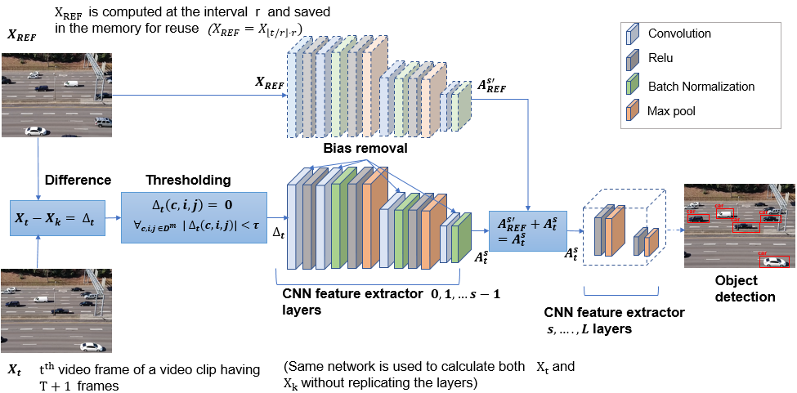
Methodology
TempDiff: Temporal Difference-Based Feature Map-Level Sparsity Induction in CNNs
TempDiff was evaluated through CAMEL video dataset on VGG16-Single Shot Detector (SSD(VGG16)) and YOLOv1 with VGG16 backbone (YOLOv1(VGG16)

Slide 15
Testing and Results
Comparison with Prior Art: Algorithm-Level Results (AD=Accuracy drop, CR=Computation reduction, MO=Memory Overhead)
Method | Neural network | Dataset | CR | AD | MR
RRM | SSD(VGG16) | MERL | 22.0% | -- | N/A
PaD | SSD(VGG16) | ImageNet VID | 25% | 1.10% | N/A
This work | SSD(VGG16) | CAMEL moderately fast videos (all) | 32.5% (35.8%) | 6.83% (12.1%) | 3.18%
ToDo | YOLO | Video from USBcamera | 17% | 7% | N/A
CBInfer | YOLOv3 | Trafffic surveilance | 80% | MSE 0-0.4 | 58%
This work | YOLOv1 (VGG16) | CAMEL (all) | 18.3% | 3.75% | 3.28%
Activation Pruning | Faster RCNN | KITTI (8 seq.) | 57.2% | 6.7% | N/A
Comparison with Prior Art on Sparsity-Aware SIGMA Architecture (CI=Compute Time Improvement, EI=Energy Improvement)
Method | Network | Accelerator | CI | EI
RRM | VGG16 | EIE | 24-36% | N/A
Activation Pruning | FRCNN (Resnet50) | SIGMA | 79.8% | 57.2%
This work | SSD(VGG16) | SIGMA | 40.2% | 54.8%
This work | YOLOv1(VGG16) | SIGMA | 27.3% | 32.0%

Slide 16
Ultra Low Power Imager with Dynamic LSB
C gniVisi n
Quarterly meeting: (26.02.2022)
Karim Ali Ahmed

Slide 17
Ultra Low Power Image Sensor
Implement an ultra low power image sensor to be used in motion detection, object recognition and/or feature extraction
Pixel

Slide 18
Reduce Power – Reduce Bit Depth
From depth of 8-bits to depth of 4 or 3bits 4/3 bits ADC instead of 8 bits
Pixel

Slide 19
Improve Image Features
Technique to improve image features at reduced bit depth
Current based sensing referenced to the whole array average
divide each pixel value by average

Slide 20
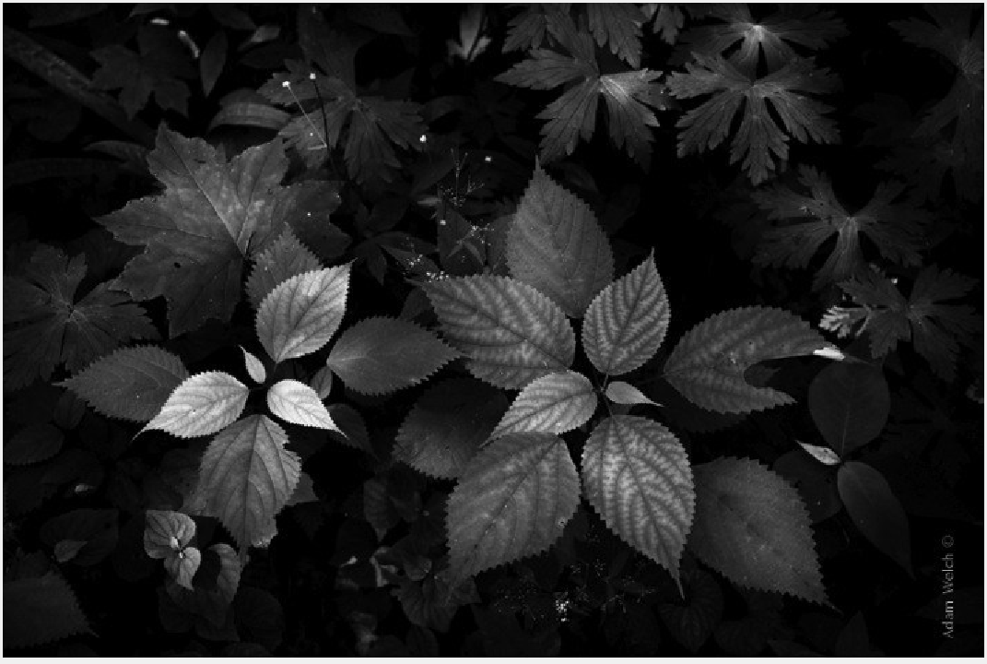
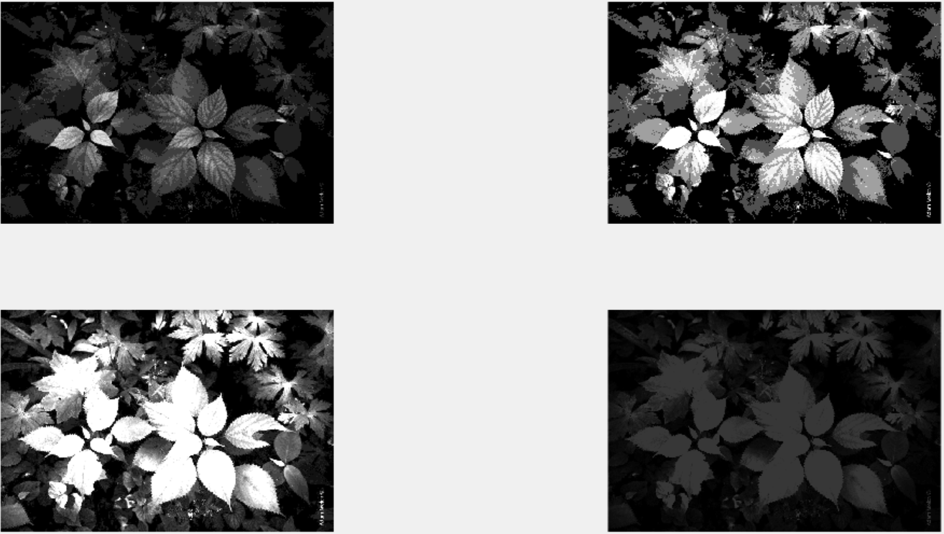
Sense Ref. to Avg. - Brightness
Original Quantized to 4bits
Original Image (depth 8bits)
Divide by average Quantized to 4bits
Brighter image, more details appear for darker images

Slide 21
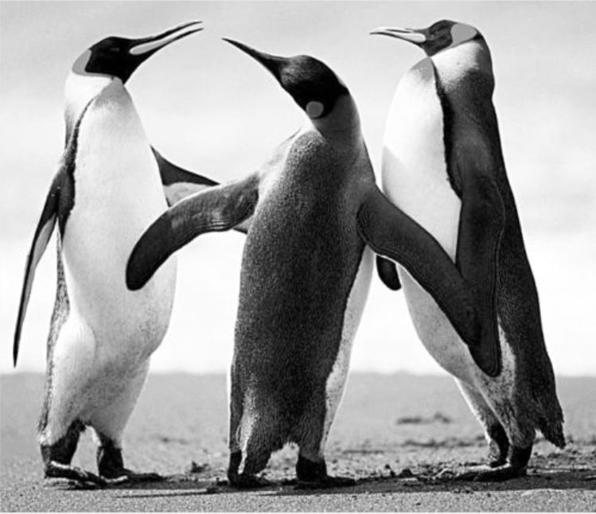
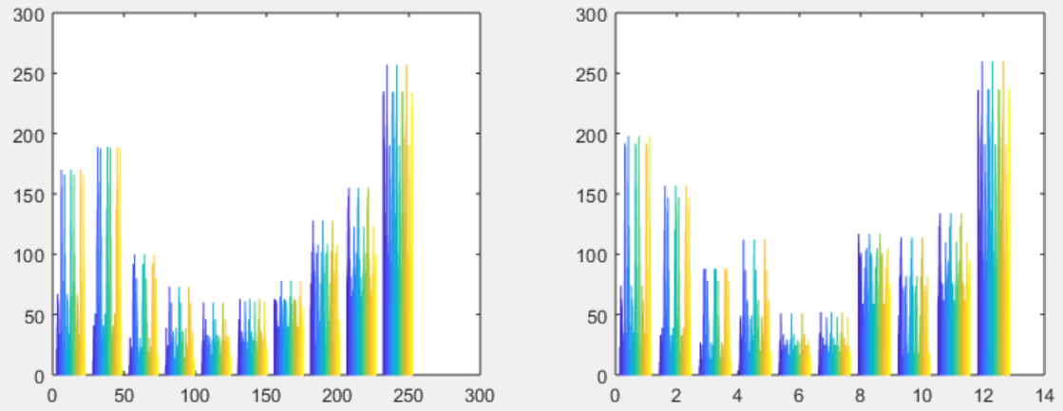
Sense Ref. to Avg. Moderate Bright.
255
Average nearly in the middle
Avg.=159
0
Original Image
Divide by average Quantized to 4bits
Similar distribution, no much gain in details and no loss

Slide 22

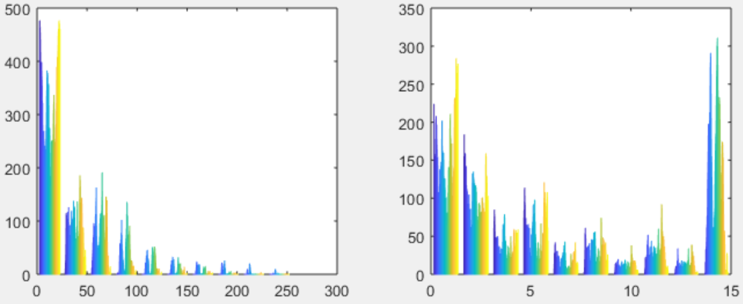
Sense Ref. to Avg. – Dark Image
255
118
Avg./2^(n-1)=0.46
10
Avg.=29.6
0
0
Original Image
Divide by average Quantized to 4bits
Dividing by average zoom in the lower end and gives more details (e.g. edges sharpening)
Pixels concentrated at lower end

Slide 23
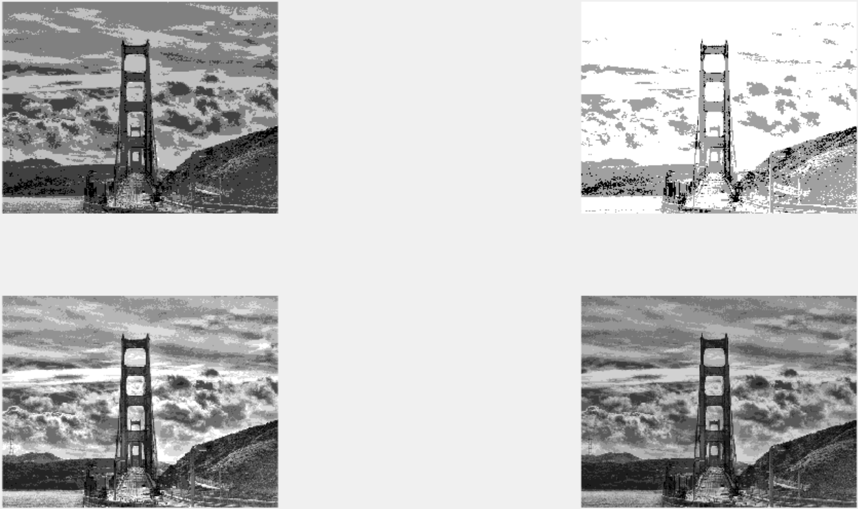
Sense Ref. to Avg. – Edges Sharpening
Leaf edges are sharper
Original Quantized to 4bits
Divide by average Quantized to 4bits
Original 16bits, Original Quantized to 3bits
Clearer edges sharpening quantizing down to 3bits compared to original image, while quantizing an image of original bit depth of 16bits
Divide by average Quantized to 3bits

Slide 24
Summary
Implement an ultra low power image sensor to be used in motion detection, object recognition and/or feature extraction
Reduced bit depth to save power
Technique to improve image features at reduced bit depth
  Sensing the pixel value relative to the whole array average value: dividing each pixel by the average
    Change image brightness: more details appears in very dark or very bright images
    Edge sharpening for the objects: improves features extraction and object recognition

Slide 25
Objectives/Deliverables
Summary of upcoming milestones/deliverables and progress towards them
Review Time Frame: | No. | Objectives | Mid-term and final deliverables as checks for success
Mid Term (end of year 3) | 1 | chip demonstration of low-level scene analysis building blocks | design completion of integrated circuit performing feature extraction at 50 µW power (or lower) at VGA resolution, 5fps frame rate (towards complete demonstration/testing deliverable at end of year 3)
 |  |  | design completion of saliency assessment engine with 80 µW power at VGA resolution, 5pfs frame rate (towards complete demonstration/testing deliverable at end of year 3)
 |  |  | design completion of imager with 100 µW power (VGA, 30 fps) at activity rate of average NeoVision2 benchmark (towards complete demonstration/testing deliverable at end of year 3)
 | 2 | deep learning model with reduced complexity | 1,000X reduced size with <2% accuracy degradation in object and human detection, compared to deep learning network with best-in-class accuracy
Project Completion |  | system on chip demonstration of a complete cognitive camera | Integrated circuit performing image sensing and scene analysis with average power consumption in the mW range, including neural acceleration with maximum accuracy no lower than the best-in-class detection/classification algorithms minus 5-10% (indoor, 500-lux lighting, max. 20 people)

Slide 26
Objectives/Deliverables
Summary of upcoming milestones/deliverables and progress towards them

Slide 27
Visibility
Summary of Project-Tracking_Template.xlsx
  list of items in “Public materials” sheet
  KEYNOTE: Widely-Adaptive Intelligent&Connected Systems for Nearly-Unstoppable Operation under Highly Uncertain Power Availability – keynote speech at the IEEE ICCE 2021 conference, Jan 13, 2021, Phu Quoc Island (Vietnam)
  From Less Batteries to Battery-Less: Enabling A Greener World through Ultra-Wide Power-Performance Adaptation down to pWs – keynote speech at the IEEE WispNet 2020 conference, June 20, 2020, Chennai (India)
  KEYNOTE: Survival of the fittest: circuits and architectures for computation with ultra-wide power-performance adaptation beyond voltage scaling – keynote speech at the IEEE S3S 2019 conference, Oct 16, 2019, San Jose (USA)

Slide 28
Visibility
  KEYNOTE: Survival of the fittest: circuits and architectures with wide power-performance adaptation – Beyond voltage scaling and down to pWs – keynote speech at the IEEE MCSoC 2019 conference, Oct 1, 2019, Singapore
  KEYNOTE: Survival of the fittest: circuits and architectures with wide power-performance adaptation beyond voltage scaling – keynote speech at the IEEE SOCC 2019 conference, Sept 3, 2019, Singapore

Slide 29
Research Staff
Current research staff (PhD, PostDoc, Research Engineers, etc.)
  Karim Ali Abdeltawwab AHMED (RF)
  Wathuthanthrige Udari Charitha De Alwis (RE, PhD)
  Udara Samurdhi Harshanga KALINGAGE, Japesh Vohra (PhD)

Slide 30
Publications
List of Papers published in International Journals in “Evidence” sheet in “Project-Tracking_Template.xlsx”
  J. H. Teo, K. Ali, S. Sarkar, M. Alioto, “Dual-Mode Clock Gating and Comparator Merging for 2.7X Energy/Conversion Reduction in SAR ADCs under Low-Activity Inputs,” being submitted to SSC-L 2021
  L. Lin, S. Jain, M. Alioto, “Sub-nW Microcontroller with Dual-Mode Logic and Self-Startup for Battery-Indifferent Sensor Nodes,” accepted to IEEE Journal of Solid-State Circuits
  O. Aiello, P. Crovetti, P. Toledo, M. Alioto, “Rail-to-Rail Dynamic Voltage Comparator Scalable down to pW-Range Power and 0.15-V Supply,” accepted to IEEE Trans. on Circuits and Systems – part II
  L. Fassio, F. Settino, L. Longyang, R. De Rose, M. Lanuzza, F. Crupi, M. Alioto, “A Robust Sub-Threshold, Low Power-Delay, Energy and Area Efficient Level Shifter,” accepted to IEEE TCAS-II

Slide 31
Publications
  S. Jain, L. Lin, M. Alioto, “Processor Energy-Performance Range Extension Beyond Voltage Scaling via Drop-In Methodologies,” IEEE Journal of Solid-State Circuits (invited), vol. 55, no. 10, pp. 2670-2679, Oct. 2020
  P. Toledo, P. Crovetti, O. Aiello, M. Alioto, “Fully Digital Rail-to-Rail OTA with Sub-1,000 µm2 Area, 250-mV Minimum Supply and nW Power at 150-pF Load in 180nm,” IEEE Solid-State Circuits Letters, vol. 3, pp. 474-477, Sept. 2020
  S. Jain, L. Lin, M. Alioto, “Broad-Purpose In-Memory Computing for Signal Monitoring and Machine Learning Workloads,” IEEE Solid-State Circuits Letters (invited), vol. 3, pp. 394-397, Sept. 2020
  J. H. Teo, S. Cheng, M. Alioto, “Low-Energy Voice Activity Detection via Energy-Quality Scaling from Data Conversion to Machine Learning,” IEEE Trans. on CAS – part I, vol. 67, no. 4, pp. 1378-1377, April 2020
  S. Jain, L. Lin, M. Alioto, Adaptive Digital Circuits for Power-Performance Range beyond Wide Voltage Scaling, Springer, 2020

Slide 32
Publications
  S. Jain, L. Longyang, M. Alioto, “Automated Design of Reconfigurable Micro-Architectures for Accelerators under Wide Voltage Scaling,” IEEE Trans. on VLSI Systems, vol. 28, no. 3, pp. 777-790, March 2020
  O. Aiello, P. Crovetti, M. Alioto, “Fully Synthesizable Low-Area Analogue-to-Digital Converters with Minimal Design Effort Based on the Dyadic Digital Pulse Modulation,” accepted to IEEE Access
  A. Alvarez, G. Ponnusamy, M. Alioto, “Energy-Quality Scalable Memory-Frugal Feature Extraction for Always-On Deep Sub-mW Distributed Vision,” IEEE Access, vol. 8, pp. 18951-18961, Jan. 2020

Slide 33
Publications
List of Presentations at International Conferences in “Evidence” sheet in “Project-Tracking_Template.xlsx”
  S. Jain, L. Lin, M. Alioto, “Broad-Purpose In-Memory Computing for DSP and Machine Learning Workloads Based on Commercial Bitcell,” in Proc. of ASSCC 2020
  S. Jain, L. Longyang, M. Alioto, “Low-Overhead Drop-In Techniques to Extend the Energy-Performance Tradeoff in Microcontrollers Beyond VDD Scaling,” in Proc. of ASSCC 2019, pp. 125-129, Macau (China), Nov. 2019
  O. Aiello, P. Crovetti, A. Sharma, M. Alioto, “Fully-Synthesizable Current-Input ADCs for Ultra-Low Area and Minimal Design Effort,” in Proc. of ICECS 2019

Slide 34
Demos/Public Materials
List of No. of TRL 4 Prototypes in “Evidence” sheet in “Project-Tracking_Template.xlsx”
  Dual-Mode Clock Gating and Comparator Merging for 2.7X Energy/Conversion Reduction in SAR ADCs under Low-Activity Inputs
  Sub-nW Microcontroller with Dual-Mode Logic and Self-Startup for Battery-Indifferent Sensor Nodes
  Rail-to-Rail Dynamic Voltage Comparator Scalable down to pW-Range Power and 0.15-V Supply
  A Robust Sub-Threshold, Low Power-Delay, Energy and Area Efficient Level Shifter
  Processor Energy-Performance Range Extension Beyond Voltage Scaling via Drop-In Methodologies

Slide 35
Demos/Public Materials
  Fully Digital Rail-to-Rail OTA with Sub-1,000 µm2 Area, 250-mV Minimum Supply and nW Power at 150-pF Load in 180nm
  Broad-Purpose In-Memory Computing for Signal Monitoring and Machine Learning Workloads
  Fully Synthesizable Low-Area Analogue-to-Digital Converters with Minimal Design Effort Based on the Dyadic Digital Pulse Modulation
  A Sub-mW, Sub-mm2 Energy-Quality Scalable Feature Extraction Accelerator for Distributed Vision in 40nm
  Sub-nW Microcontroller with Dual-Mode Logic and Self-startup for Battery-Indifferent Sensor Nodes

Slide 36
Demos/Public Materials
Links to public materials (e.g., GitHub): … (accumulate over the years, highlight new in red)
  RECMICRO scripts and design flows on GitHub: https://github.com/srbhjn459/RECMICRO

Slide 37
Talks, Videos, News, Press
List of items in “Project-Tracking_Template.xlsx”
  Press releases sheet
    Network on Chip with quintupled energy efficiency for artificial intelligence applications
    http://news.nus.edu.sg/research/five-times-more-efficient-data-transfer
    (media coverage on EurekAlert, HPCWire, …)
    first microprocessor with energy-performance tradeoff wider than voltage scaling for faster operation and longer battery life: http://news.nus.edu.sg/research/enabling-battery-powered-silicon-chips-work-faster-and-longer
    (media coverage on EurekAlert, Azo Materials, TechXplore, ScienMag…)

Slide 38
Talks, Videos, News, Press
    novel class of data converters that can be designed with fully-automated digital design flows for design turnaround time down to a few hours instead of months: https://www.eng.nus.edu.sg/ece/news/nus-innovation-paves-the-way-for-sensor-interfaces-that-are-30-times-smaller/
    (media coverage on ScienceDaily, TechXplore, TechBallad, Semiconductor Engineering, Embedded Conference Finland…)

Slide 39
Talks, Videos, News, Press
  Talks
    KEYNOTE: Widely-Adaptive Intelligent&Connected Systems for Nearly-Unstoppable Operation under Highly Uncertain Power Availability – keynote speech at the IEEE ICCE 2021 conference, Jan 13, 2021, Phu Quoc Island (Vietnam)
    From Less Batteries to Battery-Less: Enabling A Greener World through Ultra-Wide Power-Performance Adaptation down to pWs – keynote speech at the IEEE WispNet 2020 conference, June 20, 2020, Chennai (India)
    (KEYNOTE) Survival of the fittest: circuits and architectures for computation with ultra-wide power-performance adaptation beyond voltage scaling – keynote speech at the IEEE S3S 2019 conference, Oct 16, 2019, San Jose (USA)
    (KEYNOTE) Survival of the fittest: circuits and architectures with wide power-performance adaptation – Beyond voltage scaling and down to pWs – keynote speech at the IEEE MCSoC 2019 conference, Oct 1, 2019, Singapore

Slide 40
Talks, Videos, News, Press
    (KEYNOTE) Survival of the fittest: circuits and architectures with wide power-performance adaptation beyond voltage scaling – keynote speech at the IEEE SOCC 2019 conference, Sept 3, 2019, Singapore
    (KEYNOTE) Energy-Quality Scalable Integrated Systems - Preserving Energy Downscaling in the Decade Ahead – keynote speech at the IEEE SigTelCom 2019 conference, March 20, 2019, Hanoi (Vietnam)

Slide 41
Objectives/Deliverables
 |  | Year 1 |  |  |  | Year 2 |  |  |  | Year 3 |  |  |  | Year 4 |  |  |  | Year 5
 |  | Q1 | Q2 | Q3 | Q4 | Q1 | Q2 | Q3 | Q4 | Q1 | Q2 | Q3 | Q4 | Q1 | Q2 | Q3 | Q4 | Q1 | Q2 | Q3 | Q4
Sub-project 1 | System modeling, exploration, integration, demonstration
 | 1.1 System simulation/modeling framework |  |  |  |  |  |  |  | D1.1
 | 1.2 System on board (SoB) integration/characterization (round #1) |  |  |  |  |  |  |  |  |  |  |  | M1.2
 | 1.3 System on board (SoB) integration/characterization (round #2) |  |  |  |  |  |  |  |  |  |  |  |  |  |  |  | M1.3
 | 1.4 System on chip (SoC) partitioning, chip level simulation environment |  |  |  |  |  |  |  |  |  |  |  |  |  |  |  | M1.4
 | 1.5 System on chip (SoC) optimization and integration |  |  |  |  |  |  |  |  |  |  |  |  |  |  |  |  |  | D1.5
 | 1.6 SoC characterization and in-field validation |  |  |  |  |  |  |  |  |  |  |  |  |  |  |  |  |  |  |  | M1.6

Slide 42
Objectives/Deliverables
 |  | Year 1 |  |  |  | Year 2 |  |  |  | Year 3 |  |  |  | Year 4 |  |  |  | Year 5
 |  | Q1 | Q2 | Q3 | Q4 | Q1 | Q2 | Q3 | Q4 | Q1 | Q2 | Q3 | Q4 | Q1 | Q2 | Q3 | Q4 | Q1 | Q2 | Q3 | Q4
Sub-project 2 | Energy-centric circuit techniques and interaction at imager-sensemaking and wireless-sensemaking boundary
 | 2.1 Imager and transceiver architectural exploration |  |  |  | D2.1
 | 2.2 Imager and transceiver tapeout and testing (round #1) |  |  |  |  |  |  |  | D2.2 |  |  |  | M2.2
 | 2.3 Imager and transceiver tapeout and testing (round #2) |  |  |  |  |  |  |  |  |  |  |  | D2.3 |  |  |  | M2.3
 | 2.4 Imager and transceiver final revision for SoC, silicon demonstration |  |  |  |  |  |  |  |  |  |  |  |  |  |  |  |  |  | M2.4
 | 2.5 Final characterization and validation |  |  |  |  |  |  |  |  |  |  |  |  |  |  |  |  |  |  |  | M2.5
 | 5.1 Internal review meetings with Advisory Board |  |  |  | M5.1 |  |  |  | M5.2 |  |  |  | M5.3 |  |  |  | M5.4 |  |  |  | M5.5
 | 5.2 Mid-term review |  |  |  |  |  |  |  |  |  |  |  | M5.6
 | 5.3 Final review |  |  |  |  |  |  |  |  |  |  |  |  |  |  |  |  |  |  |  | M5.7

Slide 43
Objectives/Deliverables
 |  | Year 1 |  |  |  | Year 2 |  |  |  | Year 3 |  |  |  | Year 4 |  |  |  | Year 5
 |  | Q1 | Q2 | Q3 | Q4 | Q1 | Q2 | Q3 | Q4 | Q1 | Q2 | Q3 | Q4 | Q1 | Q2 | Q3 | Q4 | Q1 | Q2 | Q3 | Q4
Sub-project 3 | Energy-centric machine learning-circuit co-design
 | 3.1 Deep learning model compression |  |  |  | M3.1a |  |  |  | M3.1b |  |  |  | D3.1
 | 3.2 Energy-aware deep learning network design and training |  |  |  |  |  |  |  |  |  |  |  | D3.2
 | 3.3 Saliency model |  |  |  |  |  |  |  |  |  |  |  | M3.3
 | 3.4 In-field model fine-tuning, validation and integration |  |  |  |  |  |  |  |  |  |  |  |  |  |  |  |  |  |  |  | M3.4

Slide 44
Objectives/Deliverables
 |  | Year 1 |  |  |  | Year 2 |  |  |  | Year 3 |  |  |  | Year 4 |  |  |  | Year 5
 |  | Q1 | Q2 | Q3 | Q4 | Q1 | Q2 | Q3 | Q4 | Q1 | Q2 | Q3 | Q4 | Q1 | Q2 | Q3 | Q4 | Q1 | Q2 | Q3 | Q4
Sub-project 4 | Irrelevant activity skipping/EQ-scalable sensemaking circuits/architectures
 | 4.1 Activity skipping architectures/circuits |  |  |  |  |  |  |  |  |  |  |  | M4.1
 | 4.2 EQ-scalable architectures/circuits |  |  |  |  |  |  |  |  |  |  |  | M4.2
 | 4.3 Feature extraction, novelty assessment, deep learning, SRAM tapeout and testing (round #1) |  |  |  |  |  |  |  | D4.3 |  |  |  | M4.3
 | 4.4 Feature extraction, novelty assessment, deep learning, SRAM tapeout and testing (round #2) |  |  |  |  |  |  |  |  |  |  |  | D4.4 |  |  |  | M4.4
 | 4.5 Final characterization and validation |  |  |  |  |  |  |  |  |  |  |  |  |  |  |  |  |  |  |  | M4.4

Slide 45
Notes and Suggestions
Open discussion
  Sachin (novelty assessment, DNN)
  Karim (scalable-LSB imager)
  Udari (diff method)

Slide 46
Awards
List of External Awards for Research at International Level in “Evidence” sheet in “Project-Tracking_Template.xlsx”
  … (accumulate over the years, highlight new in red)

Slide 47
Patents
List of Patents Disclosures/Filed/Granted/Commercialized in “Evidence” sheet in “Project-Tracking_Template.xlsx”
  Invention disclosures: … (accumulate over the years, highlight new in red)
  Patents filed: … (accumulate over the years, highlight new in red)
  Patents granted: … (accumulate over the years, highlight new in red)
  Patents commercialized: … (accumulate over the years, highlight new in red)

Slide 48


Optimal CNN Exploration
Project Owner: Sayan Kumar
Presenter: Sachin Taneja
National University of Singapore (NUS)
ECE Department
Green IC group
Date: 02/12/2020

Slide 49
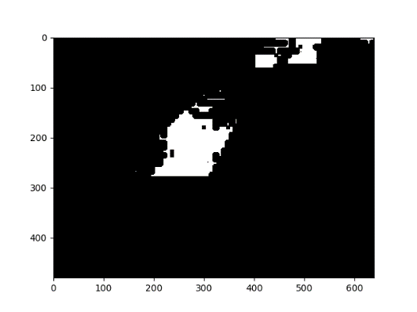
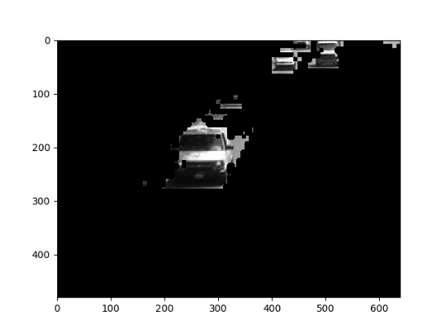
System Pipeline
Novelty Detection
  Finding novel (new frames) features between i^{th} frame and (i+1)^{th} frame.
  From the system perspective it may look like as follows-
Novelty with Contour Approach (Contour cut image pass to CNN)
  Left Hand side: Saliency Region from Image Sensor.
  Store the Corresponding Bounding Box (BB) in Memory.
  Compare the BB in the subsequent memory location and get Novel bounding box.
  Multiply the BB with the image to get focus region in full image, pass to CNN.
Image Sensor
ADC
Novelty Assessment
CNN Accelerator
Novel Location
Detected Object

Slide 50
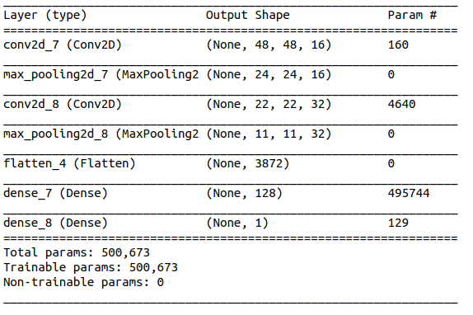
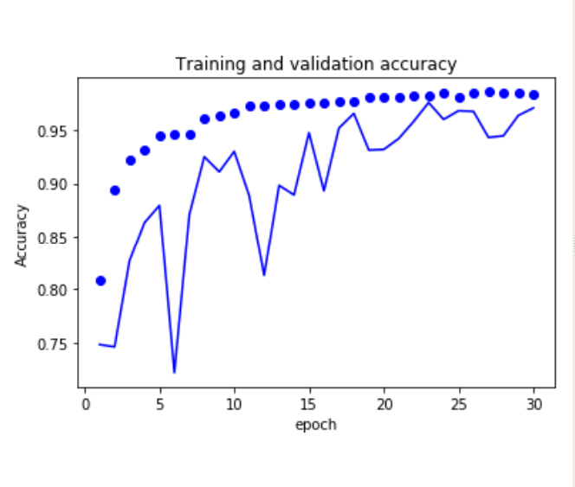
CNN Experiment
Current Experiment
  Inference Task: Human vs non-human (2 classes)
  Dataset: Human vs Non-Human (Kaggle.com)
  CNN Architecture: CNN in keras without any customization (architecture below)
  Hardware friendly optimization: quantization, compression, pruning not done
Expected Optimal CNN Requirements
  Inference Task: Animal, Vehicles, Human, None of the first three (4 class)
  Current status: Above CNN performs training > 95%, validation < 90%
  Discussion points: Community accepted dataset, Low Complexity CNN or simpler network (with hardware friendly optimization) architecture or less layers

