Slide 1








: Energy-Autonomous
Always-On Cognitive & Attentive Cameras for Distributed Real-Time Vision with milliWatt Power Consumption
C gniVisi n
Quarterly meeting: July 20, 2020
Prof. Massimo Alioto

Slide 2
Outline
Research Progress
Objectives/Deliverables
Visibility
Research Staff
Publications
Awards
Patents
Demos/Public Materials
Talks, Videos, News, Press
Notes and Suggestions

Slide 3


Imager-Pixel and readout circuit design
C gniVisi n
Quarterly meeting: (18.11.2020)
Udara Samurdhi Harshanga Kalingage

Slide 4
Outline
Circuit overview and Simulation results
Corner Analysis Simulation
Floorplan and Layout
Past Work and references

Slide 5
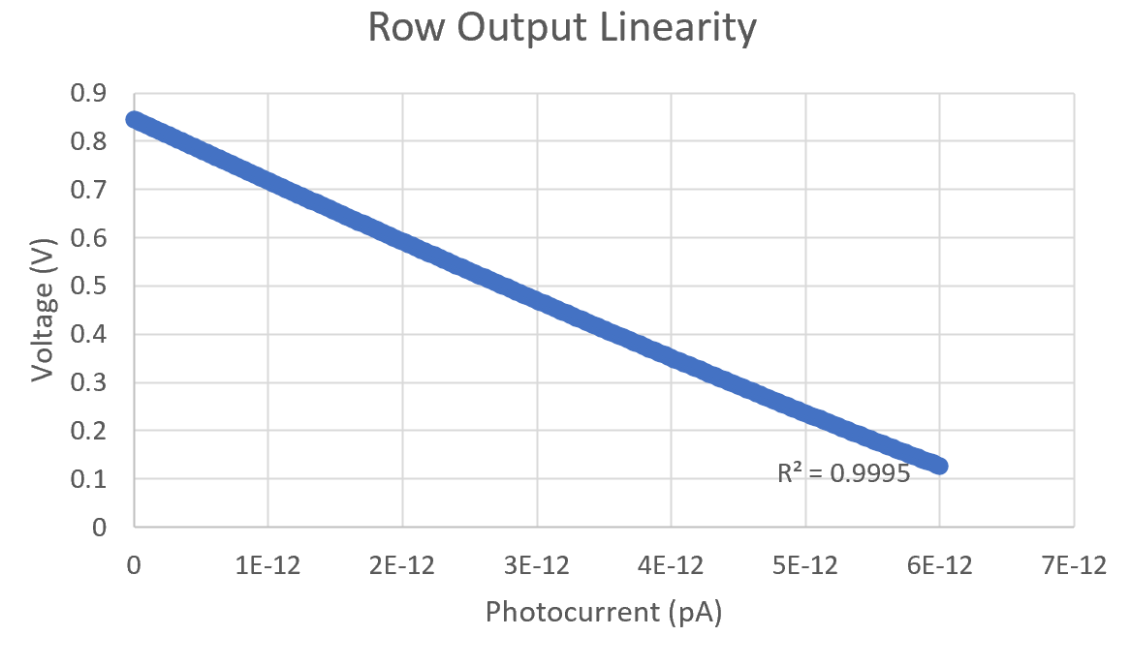
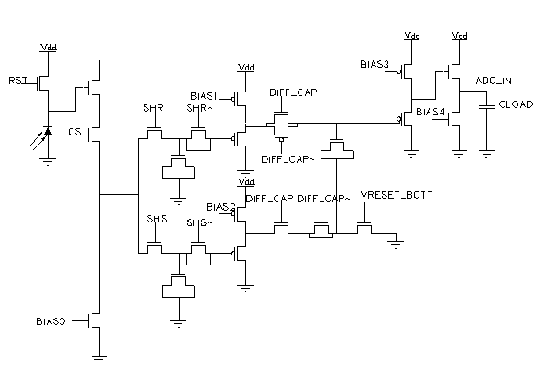
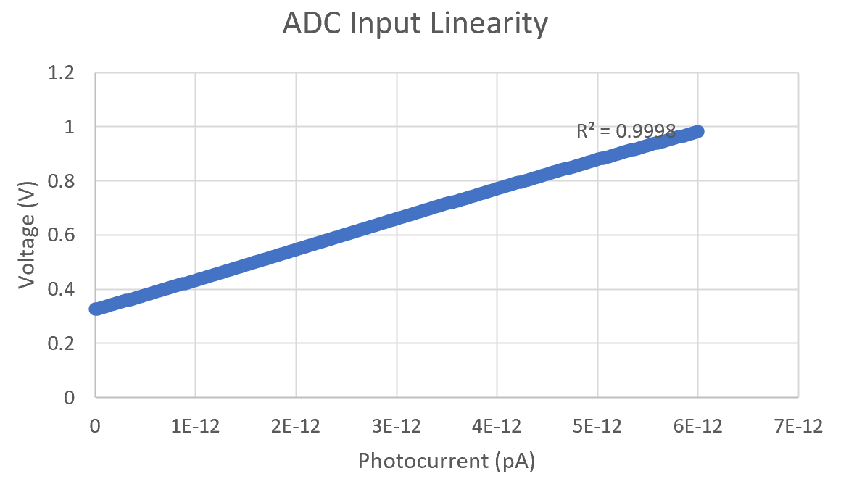
Circuit Overview and simulation results
Fig1: Pixel and the readout circuitry
top plate
row o/p
There is a offset of 2mV to 6mV before the buffer (Fig3) and after the buffer (Fig 4)

Slide 6
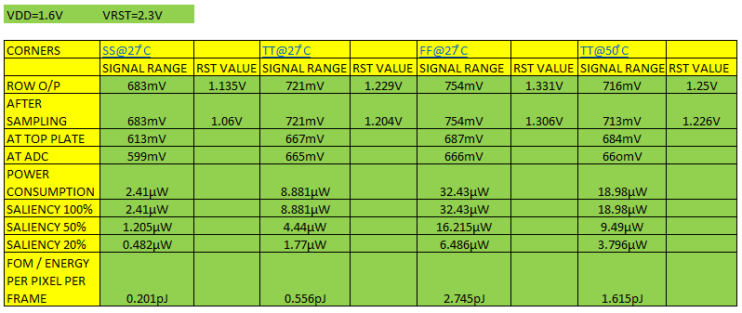
Corner Analysis Simulation
Results are obtained for different corners with fixed biasing conditions
Better range can be obtained for SS corner by changing the biasing condition
FOM(Power/frame.pixel) @ TT is 1.99pW
Table1: Corner Analysis results

Slide 7
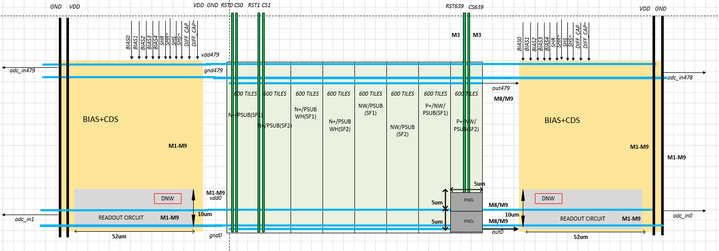
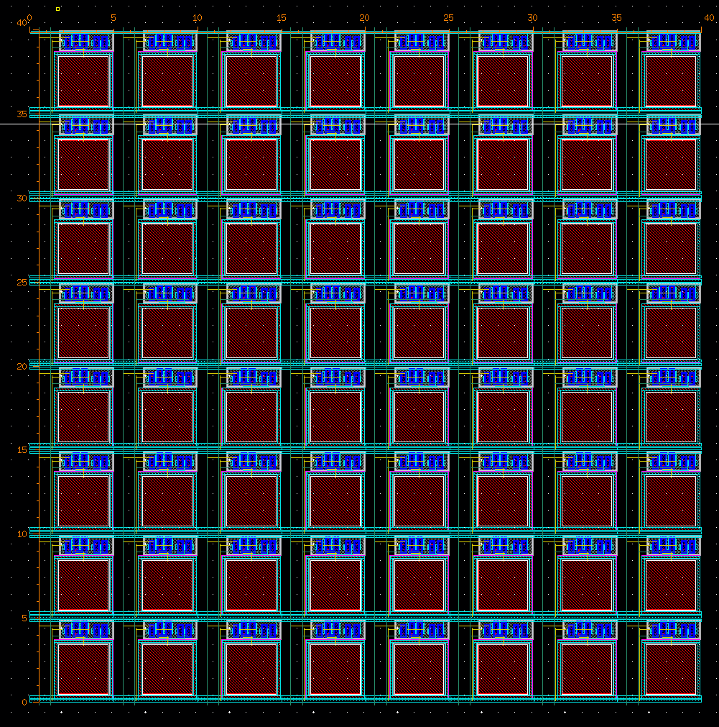
Floorplan and Layout
Challenges are
  Designing the readout circuit to meet the pixel pitch, the dimensions of the readout circuit is extended due to the presence of deep nwell
  Achieving good matching for the biasing circuit
TSMC 40nm 1P10M
Fill Factor – 35.5%
Pixel pitch – 5 µm
Fig5: Tile

Slide 8
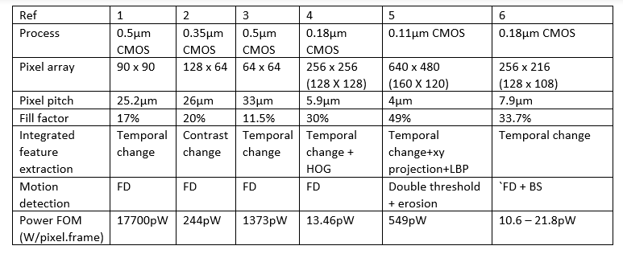
Past Work and References
N. Massari, U. Mallik, M. Clapp, G. Cauwenberghs, & R. Etienne-Cummings, “Temporal change threshold detection imager,” ISSCC Dig Tech. Papers, pp. 362-364, Feb.2005
M. Gottardi, N. Massari, and S. A. Jawed, “A 100W 128x64 Pixels Contrast-Based Asynchronous Binary Sensor for Sensor Network Applications,”IEEE Journal of Solid-State Circuits, vol. 44, no. 5, pp. 1582–1592, May 2008
S. Chen; W. Tang; X. Zhang & E. Culurciello, "A 64×64 Pixels UWB Wireless Temporal-Difference Digital Image Sensor," IEEE Transactions on Very Large-Scale Integration (VLSI) Systems, vol.20, no.12, pp.2232-2240, Dec. 2012
“An Energy-efficient Adaptive CMOS Image Sensor” Jaehyuk Choi, A dissertation submitted in partial fulfillment of the requirements for the degree of Doctor of Philosophy (Electrical Engineering) in The University of Michigan 2013
A Low-Power VGA Vision Sensor with Event Detection through Motion Computation based on Pixel-Wise Double-Threshold Background Subtraction and Local Binary Pattern Coding Yu Zou, Massimo Gottardi, Michela Lecca, Matteo Perenzoni Fondazione Bruno Kessler, via Sommarive 18, 38123-Povo, Trento
A Fully Dynamic Multi-Mode CMOS Vision Sensor With Mixed-Signal Cooperative Motion Sensing and Object Segmentation for Adaptive Edge Computing, Xiaopeng Zhong , Student Member, IEEE, Man-Kay Law , Senior Member, IEEE, Chi-Ying Tsui, Senior Member, IEEE, and Amine Bermak, Fellow, IEEE

Slide 9
: Energy-Autonomous
Always-On Cognitive & Attentive Cameras for Distributed Real-Time Vision with milliWatt Power Consumption
C gniVisi n
Quarterly meeting: (17/11/2020)
Japesh Vohra

Slide 10
Outline
Saliency Detection
  Minutes of last meeting
  Design Updates for Saliency Detection
ADC
  Proposed Design and Future Work

Slide 11
Saliency Detection
Detecting saliency early (before conversion) in an imager can reduce the amount of data processed significantly (5% of the entire data).
Saliency detection is done using background subtraction which can be implemented using simple circuits enabling in-pixel saliency detection.
Minutes of last meeting:
The input image is subsampled through spatial averaging to limit the amount of processing and memory (analog) required for saliency detection.
Current sample is compared with a long-term average (background) to determine change beyond a threshold.
Long-term average (background) value is updated to keep track of the changing background. The proposed design allows the background update rate to be adjusted dynamically.
Morphological Image Closing is performed on initial saliency values detected by background subtraction to improve the performance of saliency detection.

Slide 12
Design Updates for Saliency Detection
Design for the in-pixel saliency detection has been finalized and schematic simulations completed with circuit level improvements introduced in the following parts:
  Spatial Averaging (Tiling)
  Correlated Double Sampling
The proposed architecture targets an in-pixel mixed signal approach to reduce the energy consumption while simultaneously achieving a more accurate programmable saliency detection operation.
The increase in accuracy translates to lesser false positives and a more accurate alarm generation by the imager algorithm which triggers the conversion and transmission of data (dominant energy consumption parts).

Slide 13
Proposed ADC Design and Future Work
Proposed ADC :
Single Slope ADCs are most widely used for imagers owing to their simpler design with shared components and compact design allowing it to match the pixel pitch.
They are energy inefficient due to their linear search which requires an average of 2^(N-1) comparisons for an N-bit ADC.
The proposed ADC design targets to exploit the spatial correlation in the image data by implementing differential sampling in a novel manner in single-slope ADCs.
The high amount of spatial correlation present in the image data enables a reduction from an average of 128 comparisons (for an 8-bit ADC) to 5.02 comparisons.
Future Work:
Integration of the designed in-pixel components.
Integrating the CDS, ADC and testing components.
Fabricating and testing the performance of the imager.

Slide 14
Novelty Assessment
C gniVisi n
Quarterly meeting: 14/04/2020
Sayan Kumar

Slide 15
Outline
Why Novelty Assessment
Last Meeting Conclusion
Current Approach and Progress
Future Work

Slide 16
Why Novelty Assessment
This project is about finding novel (which are new in the frame) features between i^{th} frame and (i+1)^{th} frame.
From the system perspective it may look like as follows-
This simple technique may lead to reducing the energy consumption of the subsequent stages by order of magnitude.
Image Sensor
ADC
Novel Object Detector
CNN Accelerator
Novel Location
Detected Object
My Scope of Work

Slide 17
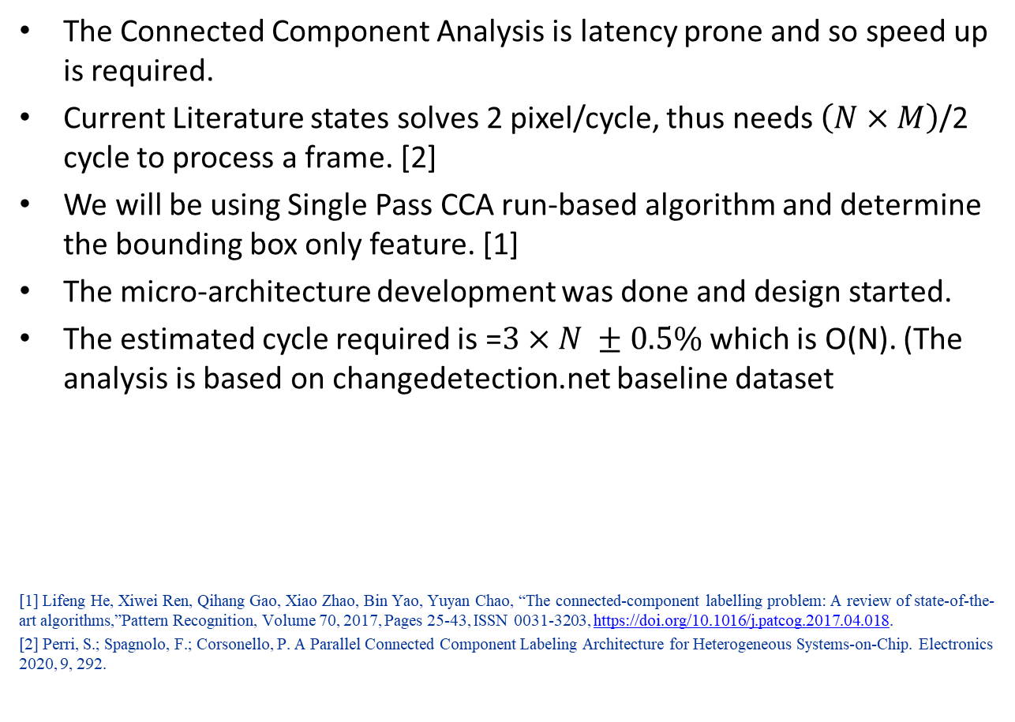
Last Meeting Overview
The Connected Component Analysis is latency prone and so speed up is required.
Current Literature states solves 2 pixel/cycle, thus needs $\left(N×M\right)$/2 cycle to process a frame. [2]
We will be using Single Pass CCA run-based algorithm and determine the bounding box only feature. [1]
The micro-architecture development was done and design started.
The estimated cycle required is =$3×N ±0.5\%$ which is O(N). (The analysis is based on changedetection.net baseline dataset
[1] Lifeng He, Xiwei Ren, Qihang Gao, Xiao Zhao, Bin Yao, Yuyan Chao, “The connected-component labelling problem: A review of state-of-the-art algorithms,”Pattern Recognition, Volume 70, 2017, Pages 25-43, ISSN 0031-3203, https://doi.org/10.1016/j.patcog.2017.04.018.
[2] Perri, S.; Spagnolo, F.; Corsonello, P. A Parallel Connected Component Labeling Architecture for Heterogeneous Systems-on-Chip. Electronics 2020, 9, 292.

Slide 18
Design of CCA
Design of CCA is done.
Our system is able to make bounding box in 4x N no of cycles (in MxN image.)
Latch Ram replaces the SRAM for better voltage scalability and reduction of amount of memory.
Literature Review to defend our work with the state-of-the art papers are done.
Our CCA only logic outperforming w.r.t existing design w.r.t throughput, power and memory usage by exploiting efficient micro-architectural trade-offs.
Other System enhancement and corresponding validation is in progress.

Slide 19
: Energy-Autonomous
Always-On Cognitive & Attentive Cameras for Distributed Real-Time Vision with milliWatt Power Consumption
C gniVisi n
Quarterly meeting: 16/11/2020
Udari De Alwis

Slide 20
Outline
Methodology
Activation calculation from frame difference
Temporal Difference Method
Object detection evaluation matrix
Testing and Results

Slide 21
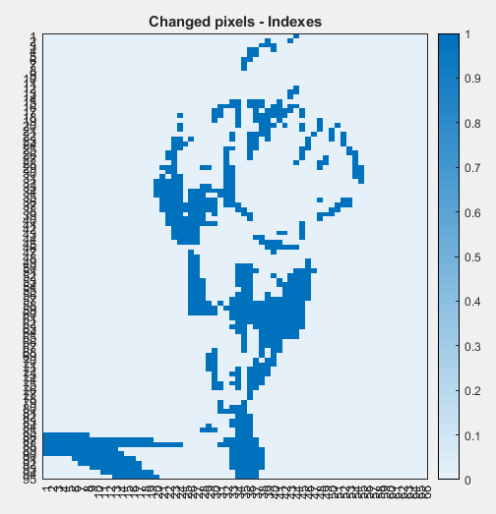
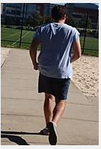
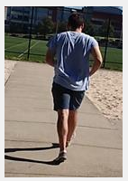
Methodology
In a video from a stationary camera, consecutive frames have more similarity (temporal correlation)
Detect the changed pixels
Calculate the convolution only for the changes
Perform this on all the layers
Frame 1
Frame 2

Slide 22
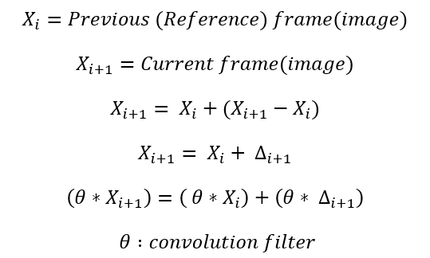
Activation calculation from frame difference
Calculating difference at each conv layer
Calculate convolution for the difference
Add the reference frame activation to the difference activation
Memory requirement increase
Additional memory access and computation cost for calculating difference and thresholding before each convolution layer

Slide 23
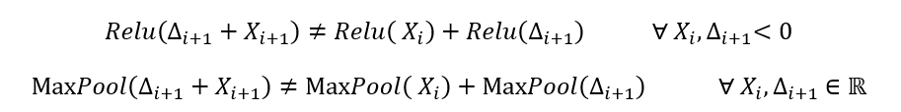
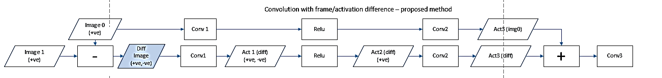
Temporal Difference Method
Calculate frame difference at the input layer
Propagate the difference through the layers in CNN
Add the activation from reference frame after multiple layers
Skip nonlinearity-> violates additivity property -> accuracy degradation

Slide 24
Activation propagation along VGG16 SSD

Slide 25
Testing and Results

Slide 26
Discussion
VGG16SSD 20%-25% computation efficiency considering 3 -15 layers (30% - 82% of the activations in the system)
Accuracy drop 2% - 12%
Testing on multiple datasets and models

Slide 27
Objectives/Deliverables
Summary of upcoming milestones/deliverables and progress towards them
Review Time Frame: | No. | Objectives | Mid-term and final deliverables as checks for success
Mid Term (end of year 3) | 1 | chip demonstration of low-level scene analysis building blocks | design completion of integrated circuit performing feature extraction at 50 µW power (or lower) at VGA resolution, 5fps frame rate (towards complete demonstration/testing deliverable at end of year 3)
 |  |  | design completion of saliency assessment engine with 80 µW power at VGA resolution, 5pfs frame rate (towards complete demonstration/testing deliverable at end of year 3)
 |  |  | design completion of imager with 100 µW power (VGA, 30 fps) at activity rate of average NeoVision2 benchmark (towards complete demonstration/testing deliverable at end of year 3)
 | 2 | deep learning model with reduced complexity | 1,000X reduced size with <2% accuracy degradation in object and human detection, compared to deep learning network with best-in-class accuracy
Project Completion |  | system on chip demonstration of a complete cognitive camera | Integrated circuit performing image sensing and scene analysis with average power consumption in the mW range, including neural acceleration with maximum accuracy no lower than the best-in-class detection/classification algorithms minus 5-10% (indoor, 500-lux lighting, max. 20 people)

Slide 28
Visibility
Summary of Project-Tracking_Template.xlsx
  list of items in “Public materials” sheet
  KEYNOTE: Widely-Adaptive Intelligent&Connected Systems for Nearly-Unstoppable Operation under Highly Uncertain Power Availability – keynote speech at the IEEE ICCE 2021 conference, Jan 13, 2021, Phu Quoc Island (Vietnam)
  From Less Batteries to Battery-Less SoCs with Nearly-Unstoppable Operation – Towards a Greener and Smarter World – keynote speech at the IEEE ISOCC 2020 conference, Oct. 22, 2020, Yeosu (Korea)
  KEYNOTE: From Less Batteries to Battery-Less: Enabling A Greener World through Ultra-Wide Power-Performance Adaptation down to pWs – keynote speech at the IEEE WispNet 2020 conference, June 20, 2020, Chennai (India)
  KEYNOTE: Survival of the fittest: circuits and architectures for computation with ultra-wide power-performance adaptation beyond voltage scaling – keynote speech at the IEEE S3S 2019 conference, Oct 16, 2019, San Jose (USA)

Slide 29
Visibility
  KEYNOTE: Survival of the fittest: circuits and architectures with wide power-performance adaptation – Beyond voltage scaling and down to pWs – keynote speech at the IEEE MCSoC 2019 conference, Oct 1, 2019, Singapore
  KEYNOTE: Survival of the fittest: circuits and architectures with wide power-performance adaptation beyond voltage scaling – keynote speech at the IEEE SOCC 2019 conference, Sept 3, 2019, Singapore

Slide 30
Research Staff
Current research staff (PhD, PostDoc, Research Engineers, etc.)
  Karim Ali Abdeltawwab AHMED (RF)
  Udara Samurdhi Harshanga KALINGAGE
  Sayan Kumar (PhD)
Past research staff (PhD, PostDoc, Research Engineers, etc.)
  list of Past Headcount in “Expenditures” sheet in “Project-Tracking_Template.xlsx”

Slide 31
Publications
List of Papers published in International Journals in “Evidence” sheet in “Project-Tracking_Template.xlsx”
  L. Fassio, F. Settino, L. Longyang, R. De Rose, M. Lanuzza, F. Crupi, M. Alioto, “A Robust Sub-Threshold, Low Power-Delay, Energy and Area Efficient Level Shifter,” accepted to IEEE TCAS-II
  S. Jain, L. Lin, M. Alioto, “Broad-Purpose In-Memory Computing for Signal Monitoring and Machine Learning Workloads,” IEEE Solid-State Circuits Letters (invited), vol. 3, pp. 394-397, Sept. 2020
  S. Jain, L. Lin, M. Alioto, “Processor Energy-Performance Range Extension Beyond Voltage Scaling via Drop-In Methodologies,” IEEE Journal of Solid-State Circuits (invited), vol. 55, no. 10, pp. 2670-2679, Oct. 2020
  J. H. Teo, S. Cheng, M. Alioto, “Low-Energy Voice Activity Detection via Energy-Quality Scaling from Data Conversion to Machine Learning,” IEEE Trans. on CAS – part I, vol. 67, no. 4, pp. 1378-1377, April 2020
  S. Jain, L. Lin, M. Alioto, Adaptive Digital Circuits for Power-Performance Range beyond Wide Voltage Scaling, Springer, 2020

Slide 32
Publications
  S. Jain, L. Longyang, M. Alioto, “Automated Design of Reconfigurable Micro-Architectures for Accelerators under Wide Voltage Scaling,” accepted to IEEE Trans. on VLSI Systems
  O. Aiello, P. Crovetti, M. Alioto, “Fully Synthesizable Low-Area Analogue-to-Digital Converters with Minimal Design Effort Based on the Dyadic Digital Pulse Modulation,” accepted to IEEE Access
  A. Alvarez, G. Ponnusamy, M. Alioto, “Energy-Quality Scalable Memory-Frugal Feature Extraction for Always-On Deep Sub-mW Distributed Vision,” IEEE Access, vol. 8, pp. 18951-18961, Jan. 2020
  Lin, S. Jain, M. Alioto, “Sub-nW Microcontroller with Dual-Mode Logic and Self-startup for Battery-Indifferent Sensor Nodes,” accepted to IEEE JSSC

Slide 33
Publications
List of Presentations at International Conferences in “Evidence” sheet in “Project-Tracking_Template.xlsx”
  J. H. Teo, K. Ali, M. Alioto, “Voice Activity Detection with >83% Accuracy under SNR down to -3dB at 1.19µW and 0.07mm2 in 40nm,” accepted to IEEE ASSCC 2020
  S. Jain, L. Lin, M. Alioto, “Broad-Purpose In-Memory Computing for Signal Monitoring and Machine Learning Workloads Based on Commercial Bitcell,” accepted to IEEE ASSCC 2020 (invited and accepted to IEEE SSC-L)
  S. Jain, L. Longyang, M. Alioto, “Low-Overhead Drop-In Techniques to Extend the Energy-Performance Tradeoff in Microcontrollers Beyond VDD Scaling,” in Proc. of ASSCC 2019, pp. 125-129, Macau (China), Nov. 2019
  O. Aiello, P. Crovetti, A. Sharma, M. Alioto, “Fully-Synthesizable Current-Input ADCs for Ultra-Low Area and Minimal Design Effort,” accepted to ICECS 2019 (best paper award)
  S. Jain, L. Longyang, M. Alioto, “Low-Overhead Drop-In Techniques to Extend the Energy-Performance Tradeoff in Microcontrollers Beyond VDD Scaling,” in Proc. of ASSCC 2019, pp. 125-129, Macau (China), Nov. 2019

Slide 34
Demos/Public Materials
List of No. of TRL 4 Prototypes in “Evidence” sheet in “Project-Tracking_Template.xlsx”
  A Robust Sub-Threshold, Low Power-Delay, Energy and Area Efficient Level Shifter
  Broad-Purpose In-Memory Computing for Signal Monitoring and Machine Learning Workloads
  Processor Energy-Performance Range Extension Beyond Voltage Scaling via Drop-In Methodologies
  Low-Energy Voice Activity Detection via Energy-Quality Scaling from Data Conversion to Machine Learning
  Fully Synthesizable Low-Area Analogue-to-Digital Converters with Minimal Design Effort Based on the Dyadic Digital Pulse Modulation
  A Sub-mW, Sub-mm2 Energy-Quality Scalable Feature Extraction Accelerator for Distributed Vision in 40nm
  Sub-nW Microcontroller with Dual-Mode Logic and Self-startup for Battery-Indifferent Sensor Nodes

Slide 35
Demos/Public Materials
Links to public materials (e.g., GitHub): … (accumulate over the years, highlight new in red)
  RECMICRO scripts and design flows on GitHub: https://github.com/srbhjn459/RECMICRO

Slide 36
Talks, Videos, News, Press
List of items in “Project-Tracking_Template.xlsx”
  Press releases sheet
    first microprocessor with energy-performance tradeoff wider than voltage scaling for faster operation and longer battery life: http://news.nus.edu.sg/research/enabling-battery-powered-silicon-chips-work-faster-and-longer
    (media coverage on EurekAlert, Azo Materials, TechXplore, ScienMag…)

Slide 37
Talks, Videos, News, Press
    novel class of data converters that can be designed with fully-automated digital design flows for design turnaround time down to a few hours instead of months: https://www.eng.nus.edu.sg/ece/news/nus-innovation-paves-the-way-for-sensor-interfaces-that-are-30-times-smaller/
    (media coverage on ScienceDaily, TechXplore, TechBallad, Semiconductor Engineering, Embedded Conference Finland…)
    NUS engineers quintuple the efficiency of moving data bits in silicon chips for artificial intelligence applications:
    http://news.nus.edu.sg/research/five-times-more- efficient-data-transfer
    (media coverage on Mirage News, HPCWire, EurekAlert, Tech Xplore, The National Tribune…)

Slide 38
Talks, Videos, News, Press
  Talks
    (KEYNOTE) Widely-Adaptive Intelligent&Connected Systems for Nearly-Unstoppable Operation under Highly Uncertain Power Availability – keynote speech at the IEEE ICCE 2021 conference, Jan 13, 2021, Phu Quoc Island (Vietnam)
    (KEYNOTE) From Less Batteries to Battery-Less SoCs with Nearly-Unstoppable Operation – Towards a Greener and Smarter World – keynote speech at the IEEE ISOCC 2020 conference, Oct. 22, 2020, Yeosu (Korea)
    (KEYNOTE) Survival of the fittest: circuits and architectures for computation with ultra-wide power-performance adaptation beyond voltage scaling – keynote speech at the IEEE S3S 2019 conference, Oct 16, 2019, San Jose (USA)
    (KEYNOTE) Survival of the fittest: circuits and architectures with wide power-performance adaptation – Beyond voltage scaling and down to pWs – keynote speech at the IEEE MCSoC 2019 conference, Oct 1, 2019, Singapore

Slide 39
Talks, Videos, News, Press
    (KEYNOTE) Survival of the fittest: circuits and architectures with wide power-performance adaptation beyond voltage scaling – keynote speech at the IEEE SOCC 2019 conference, Sept 3, 2019, Singapore
    (KEYNOTE) Energy-Quality Scalable Integrated Systems - Preserving Energy Downscaling in the Decade Ahead – keynote speech at the IEEE SigTelCom 2019 conference, March 20, 2019, Hanoi (Vietnam)

Slide 40
Objectives/Deliverables
 |  | Year 1 |  |  |  | Year 2 |  |  |  | Year 3 |  |  |  | Year 4 |  |  |  | Year 5
 |  | Q1 | Q2 | Q3 | Q4 | Q1 | Q2 | Q3 | Q4 | Q1 | Q2 | Q3 | Q4 | Q1 | Q2 | Q3 | Q4 | Q1 | Q2 | Q3 | Q4
Sub-project 1 | System modeling, exploration, integration, demonstration
 | 1.1 System simulation/modeling framework |  |  |  |  |  |  |  | D1.1
 | 1.2 System on board (SoB) integration/characterization (round #1) |  |  |  |  |  |  |  |  |  |  |  | M1.2
 | 1.3 System on board (SoB) integration/characterization (round #2) |  |  |  |  |  |  |  |  |  |  |  |  |  |  |  | M1.3
 | 1.4 System on chip (SoC) partitioning, chip level simulation environment |  |  |  |  |  |  |  |  |  |  |  |  |  |  |  | M1.4
 | 1.5 System on chip (SoC) optimization and integration |  |  |  |  |  |  |  |  |  |  |  |  |  |  |  |  |  | D1.5
 | 1.6 SoC characterization and in-field validation |  |  |  |  |  |  |  |  |  |  |  |  |  |  |  |  |  |  |  | M1.6

Slide 41
Objectives/Deliverables
 |  | Year 1 |  |  |  | Year 2 |  |  |  | Year 3 |  |  |  | Year 4 |  |  |  | Year 5
 |  | Q1 | Q2 | Q3 | Q4 | Q1 | Q2 | Q3 | Q4 | Q1 | Q2 | Q3 | Q4 | Q1 | Q2 | Q3 | Q4 | Q1 | Q2 | Q3 | Q4
Sub-project 2 | Energy-centric circuit techniques and interaction at imager-sensemaking and wireless-sensemaking boundary
 | 2.1 Imager and transceiver architectural exploration |  |  |  | D2.1
 | 2.2 Imager and transceiver tapeout and testing (round #1) |  |  |  |  |  |  |  | D2.2 |  |  |  | M2.2
 | 2.3 Imager and transceiver tapeout and testing (round #2) |  |  |  |  |  |  |  |  |  |  |  | D2.3 |  |  |  | M2.3
 | 2.4 Imager and transceiver final revision for SoC, silicon demonstration |  |  |  |  |  |  |  |  |  |  |  |  |  |  |  |  |  | M2.4
 | 2.5 Final characterization and validation |  |  |  |  |  |  |  |  |  |  |  |  |  |  |  |  |  |  |  | M2.5
 | 5.1 Internal review meetings with Advisory Board |  |  |  | M5.1 |  |  |  | M5.2 |  |  |  | M5.3 |  |  |  | M5.4 |  |  |  | M5.5
 | 5.2 Mid-term review |  |  |  |  |  |  |  |  |  |  |  | M5.6
 | 5.3 Final review |  |  |  |  |  |  |  |  |  |  |  |  |  |  |  |  |  |  |  | M5.7

Slide 42
Objectives/Deliverables
 |  | Year 1 |  |  |  | Year 2 |  |  |  | Year 3 |  |  |  | Year 4 |  |  |  | Year 5
 |  | Q1 | Q2 | Q3 | Q4 | Q1 | Q2 | Q3 | Q4 | Q1 | Q2 | Q3 | Q4 | Q1 | Q2 | Q3 | Q4 | Q1 | Q2 | Q3 | Q4
Sub-project 3 | Energy-centric machine learning-circuit co-design
 | 3.1 Deep learning model compression |  |  |  | M3.1a |  |  |  | M3.1b |  |  |  | D3.1
 | 3.2 Energy-aware deep learning network design and training |  |  |  |  |  |  |  |  |  |  |  | D3.2
 | 3.3 Saliency model |  |  |  |  |  |  |  |  |  |  |  | M3.3
 | 3.4 In-field model fine-tuning, validation and integration |  |  |  |  |  |  |  |  |  |  |  |  |  |  |  |  |  |  |  | M3.4

Slide 43
Objectives/Deliverables
 |  | Year 1 |  |  |  | Year 2 |  |  |  | Year 3 |  |  |  | Year 4 |  |  |  | Year 5
 |  | Q1 | Q2 | Q3 | Q4 | Q1 | Q2 | Q3 | Q4 | Q1 | Q2 | Q3 | Q4 | Q1 | Q2 | Q3 | Q4 | Q1 | Q2 | Q3 | Q4
Sub-project 4 | Irrelevant activity skipping/EQ-scalable sensemaking circuits/architectures
 | 4.1 Activity skipping architectures/circuits |  |  |  |  |  |  |  |  |  |  |  | M4.1
 | 4.2 EQ-scalable architectures/circuits |  |  |  |  |  |  |  |  |  |  |  | M4.2
 | 4.3 Feature extraction, novelty assessment, deep learning, SRAM tapeout and testing (round #1) |  |  |  |  |  |  |  | D4.3 |  |  |  | M4.3
 | 4.4 Feature extraction, novelty assessment, deep learning, SRAM tapeout and testing (round #2) |  |  |  |  |  |  |  |  |  |  |  | D4.4 |  |  |  | M4.4
 | 4.5 Final characterization and validation |  |  |  |  |  |  |  |  |  |  |  |  |  |  |  |  |  |  |  | M4.4

Slide 44
Notes and Suggestions
Open discussion
  application-specific neural networks for first system validation
  radio-system interaction (weight transfer)

Slide 45
Awards
List of External Awards for Research at International Level in “Evidence” sheet in “Project-Tracking_Template.xlsx”
  … (accumulate over the years, highlight new in red)

Slide 46
Patents
List of Patents Disclosures/Filed/Granted/Commercialized in “Evidence” sheet in “Project-Tracking_Template.xlsx”
  Invention disclosures: … (accumulate over the years, highlight new in red)
  Patents filed: … (accumulate over the years, highlight new in red)
  Patents granted: … (accumulate over the years, highlight new in red)
  Patents commercialized: … (accumulate over the years, highlight new in red)

