Slide 1








: Energy-Autonomous
Always-On Cognitive & Attentive Cameras for Distributed Real-Time Vision with milliWatt Power Consumption
C gniVisi n
Quarterly meeting: July 20, 2020
Prof. Massimo Alioto

Slide 2
Outline
Research Progress
Objectives/Deliverables
Visibility
Research Staff
Publications
Awards
Patents
Demos/Public Materials
Talks, Videos, News, Press
Notes and Suggestions

Slide 3


Imager-Pixel and readout circuit design
C gniVisi n
Quarterly meeting: July 20, 2020
Udara Samurdhi Harshanga Kalingage

Slide 4
Outline
Circuit overview and Simulation results
Corner Analysis Simulation
Floorplan and Layout
Past Work and references

Slide 5
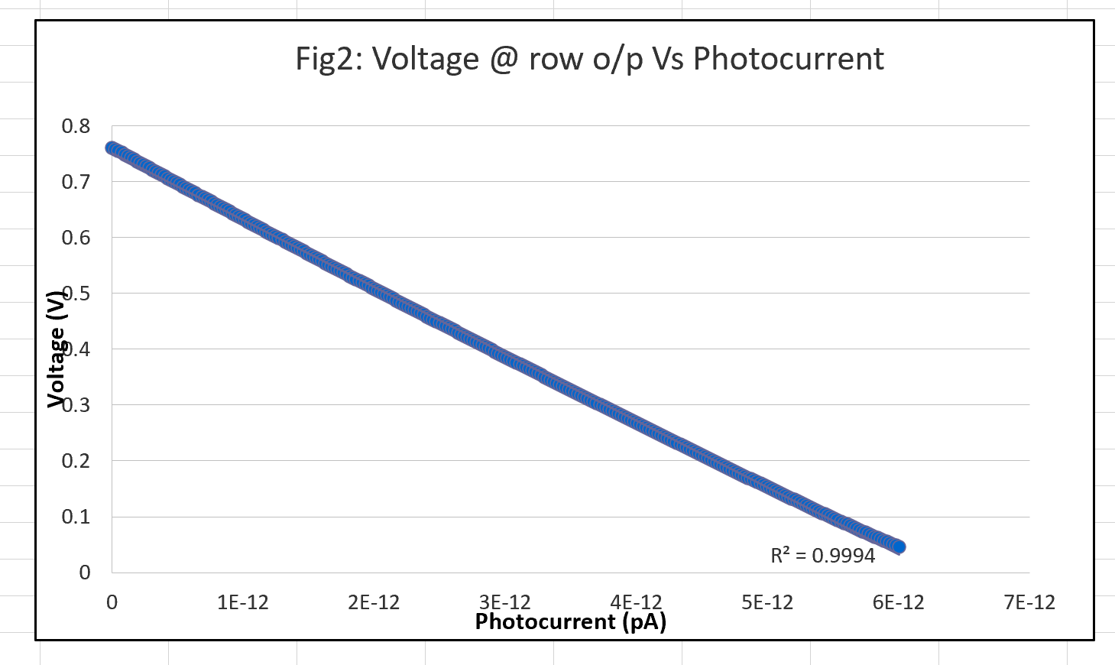
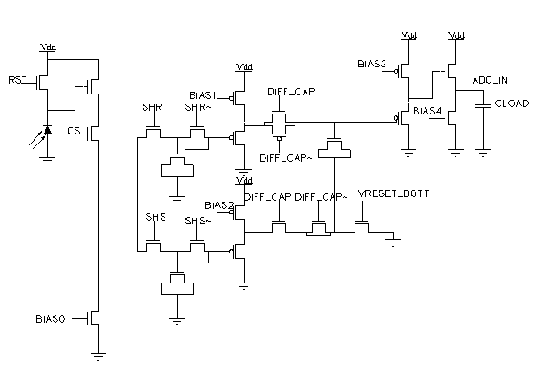
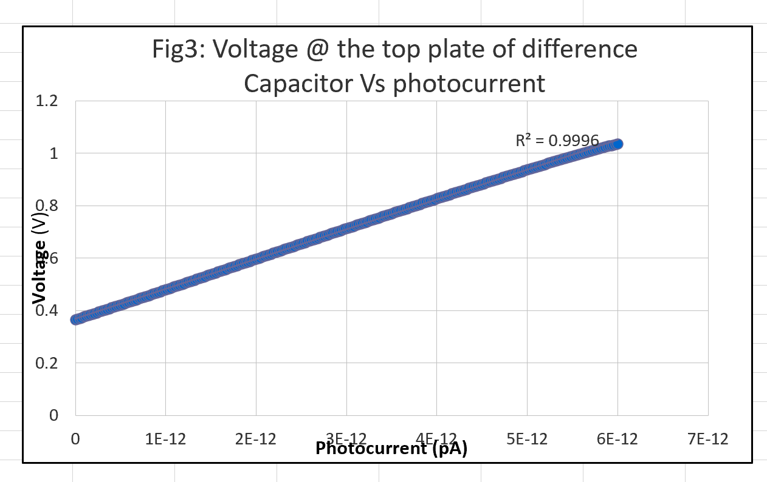
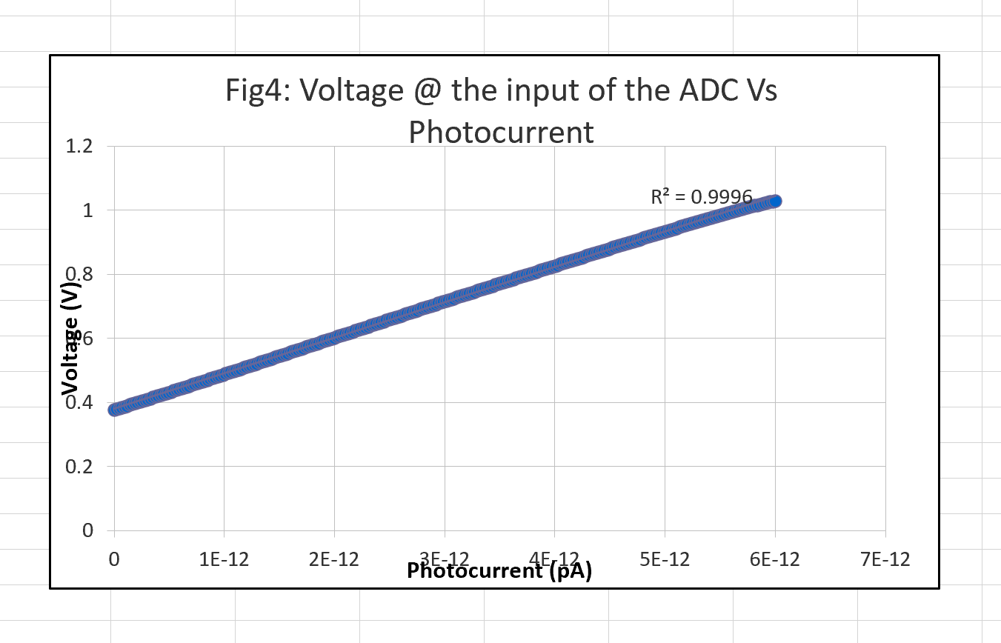
Circuit Overview and simulation results
Fig1: Pixel and the readout circuitry
top plate
row o/p
There is a offset of 2mV to 6mV before the buffer (Fig3) and after the buffer (Fig 4)

Slide 6
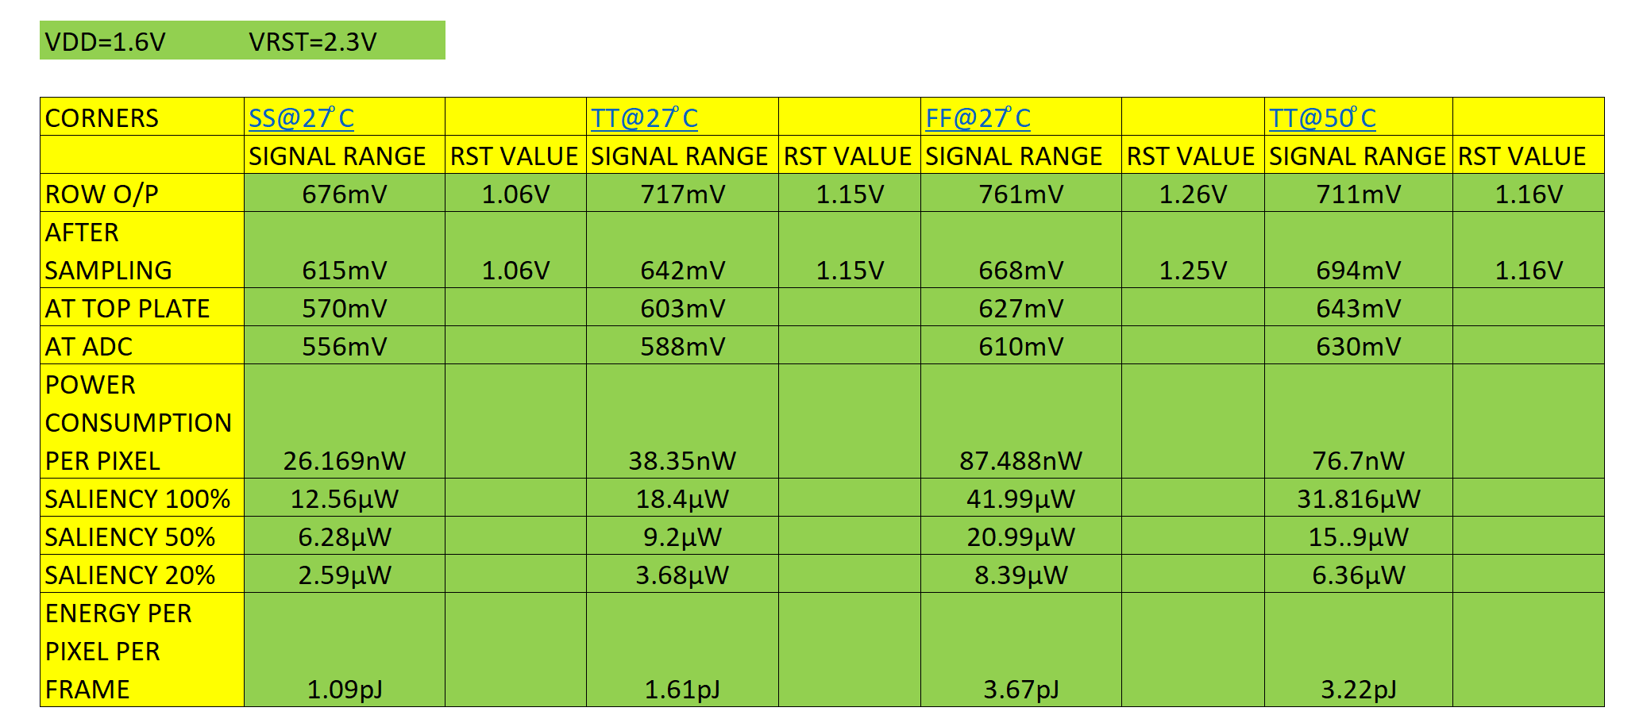
Corner Analysis Simulation
Results are obtained for different corners with fixed biasing conditions
Better range can be obtained for SS corner by changing the biasing condition
FOM(Power/frame.pixel) @ TT is 1.99pW
Table1: Corner Analysis results

Slide 7
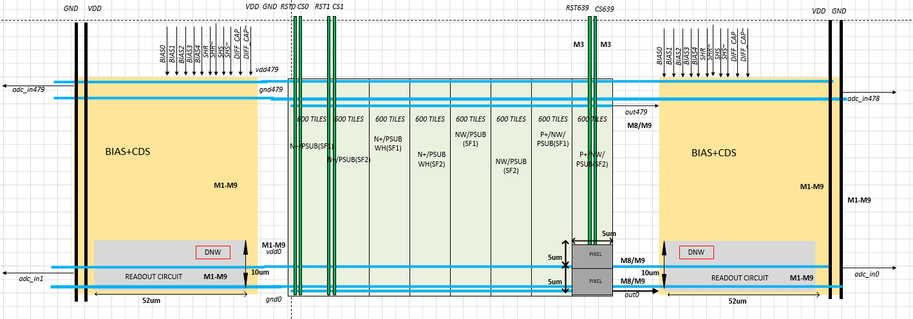
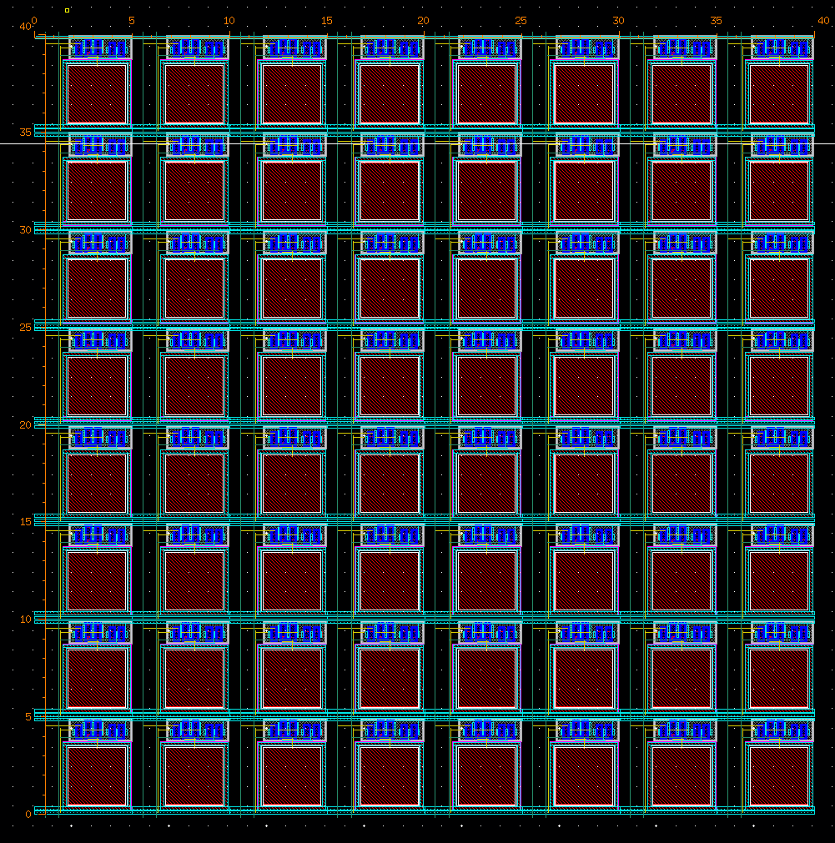
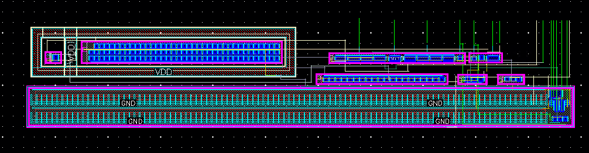
Floorplan and Layout
Challenges are
  Designing the readout circuit to meet the pixel pitch, the dimensions of the readout circuit is extended due to the presence of deep nwell
  Achieving good matching for the biasing circuit
Fig6: Readout Circuit
TSMC 40nm 1P10M
Fill Factor – 35.5%
Pixel pitch – 5 µm X 5 µm
Fig5: Tile

Slide 8
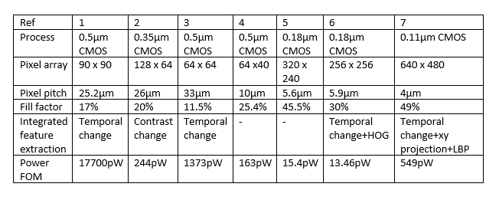
Past Work and References
N. Massari, M. Gottardi, S. Jawed, "A 100μW 64×128-Pixel Contrast-Based Asynchronous Binary Vision Sensor for Wireless Sensor Networks," ISSCC Dig Tech. Papers, pp. 588-638, Feb. 2008
M. Gottardi, N. Massari, and S. A. Jawed, “A 100W 128x64 Pixels Contrast-Based Asynchronous Binary Sensor for Sensor Network Applications,”IEEE Journal of Solid State Circuits, vol. 44, no. 5, pp. 1582–1592, May 2009
U. Mallik, M. Clapp, G. Cauwenberghs, & R. Etienne-Cummings, “Temporal change threshold detection imager,” ISSCC Dig Tech. Papers, pp. 362-364, Feb.2005
L.-gee Chen, “A single-chip CMOS APS camera with direct frame difference output,” IEEE Journal of Solid-State Circuits, vol. 34, no. 10, pp. 1415-1418,
1999
4. S. Chen; W. Tang; X. Zhang & E. Culurciello, "A 64×64 Pixels UWB Wireless Temporal-Difference Digital Image Sensor," IEEE Transactions on Very Large
Scale Integration (VLSI) Systems, vol.20, no.12, pp.2232-2240, Dec. 2012
5. “An Energy-efficient Adaptive CMOS Image Sensor” by Jaehyuk Choi, A dissertation submitted in partial fulfillment of the requirements for the degree of Doctor of Philosophy (Electrical Engineering) in The University of Michigan 2013
6. A Low-Power VGA Vision Sensor with Event Detection through Motion Computation based on Pixel-Wise Double-Threshold Background Subtraction and Local Binary Pattern Coding Yu Zou, Massimo Gottardi, Michela Lecca, Matteo Perenzoni Fondazione Bruno Kessler, via Sommarive 18, 38123-Povo, Trento, I

Slide 9
: Energy-Autonomous
Always-On Cognitive & Attentive Cameras for Distributed Real-Time Vision with milliWatt Power Consumption
C gniVisi n
Quarterly meeting: July 20, 2020
Japesh Vohra

Slide 10
Outline
In-Pixel Saliency Detection
  Tiling (Spatial Averaging)
  Background Subtraction
  Background Update
  Image Closing

Slide 11
Research Progress
Tiling (Spatial Averaging)
T11
T12
T13
T1N
T21
T22
T23
T2N
T31
T32
T33
T3N
Tiling (Spatial Averaging) is used to subsample the image before background subtraction to limit the number of comparisons as well as to limit the effect of noise.

Slide 12
Research Progress
Tiling (Spatial Averaging)
Tiling (Spatial Averaging) is used to subsample the image before background subtraction to limit the number of comparisons as well as to limit the effect of noise.

Slide 13
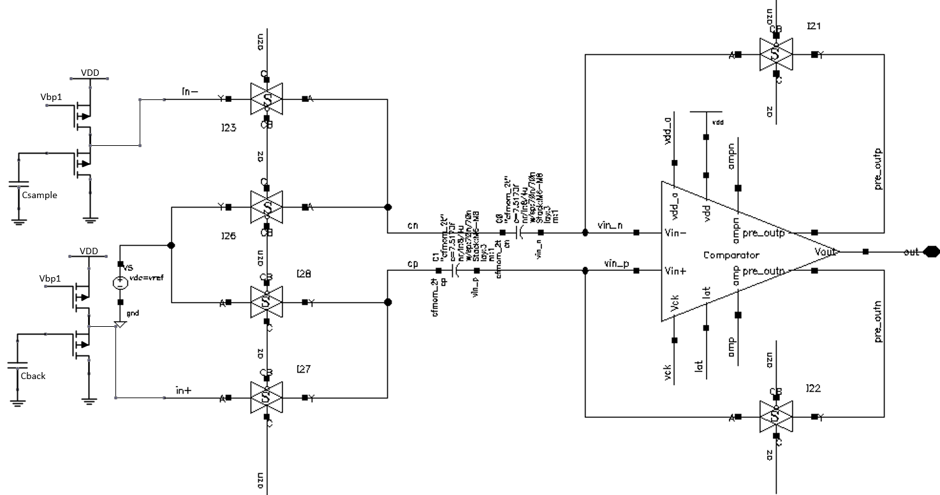
Research Progress
Background Subtraction
Current sample is compared with a long-term average (background) to determine change beyond a threshold.

Slide 14
Research Progress
Background Update
Long-term average (background) value is updated to keep track of the changing background. Background update rate can be adjusted dynamically.
$$V_{background}(i)= α∗V_{background}(i−1)+(1−α)∗V_{sample}(i)$$

Slide 15


Research Progress
Morphological Image Closing
(A) Original Image
(B) After Closing
Figure: Effect of image closing shown in (A) Original Image and (B) After Closing
Morphological Image Closing is performed on initial saliency values detected by background subtraction to improve the performance of saliency detection.
It closes the holes within detected salient tiles while keeping the initial region sizes. The image closing window size can be adjusted dynamically.
Source : https://homepages.inf.ed.ac.uk/rbf/HIPR2/close.htm

Slide 16
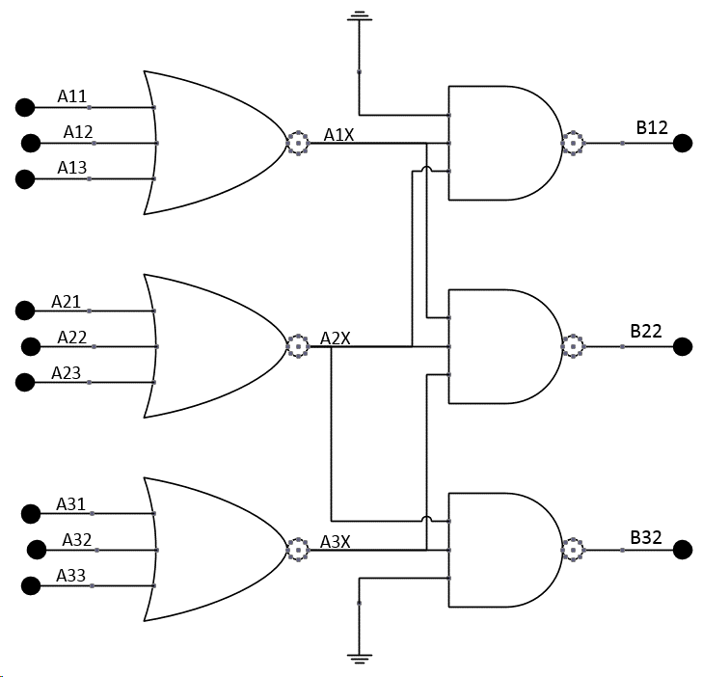
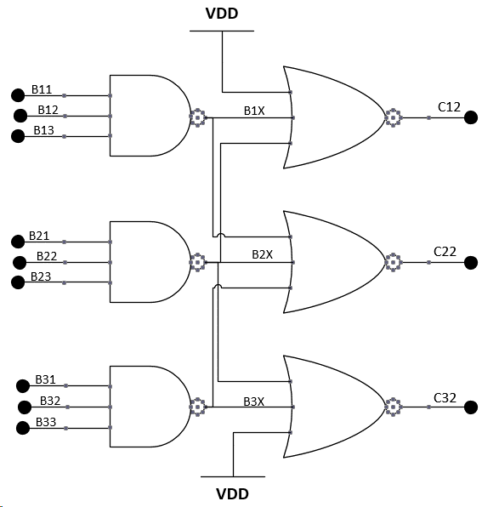
Research Progress
Morphological Image Closing
Morphological Image Closing is performed on initial saliency values detected by background subtraction to improve the performance of saliency detection.
It closes the holes within detected salient tiles while keeping the initial region sizes. The image closing window size can be adjusted dynamically.

Slide 17
Novelty Assessment
C gniVisi n
Quarterly meeting: July 20, 2020
Sayan Kumar

Slide 18
Outline
Why Novelty Assessment
Last Meeting Conclusion
Current Approach and Progress
Future Work

Slide 19
Why Novelty Assessment
This project is about finding novel (which are new in the frame) features between i^{th} frame and (i+1)^{th} frame.
From the system perspective it may look like as follows-
This simple technique may lead to reducing the energy consumption of the subsequent stages by order of magnitude.
Image Sensor
ADC
Novel Object Detector
CNN Accelerator
Novel Location
Detected Object
My Scope of Work

Slide 20
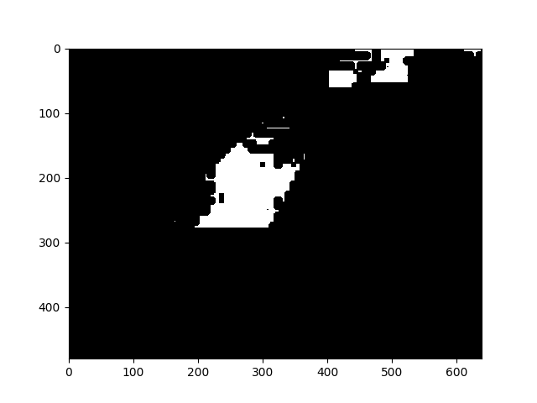
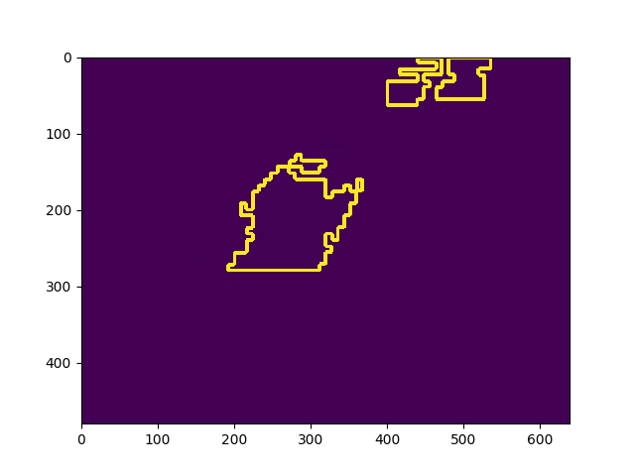
Last Meeting Overview
In the last meeting we had discussed all the approaches we took for novelty detection such as ORB, compressed image, Harr-Cascades, Histogram of Gradient.
Finally we settled that centroid tracking of the clusters is best suited for such low-power applications. Clusters can be identified by Contour Detection.
As Novelty detection block is very latency prone block and contour detection takes $3×\left(N×M\right).$ We had to think something else and our target was to make the technique work in the O(N).

Slide 21
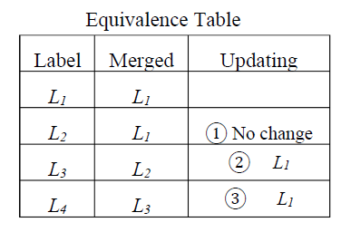
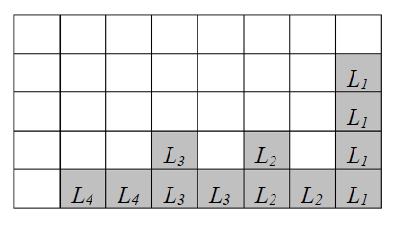
Current Approach and Progress
The Connected Component Analysis is the best way to go.[1]
Current Literature states solves 2 pixel/cycle, thus needs $\left(N×M\right)$/2 cycle to process a frame. [2]
We will be using Single Pass CCA run-based algorithm and determine the bounding box only feature. [1]
The micro-architecture has been derived and the design is in progress.
The estimated cycle required is =$3×N ±0.5\%$ which is O(N). (The analysis is based on changedetection.net baseline dataset
[1] Lifeng He, Xiwei Ren, Qihang Gao, Xiao Zhao, Bin Yao, Yuyan Chao, “The connected-component labelling problem: A review of state-of-the-art algorithms,”Pattern Recognition, Volume 70, 2017, Pages 25-43, ISSN 0031-3203, https://doi.org/10.1016/j.patcog.2017.04.018.
[2] Perri, S.; Spagnolo, F.; Corsonello, P. A Parallel Connected Component Labeling Architecture for Heterogeneous Systems-on-Chip. Electronics 2020, 9, 292.

Slide 22
Future Work
Complete the ongoing design effort.
Circuit/Architecture Innovation for further reduction is block latency by improving critical path delay.
Further Delay-Energy-Area optimization.

Slide 23
: Energy-Autonomous
Always-On Cognitive & Attentive Cameras for Distributed Real-Time Vision with milliWatt Power Consumption
C gniVisi n
Quarterly meeting: July 20, 2020
Udari De Alwis

Slide 24
Outline
Methodology
Testing and Results
Network architecture considerations
Object detection evaluation matrix
Discussion

Slide 25
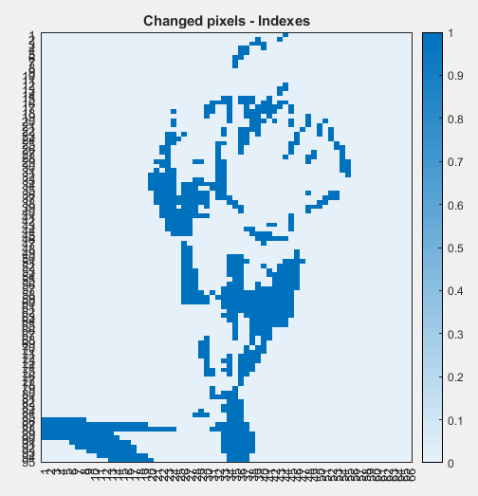
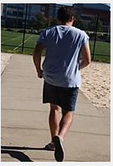
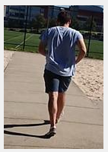
Methodology
In a video from a stationary camera, consecutive frames have more similarity (temporal correlation)
Detect the changed pixels
Calculate the convolution only for the changes
Perform this on all the layers
Frame 1
Frame 2

Slide 26
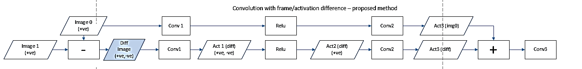
Methodology
Get the frame difference (diff frame) and process the diff frame along the network layers
Add the activation of the previous image after multiple layers
Thresholding is done at diff frame to reduce the number of pixels
Full frame is updated in different intervals (update full frame after 5,10,15th frame)
Update the full frame in frame update rate
Thresholding for zero creations
If Diff < thre -> 0

Slide 27
Testing and Results
Image classification task
  Alexnet network retrained on the CIFAR10 dataset
  Youtube object dataset
  10 object classes containing between 9 and 24 videos for each classes
  Duration of each video varies between 30 seconds and 3 minutes.
Image detection task
  VGG16 based Single Shot Detector (SSD) network
  Stationary camera video CAMEL data set.
  The dataset consists of video sequences from still cameras 26 sequences with people, bicycles, four wheeled vehicles, motorcycles, and dogs.

Slide 28
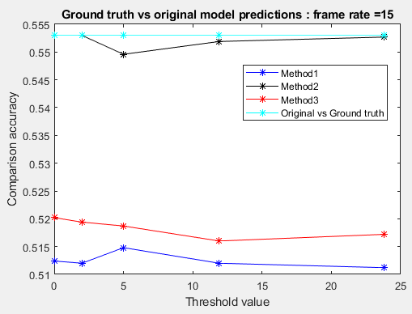
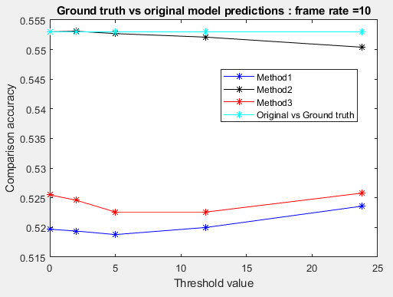
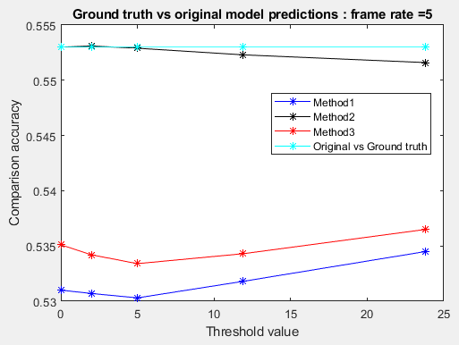
Object Classification task
Without diff method accuracy = 55.30% (ground truth accuracy)
With diff method accuracy = 51.5% - 53.5%
The lower accuracy of the ground truth might be a problem
Updating very 10th frame can become an optimal value when considering the accuracy and the computational complexity

Slide 29
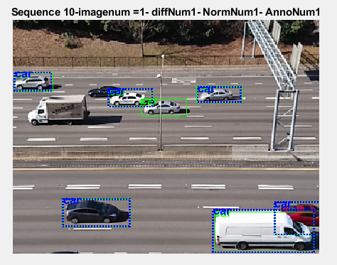
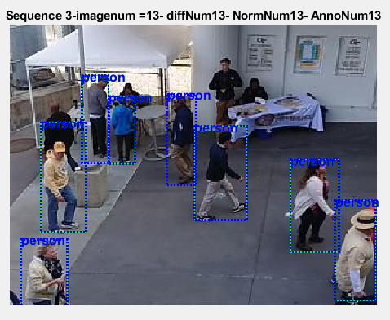
Object detection task
Average accuracy drop over the 18 video sequences
  3% for diff method
  1% for diff method with Leaky relu
Frame updating rate of 10 has been used in the experiment on the object detection task

Slide 30
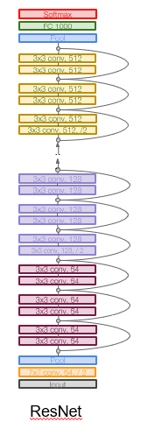
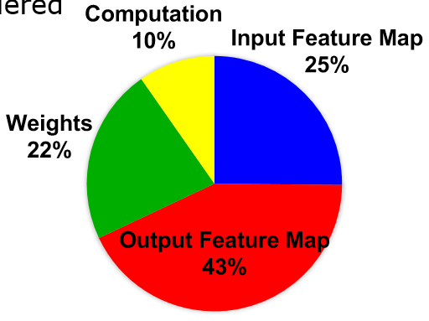
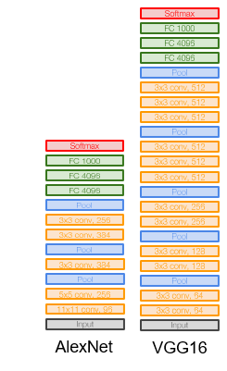
Compact Network Architectures
Number of weights alone is not a good metric for energy
All data types should be considered
Recurring layers with same dimensionality is preferred for hardware
Networks with skip connections -need to store or recalculate features from a previous stage to get the features in each stage
Tradeoff between memory (area) and computation (energy)
Energy Consumption of GoogLeNet
[Y. Chen et al, IEEE JETCAS 2019]
CS231n Stanford

Slide 31
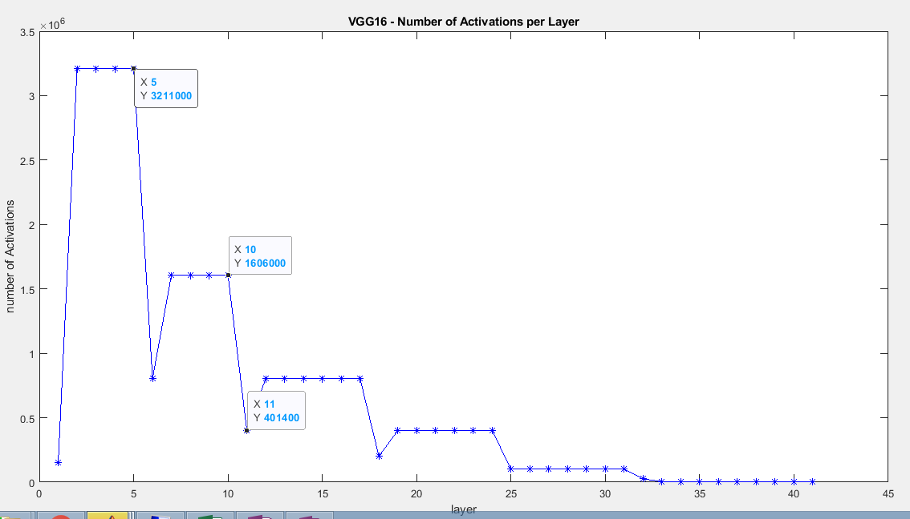
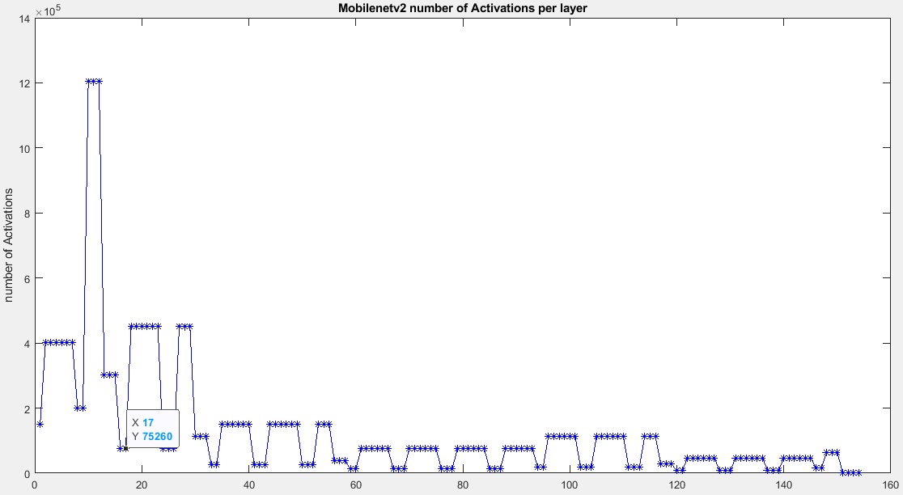
Activation Propagation along the Network
Diff method tends to loose accuracy when implemented in deeper layers (as we are skipping nonlinear layers when adding back the full frame to diff frame)
VGG16 based SSD: Diff at 5th layer, accuracy drop around 5% , covers 45% of the activations
Mobilenetv2 : 20%+ accuracy drop when diff is implemented @ 14th layer , Diff method need to be implemented covering 1-17 layers to get 38% of the activations covered

Slide 32
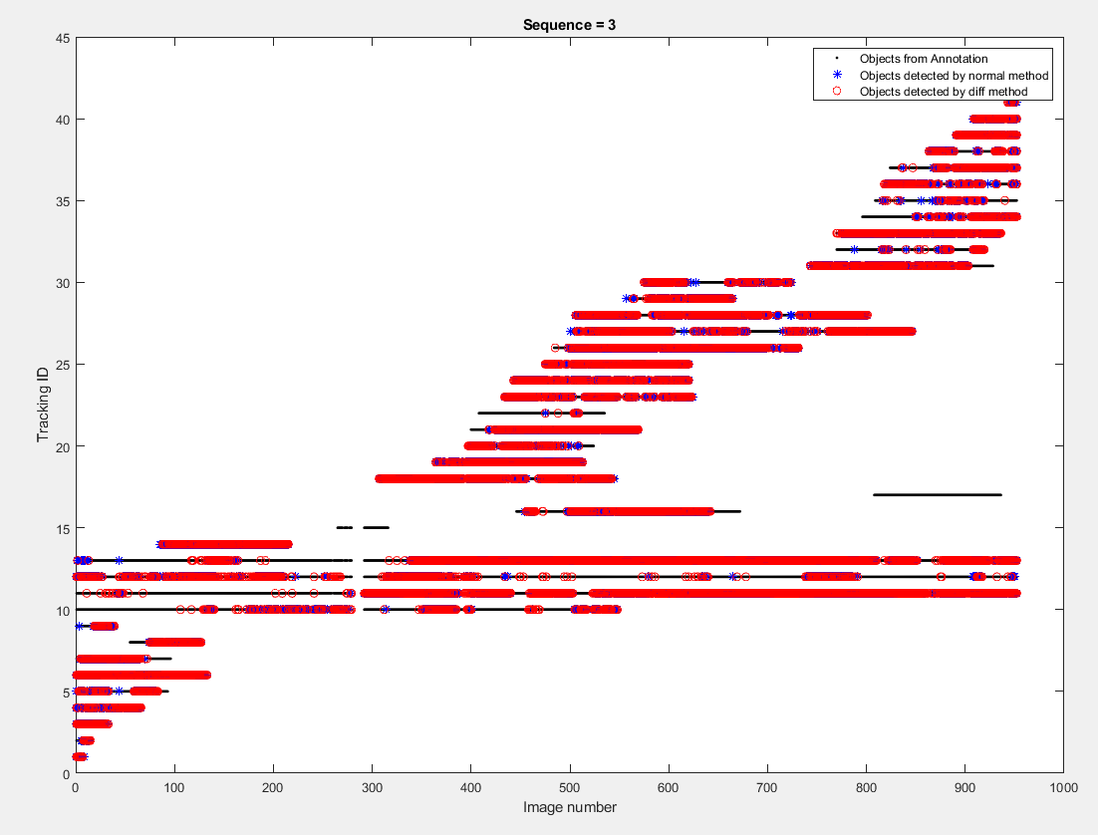
Video with multiple people moving
Detection of all the objects which were detected by the Normal Method

Slide 33
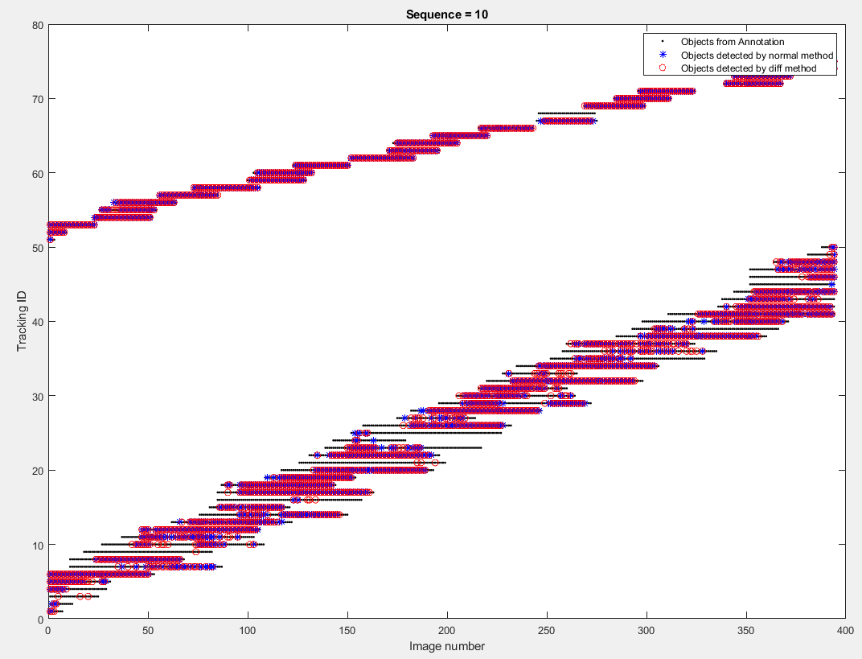
Multiple vehicles moving in a highway
Detection of all the objects which were detected by the Normal Method

Slide 34
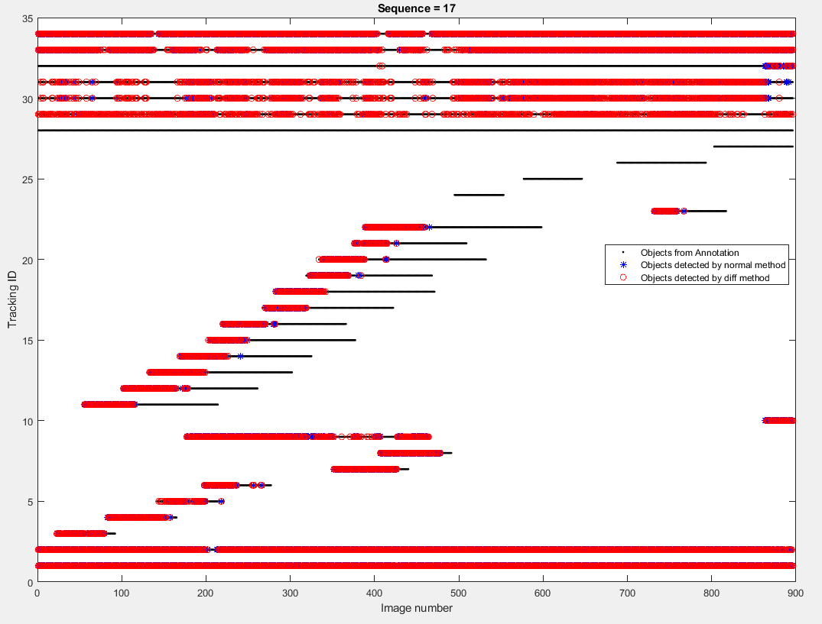
Cars at a junction stationary and moving
Detection of all the objects which were detected by the Normal Method

Slide 35
Discussion
Proposed method (diff method) was able to detect most of the objects detected by the normal method
Mean Average Precision (mAP) treats the video as collection of individual images
mAP value will be same either the method detects a given object in the first half of the video or the second half of the video
mAP is not completely capturing the requirement of the application
  Need to capture whether an objected detected in each time frame
  Capturing the object earliest is more important capturing it every ware
Looking for a suitable matrix to represent the data more accurately

Slide 36
Objectives/Deliverables
Summary of upcoming milestones/deliverables and progress towards them
Review Time Frame: | No. | Objectives | Mid-term and final deliverables as checks for success
Mid Term (end of year 3) | 1 | chip demonstration of low-level scene analysis building blocks | design completion of integrated circuit performing feature extraction at 50 µW power (or lower) at VGA resolution, 5fps frame rate (towards complete demonstration/testing deliverable at end of year 3)
 |  |  | design completion of saliency assessment engine with 80 µW power at VGA resolution, 5pfs frame rate (towards complete demonstration/testing deliverable at end of year 3)
 |  |  | design completion of imager with 100 µW power (VGA, 30 fps) at activity rate of average NeoVision2 benchmark (towards complete demonstration/testing deliverable at end of year 3)
 | 2 | deep learning model with reduced complexity | 1,000X reduced size with <2% accuracy degradation in object and human detection, compared to deep learning network with best-in-class accuracy
Project Completion |  | system on chip demonstration of a complete cognitive camera | Integrated circuit performing image sensing and scene analysis with average power consumption in the mW range, including neural acceleration with maximum accuracy no lower than the best-in-class detection/classification algorithms minus 5-10% (indoor, 500-lux lighting, max. 20 people)

Slide 37
Objectives/Deliverables
Summary of upcoming milestones/deliverables and progress towards them

Slide 38
Visibility
Summary of Project-Tracking_Template.xlsx
  list of items in “Public materials” sheet
  KEYNOTE: Widely-Adaptive Intelligent&Connected Systems for Nearly-Unstoppable Operation under Highly Uncertain Power Availability – keynote speech at the IEEE ICCE 2021 conference, Jan 13, 2021, Phu Quoc Island (Vietnam)
  KEYNOTE: From Less Batteries to Battery-Less: Enabling A Greener World through Ultra-Wide Power-Performance Adaptation down to pWs – keynote speech at the IEEE WispNet 2020 conference, June 20, 2020, Chennai (India)
  KEYNOTE: Survival of the fittest: circuits and architectures for computation with ultra-wide power-performance adaptation beyond voltage scaling – keynote speech at the IEEE S3S 2019 conference, Oct 16, 2019, San Jose (USA)
  KEYNOTE: Survival of the fittest: circuits and architectures with wide power-performance adaptation – Beyond voltage scaling and down to pWs – keynote speech at the IEEE MCSoC 2019 conference, Oct 1, 2019, Singapore
  KEYNOTE: Survival of the fittest: circuits and architectures with wide power-performance adaptation beyond voltage scaling – keynote speech at the IEEE SOCC 2019 conference, Sept 3, 2019, Singapore

Slide 39
Research Staff
Current research staff (PhD, PostDoc, Research Engineers, etc.)
  Karim Ali Abdeltawwab AHMED (RF)
  Udara Samurdhi Harshanga KALINGAGE
  Sayan Kumar (PhD)
Past research staff (PhD, PostDoc, Research Engineers, etc.)
  list of Past Headcount in “Expenditures” sheet in “Project-Tracking_Template.xlsx”

Slide 40
Publications
List of Papers published in International Journals in “Evidence” sheet in “Project-Tracking_Template.xlsx”
  S. Jain, L. Lin, M. Alioto, Adaptive Digital Circuits for Power-Performance Range beyond Wide Voltage Scaling, Springer, 2020
  S. Jain, L. Longyang, M. Alioto, “Automated Design of Reconfigurable Micro-Architectures for Accelerators under Wide Voltage Scaling,” accepted to IEEE Trans. on VLSI Systems
  O. Aiello, P. Crovetti, M. Alioto, “Fully Synthesizable Low-Area Analogue-to-Digital Converters with Minimal Design Effort Based on the Dyadic Digital Pulse Modulation,” accepted to IEEE Access
  A. Alvarez, G. Ponnusamy, M. Alioto, “Energy-Quality Scalable Memory-Frugal Feature Extraction for Always-On Deep Sub-mW Distributed Vision,” IEEE Access, vol. 8, pp. 18951-18961, Jan. 2020
  Lin, S. Jain, M. Alioto, “Sub-nW Microcontroller with Dual-Mode Logic and Self-startup for Battery-Indifferent Sensor Nodes,” accepted to IEEE JSSC
  S. Jain, L. Lin, M. Alioto, “Processor Energy-Performance Range Extension Beyond Voltage Scaling via Drop-In Methodologies,” accepted to IEEE Journal of Solid-State Circuits (invited)

Slide 41
Publications
List of Presentations at International Conferences in “Evidence” sheet in “Project-Tracking_Template.xlsx”
  S. Jain, L. Longyang, M. Alioto, “Low-Overhead Drop-In Techniques to Extend the Energy-Performance Tradeoff in Microcontrollers Beyond VDD Scaling,” in Proc. of ASSCC 2019, pp. 125-129, Macau (China), Nov. 2019
  O. Aiello, P. Crovetti, A. Sharma, M. Alioto, “Fully-Synthesizable Current-Input ADCs for Ultra-Low Area and Minimal Design Effort,” accepted to ICECS 2019 (best paper award)
  J. H. Teo, K. Ali, S. Sarkar, M. Alioto, “Dual-Mode Clock Gating and Comparator Merging for 2.7X Energy/Conversion Reduction in SAR ADCs under Low-Activity Inputs,” submitted to ASSCC 2020
  S. Jain, L. Lin, M. Alioto, “Broad-Purpose In-Memory Computing for DSP and Machine Learning Workloads Based on Commercial Bitcell,” submitted to ASSCC 2020

Slide 42
Demos/Public Materials
List of No. of TRL 4 Prototypes in “Evidence” sheet in “Project-Tracking_Template.xlsx”
  Fully Synthesizable Low-Area Analogue-to-Digital Converters with Minimal Design Effort Based on the Dyadic Digital Pulse Modulation
  A Sub-mW, Sub-mm2 Energy-Quality Scalable Feature Extraction Accelerator for Distributed Vision in 40nm
  Sub-nW Microcontroller with Dual-Mode Logic and Self-startup for Battery-Indifferent Sensor Nodes

Slide 43
Demos/Public Materials
Links to public materials (e.g., GitHub): … (accumulate over the years, highlight new in red)
  RECMICRO scripts and design flows on GitHub: https://github.com/srbhjn459/RECMICRO

Slide 44
Talks, Videos, News, Press
List of items in “Project-Tracking_Template.xlsx”
  Press releases sheet
    first microprocessor with energy-performance tradeoff wider than voltage scaling for faster operation and longer battery life: http://news.nus.edu.sg/research/enabling-battery-powered-silicon-chips-work-faster-and-longer
    (media coverage on EurekAlert, Azo Materials, TechXplore, ScienMag…)

Slide 45
Talks, Videos, News, Press
    novel class of data converters that can be designed with fully-automated digital design flows for design turnaround time down to a few hours instead of months: https://www.eng.nus.edu.sg/ece/news/nus-innovation-paves-the-way-for-sensor-interfaces-that-are-30-times-smaller/
    (media coverage on ScienceDaily, TechXplore, TechBallad, Semiconductor Engineering, Embedded Conference Finland…)
    NUS engineers quintuple the efficiency of moving data bits in silicon chips for artificial intelligence applications:
    http://news.nus.edu.sg/research/five-times-more- efficient-data-transfer
    (media coverage on Mirage News, HPCWire, EurekAlert, Tech Xplore, The National Tribune…)

Slide 46
Talks, Videos, News, Press
  Talks
    (KEYNOTE) Widely-Adaptive Intelligent&Connected Systems for Nearly-Unstoppable Operation under Highly Uncertain Power Availability – keynote speech at the IEEE ICCE 2021 conference, Jan 13, 2021, Phu Quoc Island (Vietnam)
    (KEYNOTE) Survival of the fittest: circuits and architectures for computation with ultra-wide power-performance adaptation beyond voltage scaling – keynote speech at the IEEE S3S 2019 conference, Oct 16, 2019, San Jose (USA)
    (KEYNOTE) Survival of the fittest: circuits and architectures with wide power-performance adaptation – Beyond voltage scaling and down to pWs – keynote speech at the IEEE MCSoC 2019 conference, Oct 1, 2019, Singapore

Slide 47
Talks, Videos, News, Press
    (KEYNOTE) Survival of the fittest: circuits and architectures with wide power-performance adaptation beyond voltage scaling – keynote speech at the IEEE SOCC 2019 conference, Sept 3, 2019, Singapore
    (KEYNOTE) Energy-Quality Scalable Integrated Systems - Preserving Energy Downscaling in the Decade Ahead – keynote speech at the IEEE SigTelCom 2019 conference, March 20, 2019, Hanoi (Vietnam)

Slide 48
Objectives/Deliverables
 |  | Year 1 |  |  |  | Year 2 |  |  |  | Year 3 |  |  |  | Year 4 |  |  |  | Year 5
 |  | Q1 | Q2 | Q3 | Q4 | Q1 | Q2 | Q3 | Q4 | Q1 | Q2 | Q3 | Q4 | Q1 | Q2 | Q3 | Q4 | Q1 | Q2 | Q3 | Q4
Sub-project 1 | System modeling, exploration, integration, demonstration
 | 1.1 System simulation/modeling framework |  |  |  |  |  |  |  | D1.1
 | 1.2 System on board (SoB) integration/characterization (round #1) |  |  |  |  |  |  |  |  |  |  |  | M1.2
 | 1.3 System on board (SoB) integration/characterization (round #2) |  |  |  |  |  |  |  |  |  |  |  |  |  |  |  | M1.3
 | 1.4 System on chip (SoC) partitioning, chip level simulation environment |  |  |  |  |  |  |  |  |  |  |  |  |  |  |  | M1.4
 | 1.5 System on chip (SoC) optimization and integration |  |  |  |  |  |  |  |  |  |  |  |  |  |  |  |  |  | D1.5
 | 1.6 SoC characterization and in-field validation |  |  |  |  |  |  |  |  |  |  |  |  |  |  |  |  |  |  |  | M1.6

Slide 49
Objectives/Deliverables
 |  | Year 1 |  |  |  | Year 2 |  |  |  | Year 3 |  |  |  | Year 4 |  |  |  | Year 5
 |  | Q1 | Q2 | Q3 | Q4 | Q1 | Q2 | Q3 | Q4 | Q1 | Q2 | Q3 | Q4 | Q1 | Q2 | Q3 | Q4 | Q1 | Q2 | Q3 | Q4
Sub-project 2 | Energy-centric circuit techniques and interaction at imager-sensemaking and wireless-sensemaking boundary
 | 2.1 Imager and transceiver architectural exploration |  |  |  | D2.1
 | 2.2 Imager and transceiver tapeout and testing (round #1) |  |  |  |  |  |  |  | D2.2 |  |  |  | M2.2
 | 2.3 Imager and transceiver tapeout and testing (round #2) |  |  |  |  |  |  |  |  |  |  |  | D2.3 |  |  |  | M2.3
 | 2.4 Imager and transceiver final revision for SoC, silicon demonstration |  |  |  |  |  |  |  |  |  |  |  |  |  |  |  |  |  | M2.4
 | 2.5 Final characterization and validation |  |  |  |  |  |  |  |  |  |  |  |  |  |  |  |  |  |  |  | M2.5
 | 5.1 Internal review meetings with Advisory Board |  |  |  | M5.1 |  |  |  | M5.2 |  |  |  | M5.3 |  |  |  | M5.4 |  |  |  | M5.5
 | 5.2 Mid-term review |  |  |  |  |  |  |  |  |  |  |  | M5.6
 | 5.3 Final review |  |  |  |  |  |  |  |  |  |  |  |  |  |  |  |  |  |  |  | M5.7

Slide 50
Objectives/Deliverables
 |  | Year 1 |  |  |  | Year 2 |  |  |  | Year 3 |  |  |  | Year 4 |  |  |  | Year 5
 |  | Q1 | Q2 | Q3 | Q4 | Q1 | Q2 | Q3 | Q4 | Q1 | Q2 | Q3 | Q4 | Q1 | Q2 | Q3 | Q4 | Q1 | Q2 | Q3 | Q4
Sub-project 3 | Energy-centric machine learning-circuit co-design
 | 3.1 Deep learning model compression |  |  |  | M3.1a |  |  |  | M3.1b |  |  |  | D3.1
 | 3.2 Energy-aware deep learning network design and training |  |  |  |  |  |  |  |  |  |  |  | D3.2
 | 3.3 Saliency model |  |  |  |  |  |  |  |  |  |  |  | M3.3
 | 3.4 In-field model fine-tuning, validation and integration |  |  |  |  |  |  |  |  |  |  |  |  |  |  |  |  |  |  |  | M3.4

Slide 51
Objectives/Deliverables
 |  | Year 1 |  |  |  | Year 2 |  |  |  | Year 3 |  |  |  | Year 4 |  |  |  | Year 5
 |  | Q1 | Q2 | Q3 | Q4 | Q1 | Q2 | Q3 | Q4 | Q1 | Q2 | Q3 | Q4 | Q1 | Q2 | Q3 | Q4 | Q1 | Q2 | Q3 | Q4
Sub-project 4 | Irrelevant activity skipping/EQ-scalable sensemaking circuits/architectures
 | 4.1 Activity skipping architectures/circuits |  |  |  |  |  |  |  |  |  |  |  | M4.1
 | 4.2 EQ-scalable architectures/circuits |  |  |  |  |  |  |  |  |  |  |  | M4.2
 | 4.3 Feature extraction, novelty assessment, deep learning, SRAM tapeout and testing (round #1) |  |  |  |  |  |  |  | D4.3 |  |  |  | M4.3
 | 4.4 Feature extraction, novelty assessment, deep learning, SRAM tapeout and testing (round #2) |  |  |  |  |  |  |  |  |  |  |  | D4.4 |  |  |  | M4.4
 | 4.5 Final characterization and validation |  |  |  |  |  |  |  |  |  |  |  |  |  |  |  |  |  |  |  | M4.4

Slide 52
Notes and Suggestions
Open discussion

Slide 53
Awards
List of External Awards for Research at International Level in “Evidence” sheet in “Project-Tracking_Template.xlsx”
  … (accumulate over the years, highlight new in red)

Slide 54
Patents
List of Patents Disclosures/Filed/Granted/Commercialized in “Evidence” sheet in “Project-Tracking_Template.xlsx”
  Invention disclosures: … (accumulate over the years, highlight new in red)
  Patents filed: … (accumulate over the years, highlight new in red)
  Patents granted: … (accumulate over the years, highlight new in red)
  Patents commercialized: … (accumulate over the years, highlight new in red)

