Slide 1








: Energy-Autonomous
Always-On Cognitive & Attentive Cameras for Distributed Real-Time Vision with milliWatt Power Consumption
C gniVisi n
Quarterly meeting: April 15, 2020
Prof. Massimo Alioto

Slide 2
Outline
Research Progress
Objectives/Deliverables
Visibility
Research Staff
Publications
Awards
Patents
Demos/Public Materials
Talks, Videos, News, Press
Notes and Suggestions

Slide 3


: Energy-Autonomous
Always-On Cognitive & Attentive Cameras for Distributed Real-Time Vision with milliWatt Power Consumption
C gniVisi n
Quarterly meeting: (15/04/2020)
Japesh Vohra

Slide 4
Outline
In-Pixel Saliency Detection
  Proposed Pixel Structure
  Global Readout
  Tiling (Spatial Averaging)
  Background Subtraction
  Background Update
  Image Closing
SAR ADC Readout
  static predictive ADC

Slide 5
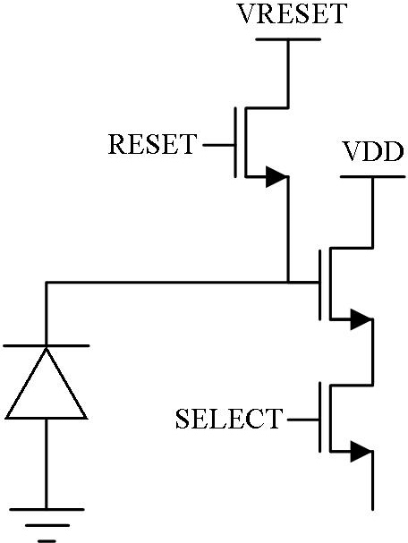
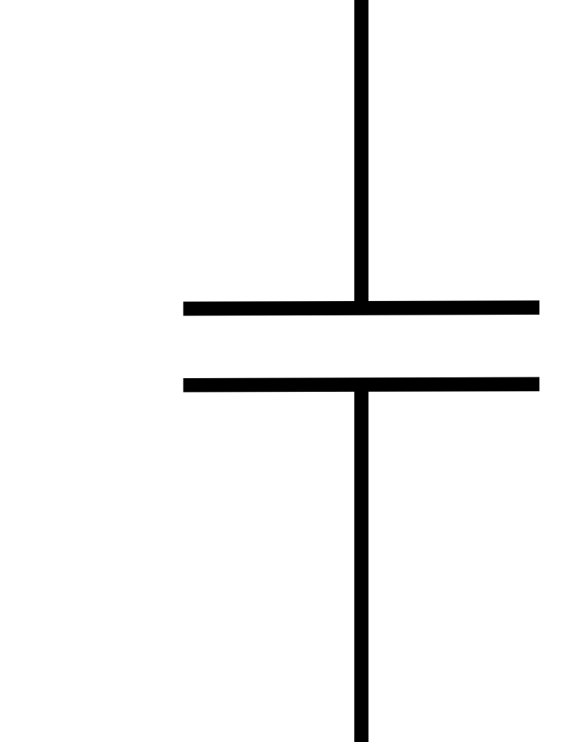
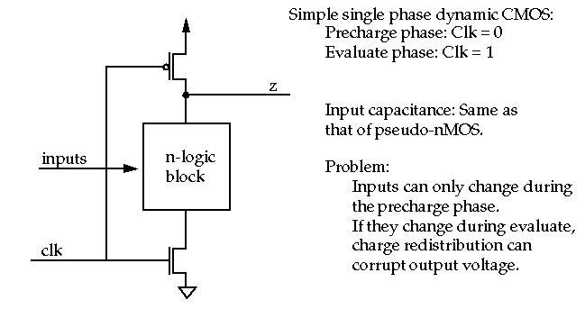
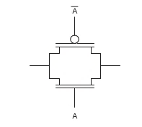

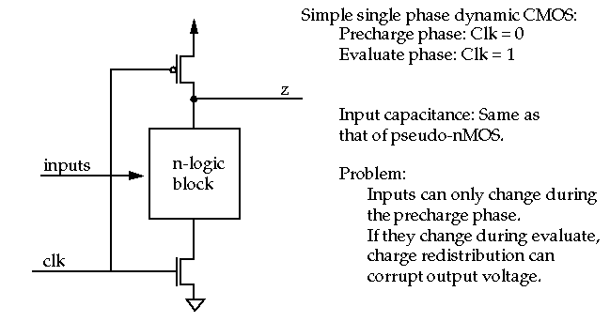
Research Progress
Proposed Pixel Structure
Pixel Structure
Cback
Csample
3T- pixel architecture is modified to store in-pixel sample and background voltages

Slide 6
Research Progress
Global pixel readout
T11
T12
T13
T1N
T21
T22
T23
T2N
T31
T32
T33
T3N
Global Shutter is used for pixel readout for saliency detection in a frame

Slide 7
Research Progress
Tiling (Spatial Averaging)
T11
T12
T13
T1N
T21
T22
T23
T2N
T31
T32
T33
T3N
Tiling (Spatial Averaging) is used to subsample the image before background subtraction to limit the number of comparisons as well as to limit the effect of noise.

Slide 8
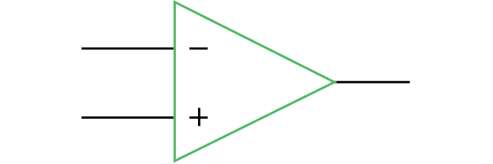

Research Progress
Background Subtraction
Pixel Structure
Cback
+δ
-δ
Csample
Current sample is compared with a long-term average (background) to determine change beyond a threshold.

Slide 9
Research Progress
Background Update
Pixel Structure
Cback
Csample
Long-term average (background) value is updated to keep track of the changing background. Background update rate can be adjusted dynamically.
$$V_{background}(i)= α∗V_{background}(i−1)+(1−α)∗V_{sample}(i)$$

Slide 10


Research Progress
Morphological Image Closing
(A) Original Image
(B) After Closing
Figure: Effect of image closing shown in (A) Original Image and (B) After Closing
Morphological Image Closing is performed on initial saliency values detected by background subtraction to improve the performance of saliency detection.
It closes the holes within detected salient tiles while keeping the initial region sizes. The image closing window size can be adjusted dynamically.
Source : https://homepages.inf.ed.ac.uk/rbf/HIPR2/close.htm

Slide 11

Imager-Pixel and readout circuit design
C gniVisi n
Quarterly meeting: (15.04.2020)
Udara Samurdhi Harshanga Kalingage

Slide 12
Outline
Circuit overview
Pixel Design-Objectives
Pixel Sub-arrays
Simulation Results for Pixels
Simulation Results for CDS Circuit

Slide 13
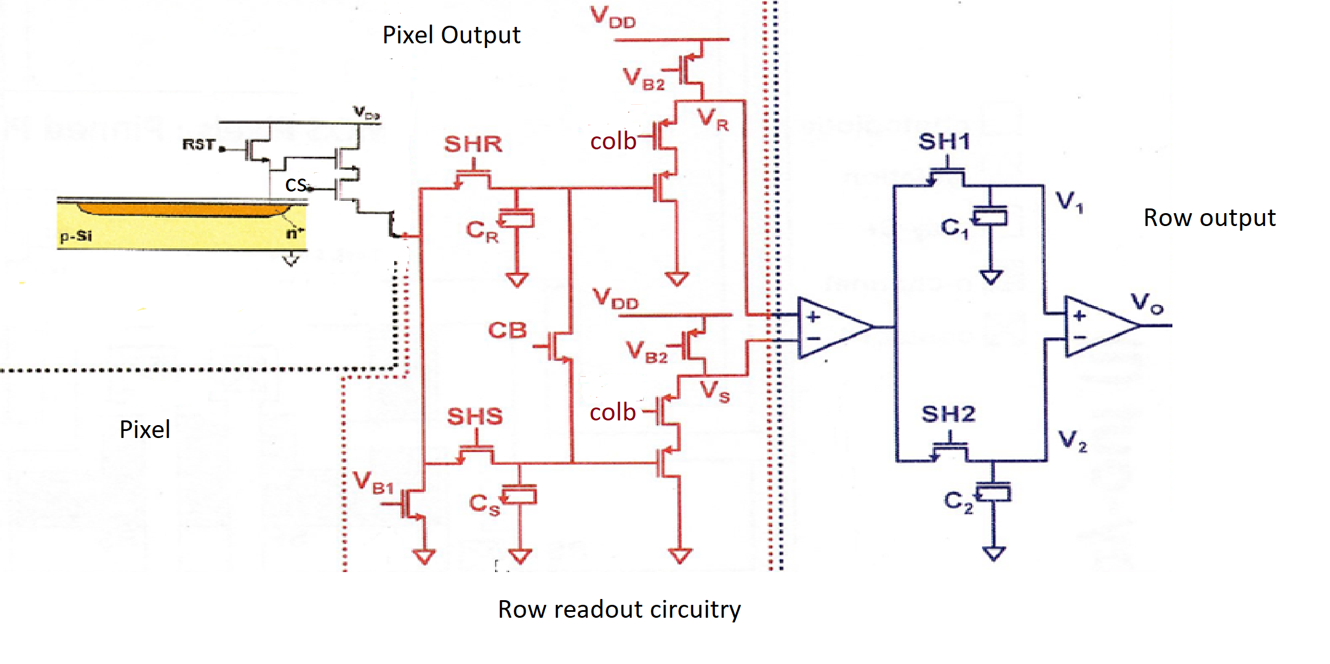
Circuit Overview
CDS output
Fig1: Pixel and the readout circuitry

Slide 14
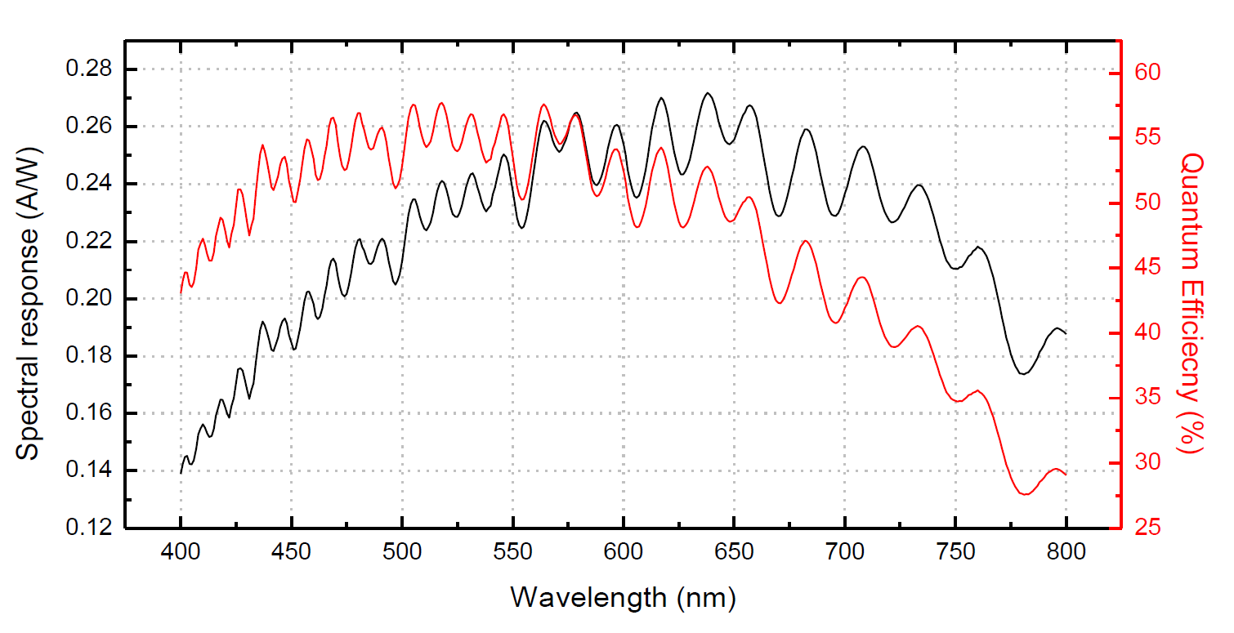
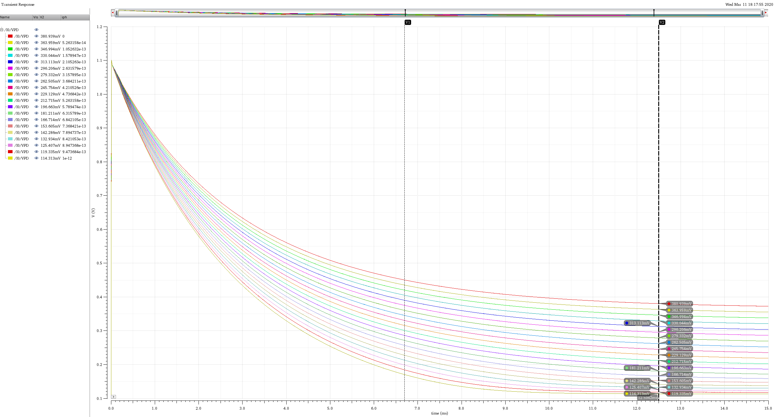
Pixel Design - Objectives
Pixel pitch < 5µm
Design of a pixel with reasonable spectral responsivity in TSMC 40nm standard CMOS process
Signal range > 600mV at the pixel output
Design and implementation of highly linear photodiode and source follower
Fig2: Spectral responsivity, QE VS wavelength
Fig3: Variation of dynamic range with integration
time

Slide 15
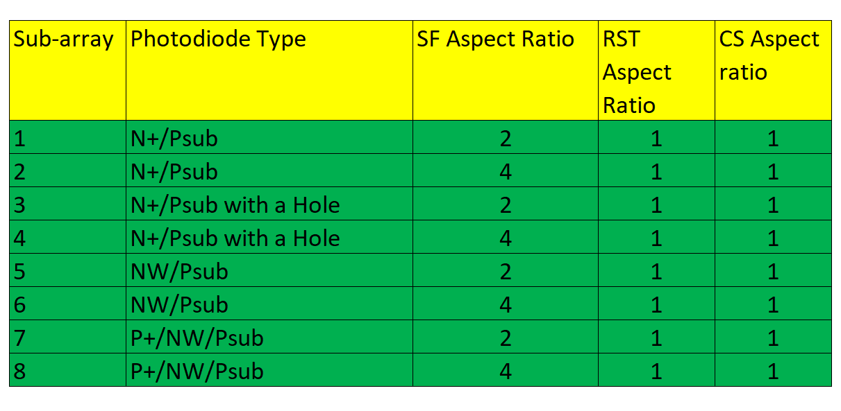
Pixel Sub-arrays
Table1: Sub-arrays
Photodiode type selected based on the area/cap ratio of the diodes tested
  NW/Psub Highest
  N+/psub Moderate(8% less)
  P+/NW/Psub Moderate
Structures with holes are added to test the improvement of QE at shorter wavelength
Maximum Aspect ratio for source follower transistor is double the minimum size (2*320nm/270nm) to maintain a pitch < 5µm and maximum fill factor

Slide 16
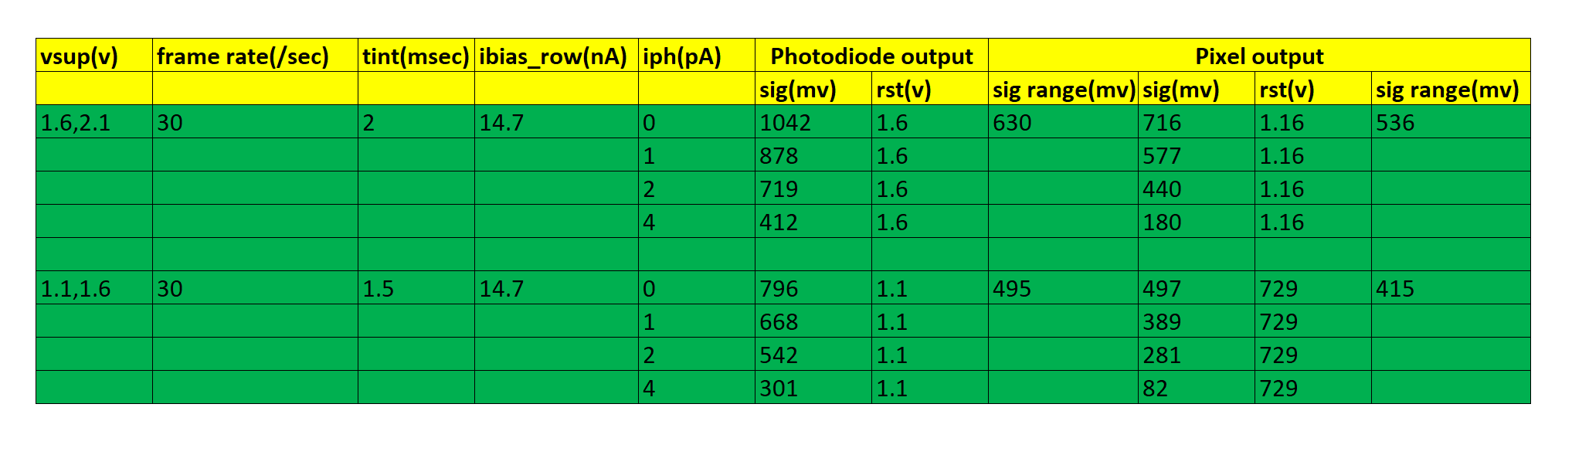
Simulation Results for Pixel
The signal range vary with the supply voltage, and reset pulse amplitude
Overcast day i.e. 1000 Lux generate 1pA photocurrent
The integration time is limited by the minimum voltage for which the source follower input - output relationship is linear
Lower integration time -> lower signal range
Table2: Signal range

Slide 17
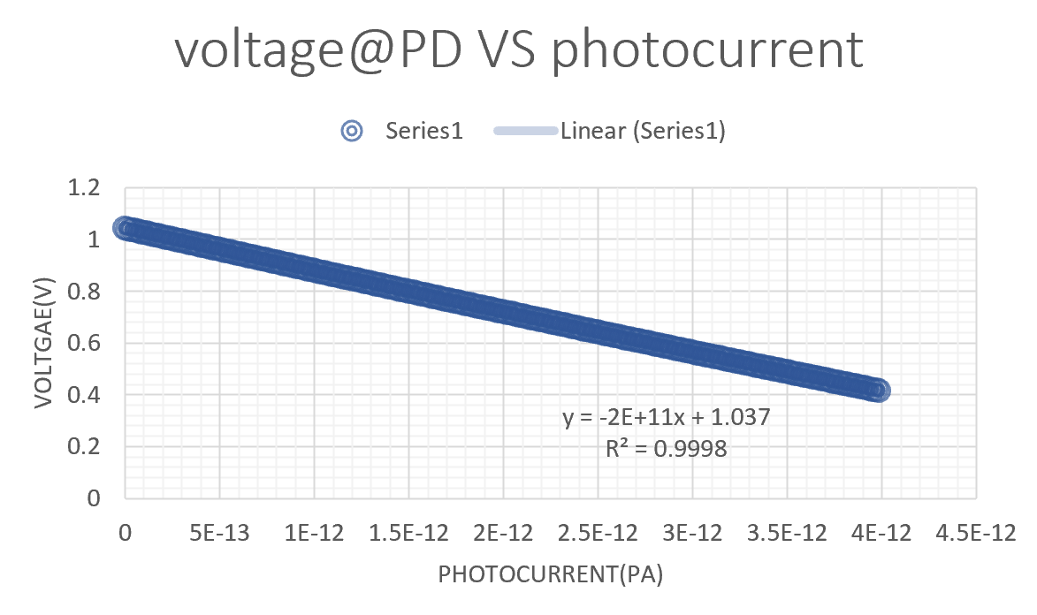
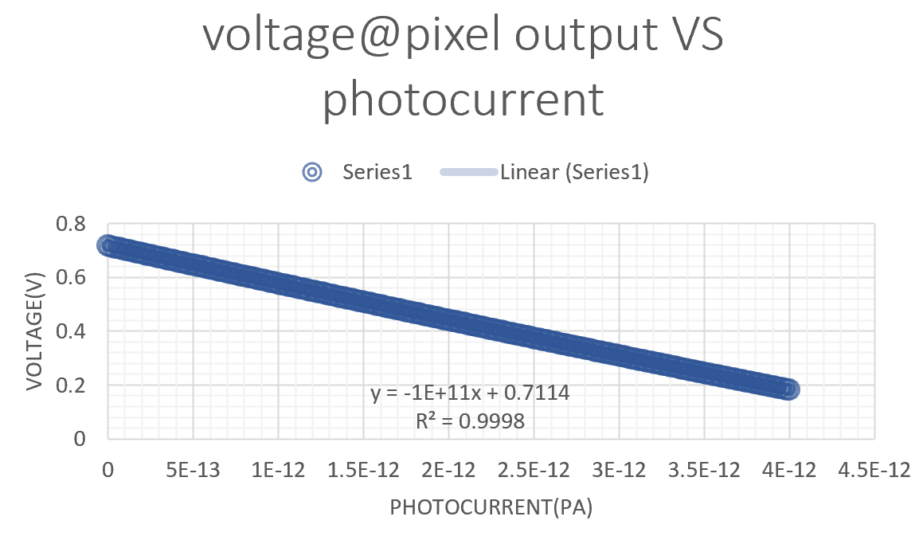
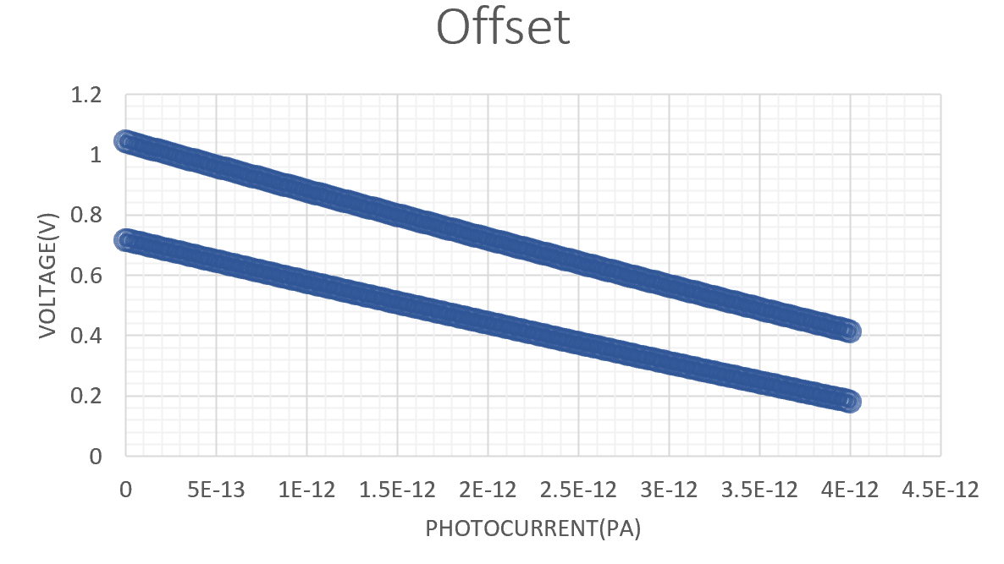
Simulation Results for Pixel
Fig4
Fig5
Fig6
There is a 200mV offset

Slide 18
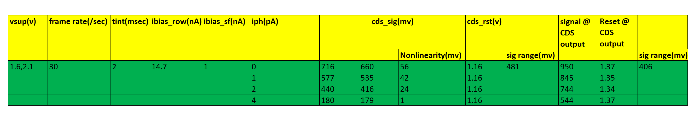
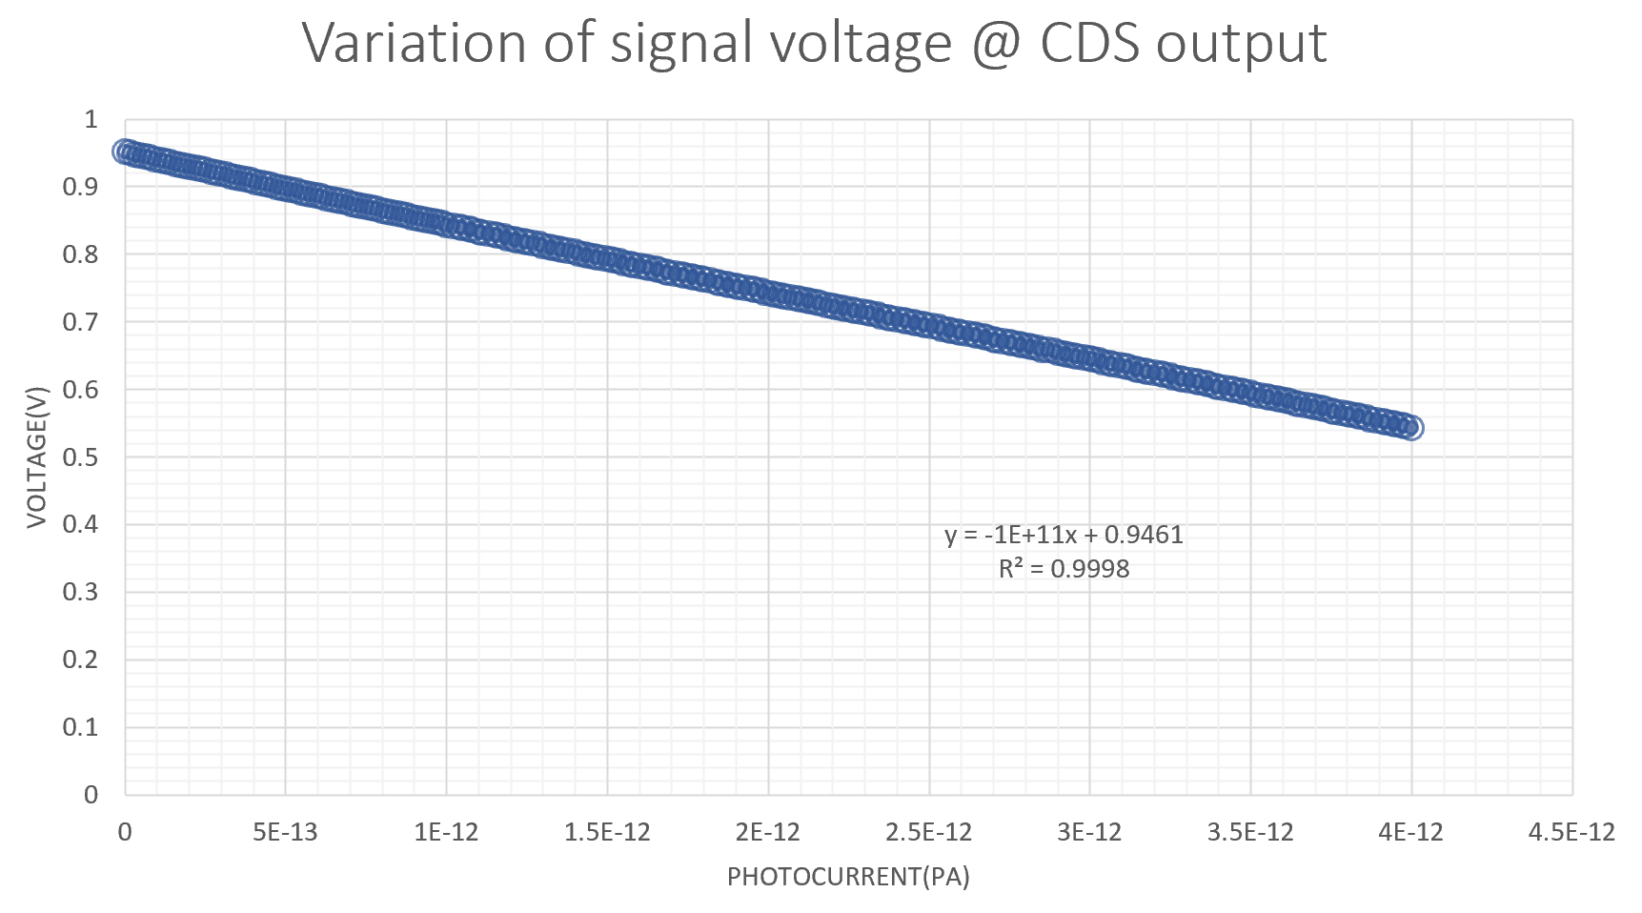
Simulation Results for CDS Circuit
Nonlinearity due to the charge injection is reduced by
  Adding a dummy switch and tuning its width to get to get the lowest charge injection
  Varying the size of the capacitor Cs
Table3: Non-linearity at the output of the CDS circuit
Fig7

Slide 19
Novelty Assessment
C gniVisi n
Research Attachment 2: 14/04/2020
Sayan Kumar

Slide 20
Outline
Why Novelty Assessment
ORB: Failure Analysis
Alternative Approaches
Current Method
Future Work

Slide 21
Why Novelty Assessment
This project is about finding novel (which are new in the frame) features between i^{th} frame and (i+1)^{th} frame.
From the system perspective it may look like as follows-
This simple technique may lead to reducing the energy consumption of the subsequent stages by order of magnitude.
Image Sensor
ADC
Novel Object Detector
CNN Accelerator
Novel Location
Detected Object
My Scope of Work

Slide 22
ORB: Failure Analysis

Slide 23
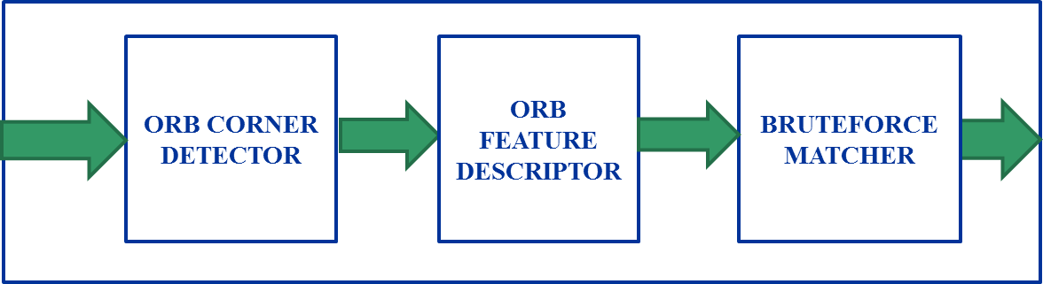
ORB Feature Extraction
Any Feature extractor has three main component- Keypoint Detection, Keypoint Descriptor and Feature Matching.
ORB is based on FAST keypoint detector[2] and BRIEF descriptor[3].
Only Difference is with both FAST and BRIEF, an extra orientation component is added in ORB.[1]
[1] E. Rublee, V. Rabaud, K. Konolige, "ORB: An efficient alternative to SIFT or SURF", Computer Vision and 2011 IEEE International Conference, pp 2564-2571, Nov 2011
[2] E. Rosten, R. Porter, and T. Drummond, “FASTER and better: A machine learning approach to corner detection,” IEEE Trans. Pattern Anal. Mach. Intell., vol. 32, no. 1, pp. 105–119, Jan. 2010
[3] M. Calonder, V. Lepetit, C. Strecha, and P. Fua, “BRIEF: Binary robust independent elementary features,” in Proc. Eur. Conf. Comput. Vision, May 2010, pp. 778–792
[4] Anastacia B. Alvarez ; Gopalakrishnan Ponnusamy ; Massimo Alioto “EQSCALE: Energy-quality scalable feature extraction engine for Sub-mW real-time video processing with 0.55 mm2 area in 40nm CMOS”
[5] Martin A. Fischler & Robert C. Bolles (June 1981). "Random Sample Consensus: A Paradigm for Model Fitting with Applications to Image Analysis and Automated Cartography" Comm. ACM. 24 (6): 381–395

Slide 24
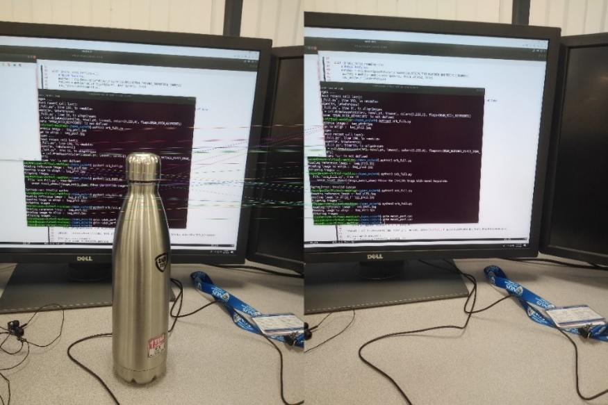
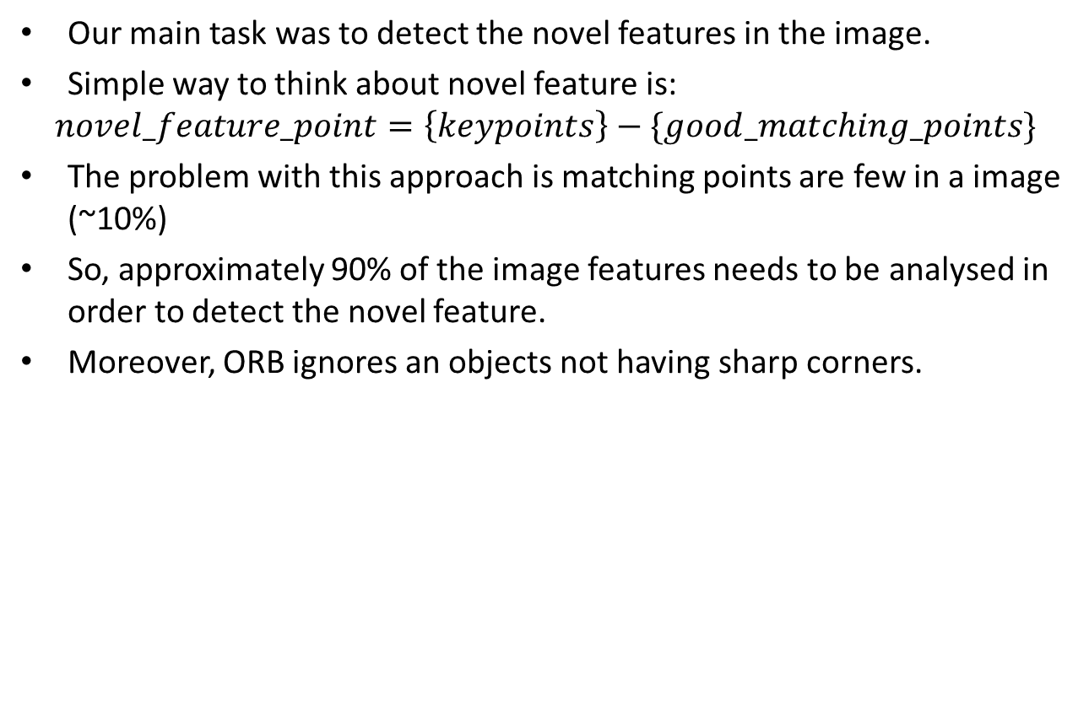
ORB Failure Analysis
Our main task was to detect the novel features in the image.
Simple way to think about novel feature is:
$$novel_feature_point=\left\{keypoints\right\}−\{good_matching_points\}$$
The problem with this approach is matching points are few in a image (~10%)
So, approximately 90% of the image features needs to be analysed in order to detect the novel feature.
Moreover, ORB ignores an objects not having sharp corners.

Slide 25
Alternative Approaches

Slide 26
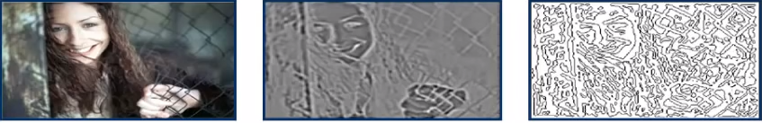
Passing Compressed Image
It is enough if we can pass the texture of the image instead of an image.
Is it okay, we will pass the image texture to CNN. We need to evaluate it. If we can, there will be great level of sparsity in the input. Thus, computation can be decreased to a great level.
Texture should be taken in the difference image to save additional computation.
CNN accuracy will be hit by this method.

Slide 27
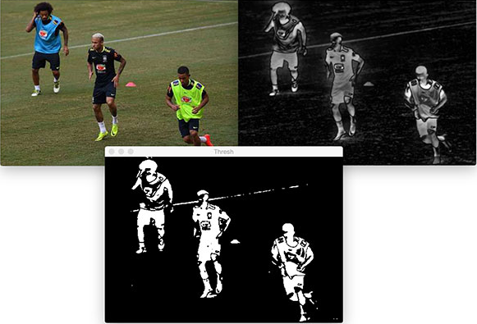
Saliency Pre-processor
Saliency Detection is already there in the Analog domain.
Saliency Pre-processor along with Novelty Detection will further decrease the amount of computation and opens door for other approaches.

Slide 28
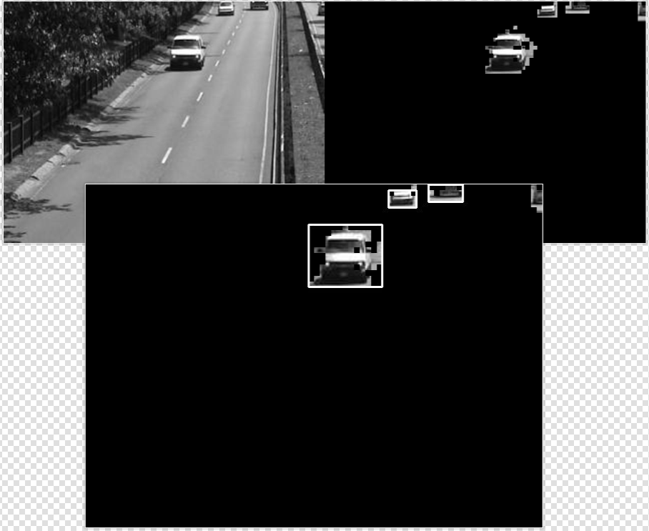

Finding Cluster : Adaptive Blob Detection
Blobs and corresponding parameters should be adaptive to image cluster’s size.
Pros: Simpler to implement, minimal computation, minimal latency(NxM cycle), easier to use with centroid tracking technique.
Cons: Multiple Blob for single object.

Slide 29
Other Approaches
Harr- Cascades:
1. Good for pre-trained feature detection but will not be suitable for similarity matching in subsequent frames.
2. Involves Convolution Operation, so more power hungry.
Histogram of Gradient (HoG):
1. A feature extraction Algorithm.
2. Requires large memory thus more power.
3. Requires SVM support to work as object classifier

Slide 30
Current Method: Object Tracking Without Detecting.

Slide 31
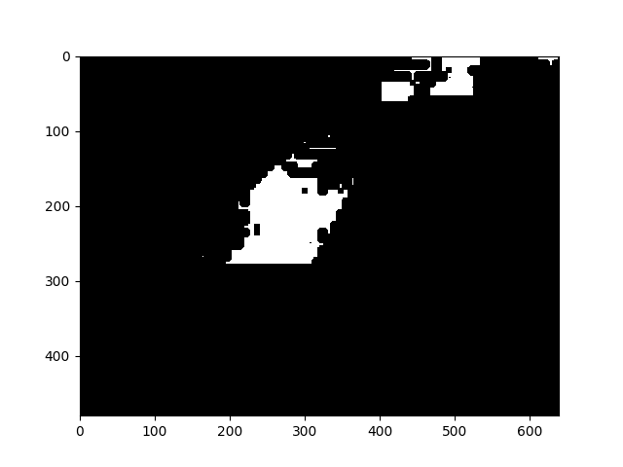
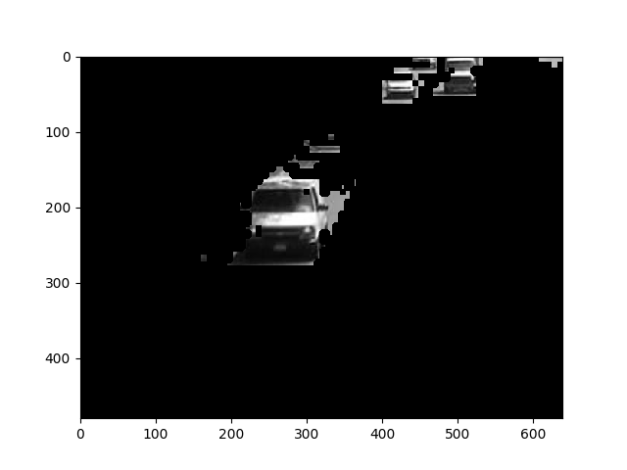
Contour Detection
Binarize the salient image and find contours.
Find the centre for each contour and filter the contour based on area.
The contours in binary image and salient image look like as follows.
We can determine the centroid and track them to find the novel image content.

Slide 32
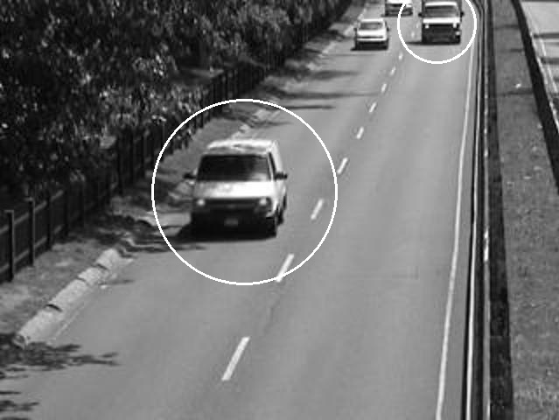
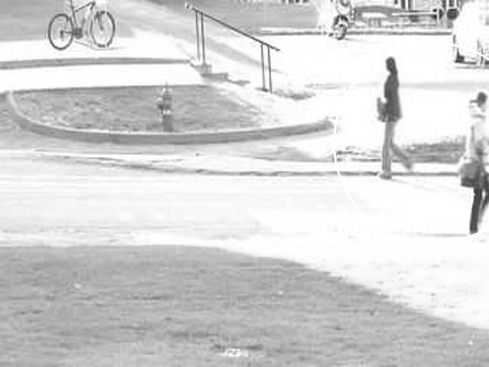
Contour Approach Contd.
The same images with multiple blob shown in the previous slides are shown below with contour approach.
Pros: No Multiple Blob for a single contour, simpler to implement, reliable, 10x data reduction for subsequent stages.
Cons: Multiple memory access, more power w.r.t adaptive blob approach.

Slide 33
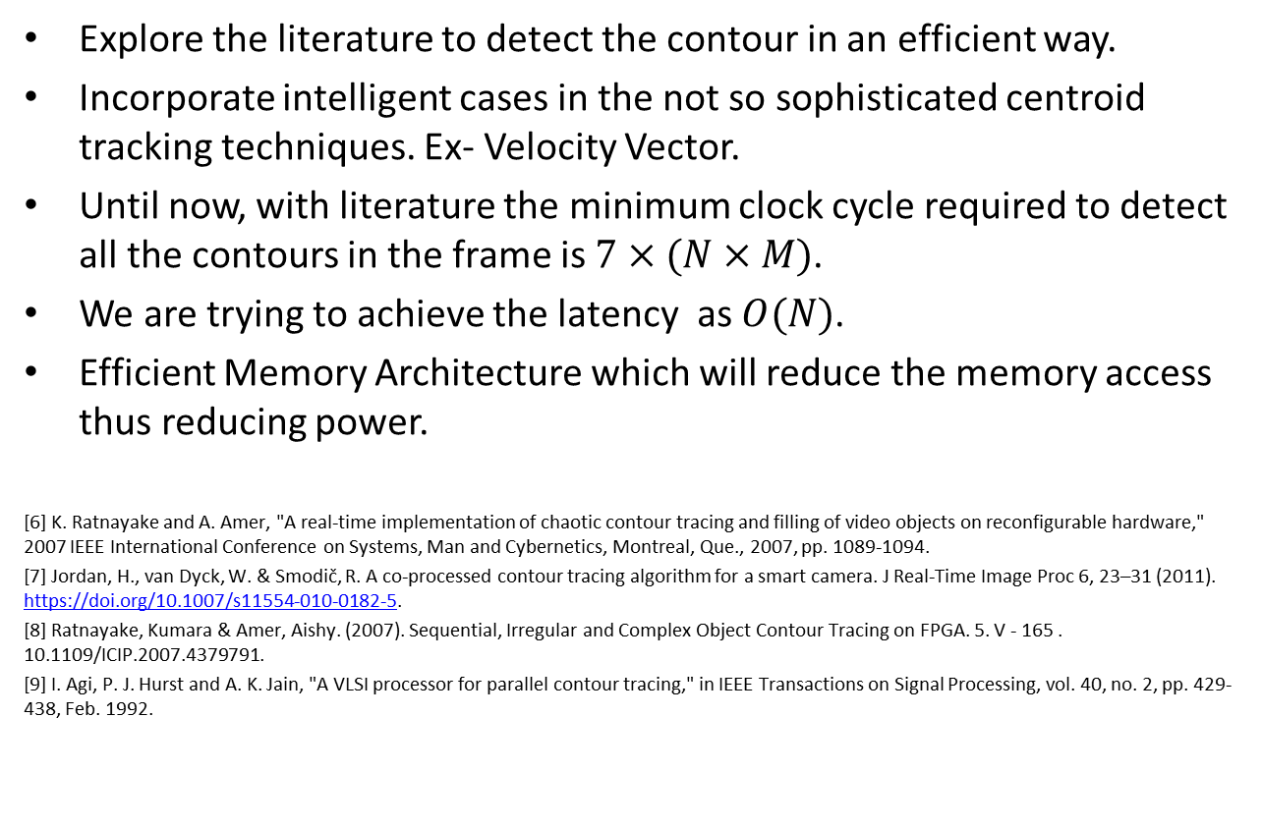
Future Work
Explore the literature to detect the contour in an efficient way.
Incorporate intelligent cases in the not so sophisticated centroid tracking techniques. Ex- Velocity Vector.
Until now, with literature the minimum clock cycle required to detect all the contours in the frame is $7×(N×M)$.
We are trying to achieve the latency as $O(N)$.
Efficient Memory Architecture which will reduce the memory access thus reducing power.
[6] K. Ratnayake and A. Amer, "A real-time implementation of chaotic contour tracing and filling of video objects on reconfigurable hardware," 2007 IEEE International Conference on Systems, Man and Cybernetics, Montreal, Que., 2007, pp. 1089-1094.
[7] Jordan, H., van Dyck, W. & Smodič, R. A co-processed contour tracing algorithm for a smart camera. J Real-Time Image Proc 6, 23–31 (2011). https://doi.org/10.1007/s11554-010-0182-5.
[8] Ratnayake, Kumara & Amer, Aishy. (2007). Sequential, Irregular and Complex Object Contour Tracing on FPGA. 5. V - 165 . 10.1109/ICIP.2007.4379791.
[9] I. Agi, P. J. Hurst and A. K. Jain, "A VLSI processor for parallel contour tracing," in IEEE Transactions on Signal Processing, vol. 40, no. 2, pp. 429-438, Feb. 1992.

Slide 34
: Energy-Autonomous
Always-On Cognitive & Attentive Cameras for Distributed Real-Time Vision with milliWatt Power Consumption
C gniVisi n
Quarterly meeting: April 15, 2020
Udari De Alwis

Slide 35
Outline
Methodology
Testing and Results
Discussion

Slide 36
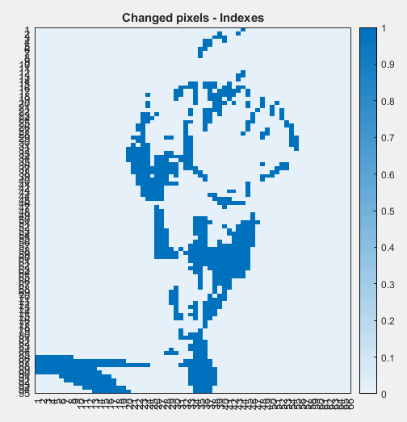
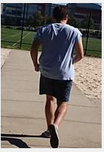
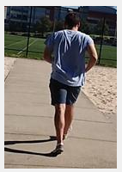
Methodology
In a video from a stationary camera, consecutive frames have more similarity (temporal correlation)
Detect the changed pixels
Calculate the convolution only for the changes
Perform this on all the layers
Frame 1
Frame 2

Slide 37

Methodology
Absolute difference between the current to the previous input to the layer w.r.t to a threshold
Compute the convolution to the difference and add back to create a full frame
Image n/ Activation n
Conv
Difference
Thresholding
Conv
Add
Relu
Image n+ m/ Activation n + m
Diff. Convolution block

Slide 38
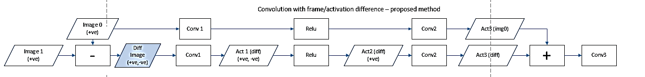
Methodology
Get the frame difference (diff frame) and process the diff frame along the network layers
Add the activation of the previous image after multiple layers
Accuracy decreases as we are skipping the non linear activations
Initially this concept was tested without retraining the networks

Slide 39
Methodology
Thresholding is done at diff frame to reduce the number of pixels
Full frame is updated in different intervals (update full frame after 5,10,15th frame)
Update the full frame in frame update rate
Thresholding for zero creations
If Diff < thre -> 0

Slide 40
Testing and Results
Image classification task
  Alexnet network retrained on the CIFAR10 dataset
  Youtube object dataset
  10 object classes containing between 9 and 24 videos for each classes
  Duration of each video varies between 30 seconds and 3 minutes.
Image detection task
  VGG16 based Single Shot Detector (SSD) network
  Stationary camera video CAMEL data set.
  The dataset consists of video sequences from still cameras 26 sequences with people, bicycles, four wheeled vehicles, motorcycles, and dogs.

Slide 41
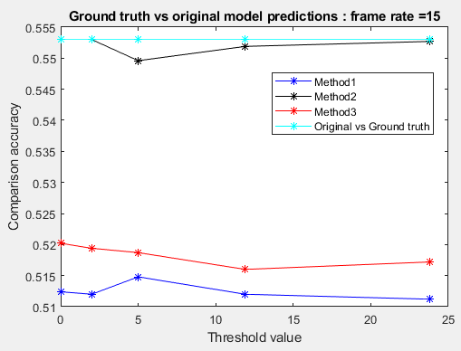
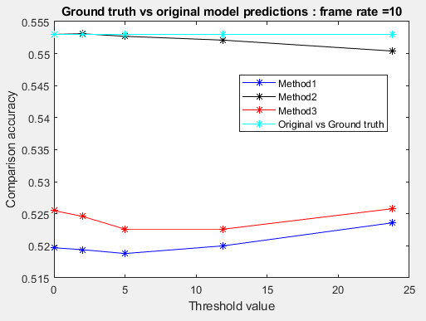
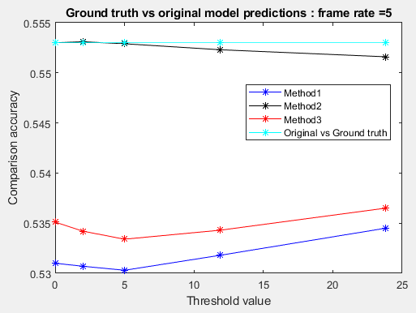
Object Classification task
Without diff method accuracy = 55.30% (ground truth accuracy)
With diff method accuracy = 51.5% - 53.5%
The lower accuracy of the ground truth might be a problem
Updating very 10th frame can become an optimal value when considering the accuracy and the computational complexity

Slide 42
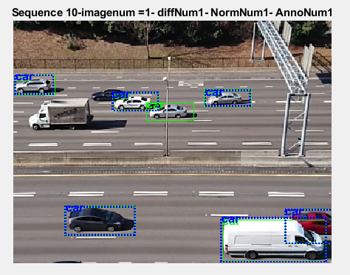
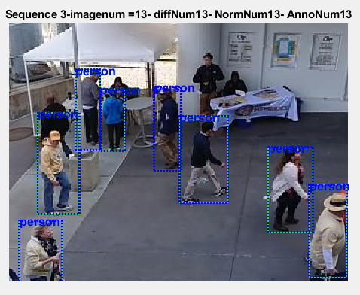
Object detection task
Average accuracy drop over the 18 video sequences
  3% for diff method
  1% for diff method with Leaky relu
Frame updating rate of 10 has been used in the experiment on the object detection task

Slide 43
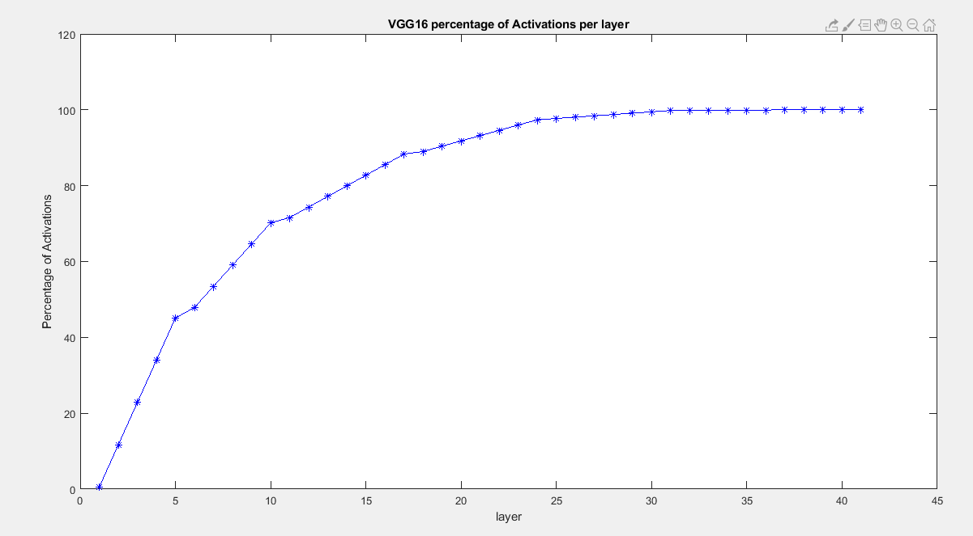
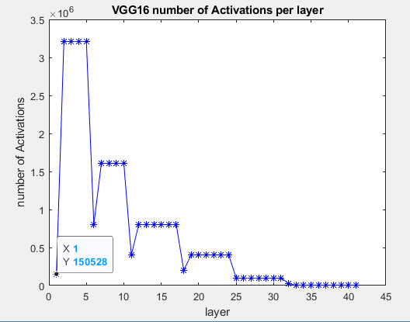
Discussion
How to increase accuracy when diff method is implemented in further layers.
Narrow down the problem to network with less layers. (Scaling down VGG for few classes)
Semantic Segmentation rather bounding box detection
Diff frame is sparse – replace convolution with Submanifold Sparse Convolutions, for build computational efficiency
Relu 1_2 – 45% of the activations in the network
Relu 1_2
Maxpool1

Slide 44
Research Progress
SAR ADC Readout
SAR ADC will be used to readout the pixels in salient tiles.
Image Data has a high amount of spatial correlation.
Previous pixel can be used to estimate the range of next pixel.
Static Predictive Approach
  Check whether previous M MSBs are common in an N-bit ADC
  If yes,
    Proceed with the conversion of the rest (N-M) bits
  If No,
    Proceed with the full N-bit conversion.

Slide 45
Objectives/Deliverables
Summary of upcoming milestones/deliverables and progress towards them
Review Time Frame: | No. | Objectives | Mid-term and final deliverables as checks for success
Mid Term (end of year 3) | 1 | chip demonstration of low-level scene analysis building blocks | design completion of integrated circuit performing feature extraction at 50 µW power (or lower) at VGA resolution, 5fps frame rate (towards complete demonstration/testing deliverable at end of year 3)
 |  |  | design completion of saliency assessment engine with 80 µW power at VGA resolution, 5pfs frame rate (towards complete demonstration/testing deliverable at end of year 3)
 |  |  | design completion of imager with 100 µW power (VGA, 30 fps) at activity rate of average NeoVision2 benchmark (towards complete demonstration/testing deliverable at end of year 3)
 | 2 | deep learning model with reduced complexity | 1,000X reduced size with <2% accuracy degradation in object and human detection, compared to deep learning network with best-in-class accuracy
Project Completion |  | system on chip demonstration of a complete cognitive camera | Integrated circuit performing image sensing and scene analysis with average power consumption in the mW range, including neural acceleration with maximum accuracy no lower than the best-in-class detection/classification algorithms minus 5-10% (indoor, 500-lux lighting, max. 20 people)

Slide 46
Objectives/Deliverables
Summary of upcoming milestones/deliverables and progress towards them

Slide 47
Visibility
Summary of Project-Tracking_Template.xlsx
  list of items in “Public materials” sheet
  From Less Batteries to Battery-Less: Enabling A Greener World through Ultra-Wide Power-Performance Adaptation down to pWs – keynote speech at the IEEE WispNet 2020 conference, June 20, 2020, Chennai (India)
  KEYNOTE: Survival of the fittest: circuits and architectures for computation with ultra-wide power-performance adaptation beyond voltage scaling – keynote speech at the IEEE S3S 2019 conference, Oct 16, 2019, San Jose (USA)
  KEYNOTE: Survival of the fittest: circuits and architectures with wide power-performance adaptation – Beyond voltage scaling and down to pWs – keynote speech at the IEEE MCSoC 2019 conference, Oct 1, 2019, Singapore
  KEYNOTE: Survival of the fittest: circuits and architectures with wide power-performance adaptation beyond voltage scaling – keynote speech at the IEEE SOCC 2019 conference, Sept 3, 2019, Singapore

Slide 48
Research Staff
Current research staff (PhD, PostDoc, Research Engineers, etc.)
  Karim Ali Abdeltawwab AHMED (RF)
  Udara Samurdhi Harshanga KALINGAGE, Thoithoi Salam Singh (RE)
  Sayan Kumar (PhD)
Past research staff (PhD, PostDoc, Research Engineers, etc.)
  list of Past Headcount in “Expenditures” sheet in “Project-Tracking_Template.xlsx”

Slide 49
Publications
List of Papers published in International Journals in “Evidence” sheet in “Project-Tracking_Template.xlsx”
  S. Jain, L. Lin, M. Alioto, Adaptive Digital Circuits for Power-Performance Range beyond Wide Voltage Scaling, Springer, 2020
  S. Jain, L. Longyang, M. Alioto, “Automated Design of Reconfigurable Micro-Architectures for Accelerators under Wide Voltage Scaling,” accepted to IEEE Trans. on VLSI Systems
  O. Aiello, P. Crovetti, M. Alioto, “Fully Synthesizable Low-Area Analogue-to-Digital Converters with Minimal Design Effort Based on the Dyadic Digital Pulse Modulation,” accepted to IEEE Access
  A. Alvarez, G. Ponnusamy, M. Alioto, “A Sub-mW, Sub-mm2 Energy-Quality Scalable Feature Extraction Accelerator for Distributed Vision in 40nm,” accepted to IEEE Access
  L. Lin, S. Jain, M. Alioto, “Sub-nW Microcontroller with Dual-Mode Logic and Self-startup for Battery-Indifferent Sensor Nodes,” submitted to IEEE JSSC

Slide 50
Publications
List of Presentations at International Conferences in “Evidence” sheet in “Project-Tracking_Template.xlsx”
  S. Jain, L. Longyang, M. Alioto, “Low-Overhead Drop-In Techniques to Extend the Energy-Performance Tradeoff in Microcontrollers Beyond VDD Scaling,” in Proc. of ASSCC 2019, pp. 125-129, Macau (China), Nov. 2019
  O. Aiello, P. Crovetti, A. Sharma, M. Alioto, “Fully-Synthesizable Current-Input ADCs for Ultra-Low Area and Minimal Design Effort,” accepted to ICECS 2019
  J. H. Teo, K. Ali, S. Sarkar, M. Alioto, “Dual-Mode Clock Gating and Comparator Merging for 2.7X Energy/Conversion Reduction in SAR ADCs under Low-Activity Inputs,” being submitted to ASSCC 2020
  S. Jain, L. Lin, M. Alioto, “Broad-Purpose In-Memory Computing for DSP and Machine Learning Workloads Based on Commercial Bitcell,” being submitted to ASSCC 2020

Slide 51
Demos/Public Materials
List of No. of TRL 4 Prototypes in “Evidence” sheet in “Project-Tracking_Template.xlsx”
  Fully Synthesizable Low-Area Analogue-to-Digital Converters with Minimal Design Effort Based on the Dyadic Digital Pulse Modulation
  A Sub-mW, Sub-mm2 Energy-Quality Scalable Feature Extraction Accelerator for Distributed Vision in 40nm
  Sub-nW Microcontroller with Dual-Mode Logic and Self-startup for Battery-Indifferent Sensor Nodes

Slide 52
Demos/Public Materials
Links to public materials (e.g., GitHub): … (accumulate over the years, highlight new in red)
  RECMICRO scripts and design flows on GitHub: https://github.com/srbhjn459/RECMICRO

Slide 53
Talks, Videos, News, Press
List of items in “Project-Tracking_Template.xlsx”
  Press releases sheet
    first microprocessor with energy-performance tradeoff wider than voltage scaling for faster operation and longer battery life: http://news.nus.edu.sg/research/enabling-battery-powered-silicon-chips-work-faster-and-longer
    (media coverage on EurekAlert, Azo Materials, TechXplore, ScienMag…)

Slide 54
Talks, Videos, News, Press
    novel class of data converters that can be designed with fully-automated digital design flows for design turnaround time down to a few hours instead of months: https://www.eng.nus.edu.sg/ece/news/nus-innovation-paves-the-way-for-sensor-interfaces-that-are-30-times-smaller/
    (media coverage on ScienceDaily, TechXplore, TechBallad, Semiconductor Engineering, Embedded Conference Finland…)

Slide 55
Talks, Videos, News, Press
  Talks
    (KEYNOTE) Survival of the fittest: circuits and architectures for computation with ultra-wide power-performance adaptation beyond voltage scaling – keynote speech at the IEEE S3S 2019 conference, Oct 16, 2019, San Jose (USA)
    (KEYNOTE) Survival of the fittest: circuits and architectures with wide power-performance adaptation – Beyond voltage scaling and down to pWs – keynote speech at the IEEE MCSoC 2019 conference, Oct 1, 2019, Singapore
    (KEYNOTE) Survival of the fittest: circuits and architectures with wide power-performance adaptation beyond voltage scaling – keynote speech at the IEEE SOCC 2019 conference, Sept 3, 2019, Singapore
    (KEYNOTE) Energy-Quality Scalable Integrated Systems - Preserving Energy Downscaling in the Decade Ahead – keynote speech at the IEEE SigTelCom 2019 conference, March 20, 2019, Hanoi (Vietnam)

Slide 56
Objectives/Deliverables
 |  | Year 1 |  |  |  | Year 2 |  |  |  | Year 3 |  |  |  | Year 4 |  |  |  | Year 5
 |  | Q1 | Q2 | Q3 | Q4 | Q1 | Q2 | Q3 | Q4 | Q1 | Q2 | Q3 | Q4 | Q1 | Q2 | Q3 | Q4 | Q1 | Q2 | Q3 | Q4
Sub-project 1 | System modeling, exploration, integration, demonstration
 | 1.1 System simulation/modeling framework |  |  |  |  |  |  |  | D1.1
 | 1.2 System on board (SoB) integration/characterization (round #1) |  |  |  |  |  |  |  |  |  |  |  | M1.2
 | 1.3 System on board (SoB) integration/characterization (round #2) |  |  |  |  |  |  |  |  |  |  |  |  |  |  |  | M1.3
 | 1.4 System on chip (SoC) partitioning, chip level simulation environment |  |  |  |  |  |  |  |  |  |  |  |  |  |  |  | M1.4
 | 1.5 System on chip (SoC) optimization and integration |  |  |  |  |  |  |  |  |  |  |  |  |  |  |  |  |  | D1.5
 | 1.6 SoC characterization and in-field validation |  |  |  |  |  |  |  |  |  |  |  |  |  |  |  |  |  |  |  | M1.6

Slide 57
Objectives/Deliverables
 |  | Year 1 |  |  |  | Year 2 |  |  |  | Year 3 |  |  |  | Year 4 |  |  |  | Year 5
 |  | Q1 | Q2 | Q3 | Q4 | Q1 | Q2 | Q3 | Q4 | Q1 | Q2 | Q3 | Q4 | Q1 | Q2 | Q3 | Q4 | Q1 | Q2 | Q3 | Q4
Sub-project 2 | Energy-centric circuit techniques and interaction at imager-sensemaking and wireless-sensemaking boundary
 | 2.1 Imager and transceiver architectural exploration |  |  |  | D2.1
 | 2.2 Imager and transceiver tapeout and testing (round #1) |  |  |  |  |  |  |  | D2.2 |  |  |  | M2.2
 | 2.3 Imager and transceiver tapeout and testing (round #2) |  |  |  |  |  |  |  |  |  |  |  | D2.3 |  |  |  | M2.3
 | 2.4 Imager and transceiver final revision for SoC, silicon demonstration |  |  |  |  |  |  |  |  |  |  |  |  |  |  |  |  |  | M2.4
 | 2.5 Final characterization and validation |  |  |  |  |  |  |  |  |  |  |  |  |  |  |  |  |  |  |  | M2.5
 | 5.1 Internal review meetings with Advisory Board |  |  |  | M5.1 |  |  |  | M5.2 |  |  |  | M5.3 |  |  |  | M5.4 |  |  |  | M5.5
 | 5.2 Mid-term review |  |  |  |  |  |  |  |  |  |  |  | M5.6
 | 5.3 Final review |  |  |  |  |  |  |  |  |  |  |  |  |  |  |  |  |  |  |  | M5.7

Slide 58
Objectives/Deliverables
 |  | Year 1 |  |  |  | Year 2 |  |  |  | Year 3 |  |  |  | Year 4 |  |  |  | Year 5
 |  | Q1 | Q2 | Q3 | Q4 | Q1 | Q2 | Q3 | Q4 | Q1 | Q2 | Q3 | Q4 | Q1 | Q2 | Q3 | Q4 | Q1 | Q2 | Q3 | Q4
Sub-project 3 | Energy-centric machine learning-circuit co-design
 | 3.1 Deep learning model compression |  |  |  | M3.1a |  |  |  | M3.1b |  |  |  | D3.1
 | 3.2 Energy-aware deep learning network design and training |  |  |  |  |  |  |  |  |  |  |  | D3.2
 | 3.3 Saliency model |  |  |  |  |  |  |  |  |  |  |  | M3.3
 | 3.4 In-field model fine-tuning, validation and integration |  |  |  |  |  |  |  |  |  |  |  |  |  |  |  |  |  |  |  | M3.4

Slide 59
Objectives/Deliverables
 |  | Year 1 |  |  |  | Year 2 |  |  |  | Year 3 |  |  |  | Year 4 |  |  |  | Year 5
 |  | Q1 | Q2 | Q3 | Q4 | Q1 | Q2 | Q3 | Q4 | Q1 | Q2 | Q3 | Q4 | Q1 | Q2 | Q3 | Q4 | Q1 | Q2 | Q3 | Q4
Sub-project 4 | Irrelevant activity skipping/EQ-scalable sensemaking circuits/architectures
 | 4.1 Activity skipping architectures/circuits |  |  |  |  |  |  |  |  |  |  |  | M4.1
 | 4.2 EQ-scalable architectures/circuits |  |  |  |  |  |  |  |  |  |  |  | M4.2
 | 4.3 Feature extraction, novelty assessment, deep learning, SRAM tapeout and testing (round #1) |  |  |  |  |  |  |  | D4.3 |  |  |  | M4.3
 | 4.4 Feature extraction, novelty assessment, deep learning, SRAM tapeout and testing (round #2) |  |  |  |  |  |  |  |  |  |  |  | D4.4 |  |  |  | M4.4
 | 4.5 Final characterization and validation |  |  |  |  |  |  |  |  |  |  |  |  |  |  |  |  |  |  |  | M4.4

Slide 60
Notes and Suggestions
Open discussion

Slide 61
Awards
List of External Awards for Research at International Level in “Evidence” sheet in “Project-Tracking_Template.xlsx”
  … (accumulate over the years, highlight new in red)

Slide 62
Patents
List of Patents Disclosures/Filed/Granted/Commercialized in “Evidence” sheet in “Project-Tracking_Template.xlsx”
  Invention disclosures: … (accumulate over the years, highlight new in red)
  Patents filed: … (accumulate over the years, highlight new in red)
  Patents granted: … (accumulate over the years, highlight new in red)
  Patents commercialized: … (accumulate over the years, highlight new in red)

