Slide 1








: Energy-Autonomous
Always-On Cognitive & Attentive Cameras for Distributed Real-Time Vision with milliWatt Power Consumption
C gniVisi n
Quarterly meeting: (date)
Prof. … (speaker)

Slide 2
Research Progress
MobileNet V2 is the current SOTA deep learning model for object recognition.
It relies on the inverted residual bottleneck (IRB) architecture design
Common belief behind IRB: (i) shortcut should be put between low-dim features; (ii) feature transformation should be applied to high-dim features.

Slide 3
Research Progress
Structure:
Pointwise convolution expand feature dimension
Depth-wise convolution at expanded feature space
Another pointwise convolution to reduce the feature dimension
Use linear activations
Advantages:
Depth-wise convolution at expanded feature dimension reduced computation cost and could potentially save the computation memory usage
linear activation reduces the information loss
Shortcut along bottleneck position to reduce elementwise operation
Add
3. Less elementwise
addition
1x1 conv, linear
2. Linear activation
3x3 Dwise, ReLU6
1.Dwise convolution
reduce FLOPs
1x1 Conv, ReLU6
Input
MobileNetV2 normal building block

Slide 4
Research Progress
Achievements:
72% top 1 classification accuracy on ImageNet with 3.4M number of parameters and 300M Madd
  Compared to ResNet50: 8x less parameter and computation cost
IRB used as basic block for most of modern SOTA models:
  EfficientNet, MobileNetV3, MixConv, etc.
  NAS search space: Proxyless NAS, MNasNet
Add
3. Less elementwise
addition
1x1 conv, linear
2. Linear activation
3x3 Dwise, ReLU6
1.Dwise convolution
reduce FLOPs
1x1 Conv, ReLU6
Input
MobileNetV2 normal building block

Slide 5
Research Progress
Three positions for connecting shortcut with high dimension feature space:
Setting 1: dimensional pointwise convolution outputs
Setting 2: high dimensional depth-wise convolution outputs
Setting 3: high dimensional depth-wise convolution outputs with linear activation
1x1 Conv,
Linear
3x3 Dwise, ReLU6
2
1x1 Conv,
ReLU6
1x1 Conv,
Linear
*rm denotes remove the ReLU activation layer after the corresponding 3x3 Dwise conv
3
3x3 Dwise, ReLU6
1
1x1 Conv,
ReLU6

Slide 6
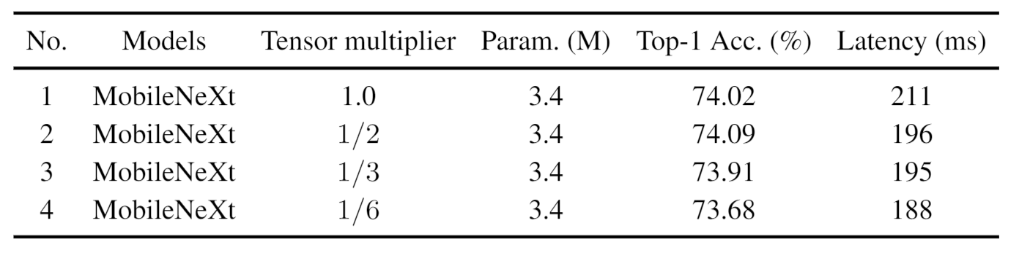
Research Progress
Use a partial number of channels of the input tensor as shortcut connection
Advantages: reduce element-wise summation
Out = x + input[:N/2]
Add
3x3 Dwise, linear
1x1 Conv,
ReLU6
Model performance with different number of identity channels
1x1 Conv,
Linear
3x3 Dwise, ReLU6
Input
Tensor Multiplier

Slide 7
Research Progress
A new architecture design
Structure:
Advocate bottleneck structure, apply shortcut connection along expanded feature dimension
Apply partial channels for the shortcut connection
Advantages:
Wider channels on the shortcut path speed up the convergence
Partial identity tensor channels reduce the elementwise operation
Achievements:
74.09% top 1 classification accuracy on ImageNet with 3.4M number of parameters and 300M Madd by direct replacing IRB in MobileNetV2 with half number of shortcut channels
Add
3x3 Dwise, linear
1x1 Conv,
ReLU6
1x1 Conv,
Linear
3x3 Dwise, ReLU6
Input
SGBlock structure

Slide 8
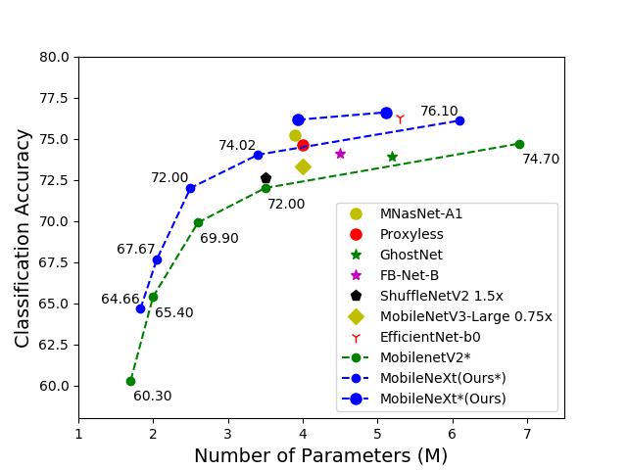
Research Progress
Performance comparison with SOTA
76.80
77.0
76.1
74.02
72.00
67.67
64.66

Slide 9
Visibility
Summary of Project-Tracking_Template.xlsx
  1 paper accepted by ECCV 2020 on efficient deep learning model design
  Invited talk at ECCV 2020 conference

Slide 10
Research Staff
Current research staff (PhD, PostDoc, Research Engineers, etc.)
  2 postdoctoral research fellow

Slide 11
Publications
List of Presentations at International Conferences in “Evidence” sheet in “Project-Tracking_Template.xlsx”
  Rethinking Bottleneck Structure for Efficient Mobile Network Design. ECCV 2020.

